Slide 1
“

Slide 2
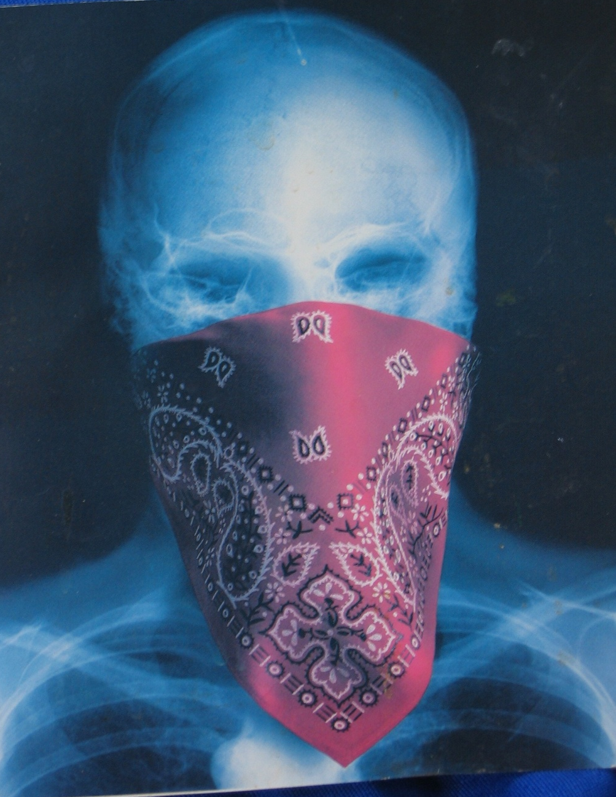
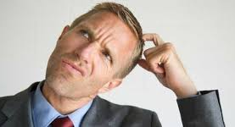
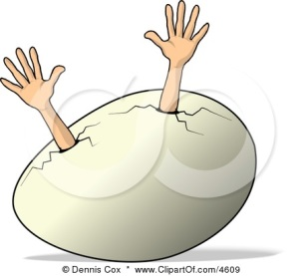
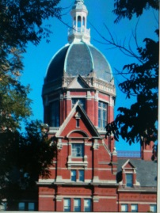
Radiology-Gross Anatomy Correlations
Donna Magid, MD, M.Ed
Professor, Radiology, Orthopaedic Surgery, and
Functional Anatomy & Evolution
Director/Developer, JHU SOM Horizontal Strand in Dxc. Imaging
“Hatch to Match”

Slide 3
IMAGING IS UBIQUITOUS
120 medical students/year….115 of which will NOT go into Radiology
HOWEVER!! Those 115….will have few (if any) patients over the next 40 years who elude diagnostic imaging.
Future physicians need to
understand how to most
effectively utilize imaging.
X

Slide 4
NON-INTERPRETIVE SKILLS
Intro covers some interpretive but more importantly, conveys: What imaging can (can’t!) do
Relative cost-benefit considerations (“HVC”) How to be effective utilizers : choose intelligently
Med Students, clinicians, nurses, techs, become much better at frequently-encountered entities
(radiographs, ECGs, ICU monitors, blood cell smears …).
….BUT…..
Radiology Residency takes 5-6 years…. For a reason.

Slide 5
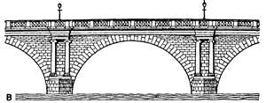
Rad-Anatomy Objectives The Philosophical…
How does this cadaver relate to live patients?
Can Radiology bridge (cadaver<-->bedside)?
What is in this bone box?
What do Radiologists do?
How does one choose imaging studies wisely?
How can I possibly learn all this material?!
Should I have gone to Law School….

Slide 6
OBJECTIVES The Concrete
How are images created and captured
What are cost/benefit aspects to consider
“Cost” = risk, efficacy, discomfort….$$
What do non-Radiologists need to know
How does one consult with a Radiologist
SOM Survival skills: advisors and mentors

Slide 7
TeamRads.com
Resource across the four years:
Introduction to Imaging, PRECEDEs
Normals and intro Abnormals
Common studies and entities
Transition to Wards
ACR AC aur.org
American College of Radiology Approriateness Criteria
‘What to REQUEST, when’.

Slide 8
WHAT IS THIS? WHY SHOULD I CARE?
Integrating Gross Anatomy with reality
Integrating (Pre-clinical ←→ Clinical)
“Talk the Talk”
Laying down neural synapses
Vocabulary, concepts (repeat, spiral)
“Walk the Walk”
Learning 2D ways to see 3D world
Learning how clinicians think
Building Mind Palaces off-line
Notes:
Cadavers real as it gets—but dead. Basic Sci not that different from college classrooms
Revisit over 2-3 yrs, reduce the ‘huh?’
Lists of facts transferred to cadaver and from there to reality and live pts

Slide 9
GOAL: Intelligent Consultation = ”High Value” PATIENT CARE
Students as ‘embryonic Radiologists’ (not).
All students *must* learn:
*How not to kill a patient “Order”
*What to ‘request’ (or avoid!) when
*How to consult with Imaging
What tests answer which questions
Absolute and relative contraindications
Dose, risk variables
Notes:
Crystal clear scenarios

Slide 10
IMAGING: NOT JUST “X-RAYS”
Gateway to Health Care (In-, Out-, and EMed pt)
Virtually all patients get imaging (have you?)
Diagnostic Imaging offers definitive diagnosis
(Relatively) non-invasive, non-destructive
“Roadmap” for surgery, biopsy, RT
“Rule in”, “Rule out”
Dx &Rx: Interventional (Image-guided procedures): Replace more invasive procedures
Streamline invasive procedures/surgery
Shorten recovery
Notes:
Coronary stent AM, Harbor PM
How many w/ radiograph including dental?

Slide 11
Wilhelm Conrad Röentgen
Nov. 1895 “On a New Kind of Rays”
“I have seen my death!” Anna Ludwig
Notes:
November 1895 produced and detected first x-ray

Slide 12
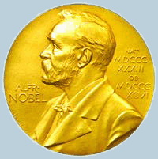
Wilhelm Conrad Röentgen
1st Nobel in Physics, 1901
Refused, like Curie, to take out patents; believed all should benefit
Notes:
Won first nobel prize in physics in 1901

Slide 13
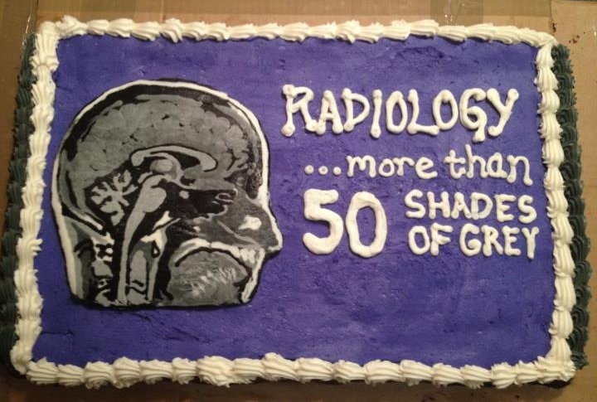
What Properties Determine Shades of Grey?

Slide 14
What determines BLACK →GREY→ WHITE?
Atomic # n and path length
Lead
Metals
Bone
Muscle
Blood
Liver
Fat
Air
WHITE:
Radio-opaque;
STOPS “More”
Like Metal
BLACK :
Radiolucent;
STOPS “Less”;
Like Air
Schematic derived from Squires Fundamentals of Radiology- Sixth Edition

Slide 15
Metal (VERY white)
‘Radiodense’
“High attenuation”
Bone (relatively white)
‘higher attenuation’
“more radiodense”
Air (VERY black) ‘Radiolucent’
Soft tissue (relatively gray)
‘Lower attenuation’

Slide 16
Radiology Has The Best Toys!

Slide 17
MODALITIES (increasingly complex menu- hence ACR AC)
Radiographs/Plain film/Traditional (‘Xray’)
Computed Tomography (CT, CAT scan)
Ultrasound (US, sound wave physics)
Nuclear Medicine (physiologic uptake)
Magnetic Resonance Imaging
(polar molecules spinning)
Positron Emission Tomography (PET)
(metabolic, molecular)
Notes:
Physics mandates vocab/relevance

Slide 18
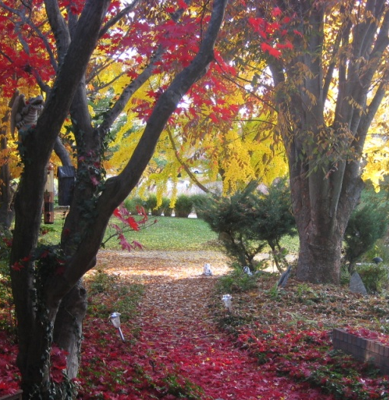
ANSWERING QUESTIONS (Anticipate Thanksgiving!)
X-rays cause cancer! Is this study safe?
Should I get one of those total-body CTs?
How about one of those cardiac CTs?
I want one of those cute fetal 3D ‘portraits’ you can get at the mall, it’s safe, right?
Notes:
How many of you will be asked at Thanksgiving?

Slide 19
ANSWERS, IN BRIEF:
TOTAL BODY CT: In asymptomatic pts. without family hx/risk factors, ACR states ‘no evidence that total body screening is cost efficient or effective in prolonging life”. COMING SOON…
Excessive radiation is unsafe!
To the individual
To populations
Over-pursuit of ‘incidentalomas’
Once seen, obliged to work up:
biopsy, surgery, more radiation, worry

Slide 20
SELF-REFERRED CT
When targeted to specific disease in at-risk pts. (eg, lung ca. screen in smokers; coronary artery calcium scoring if risk factors) total body CT, or CT ‘virtual” colonoscopy for colon cancer, ‘may be clinically valid.”
‘Doc In A Box” vs. prospective multicenter studies→ ‘Standard of Care” (SOC)
Pending: Clear ACR guidelines
(~ mammography, colonoscopy,…)
Evidence-based medicine

Slide 21
RSNA 2014: FDA Warns Against “Keepsake” US “BUT TomKat DID IT! Suri seems fine…”
US for entertainment purposes is not valid
Mall ‘boutiques’ offer portraits for ~$400
Untrained users give false sense of security, can’t do adequate prenatal exam
Most safety studies are from ’70’s, ’80’s; energies increased +8X in last 15 yrs.
Cavitation, tissue heating concerns
Yale research: “US disrupts fetal neuronal migration to cerebral cortex, mice”
Notes:
Suck thumb, see penis, bond

Slide 22
Meet Mr. Whole Wheat

Slide 23
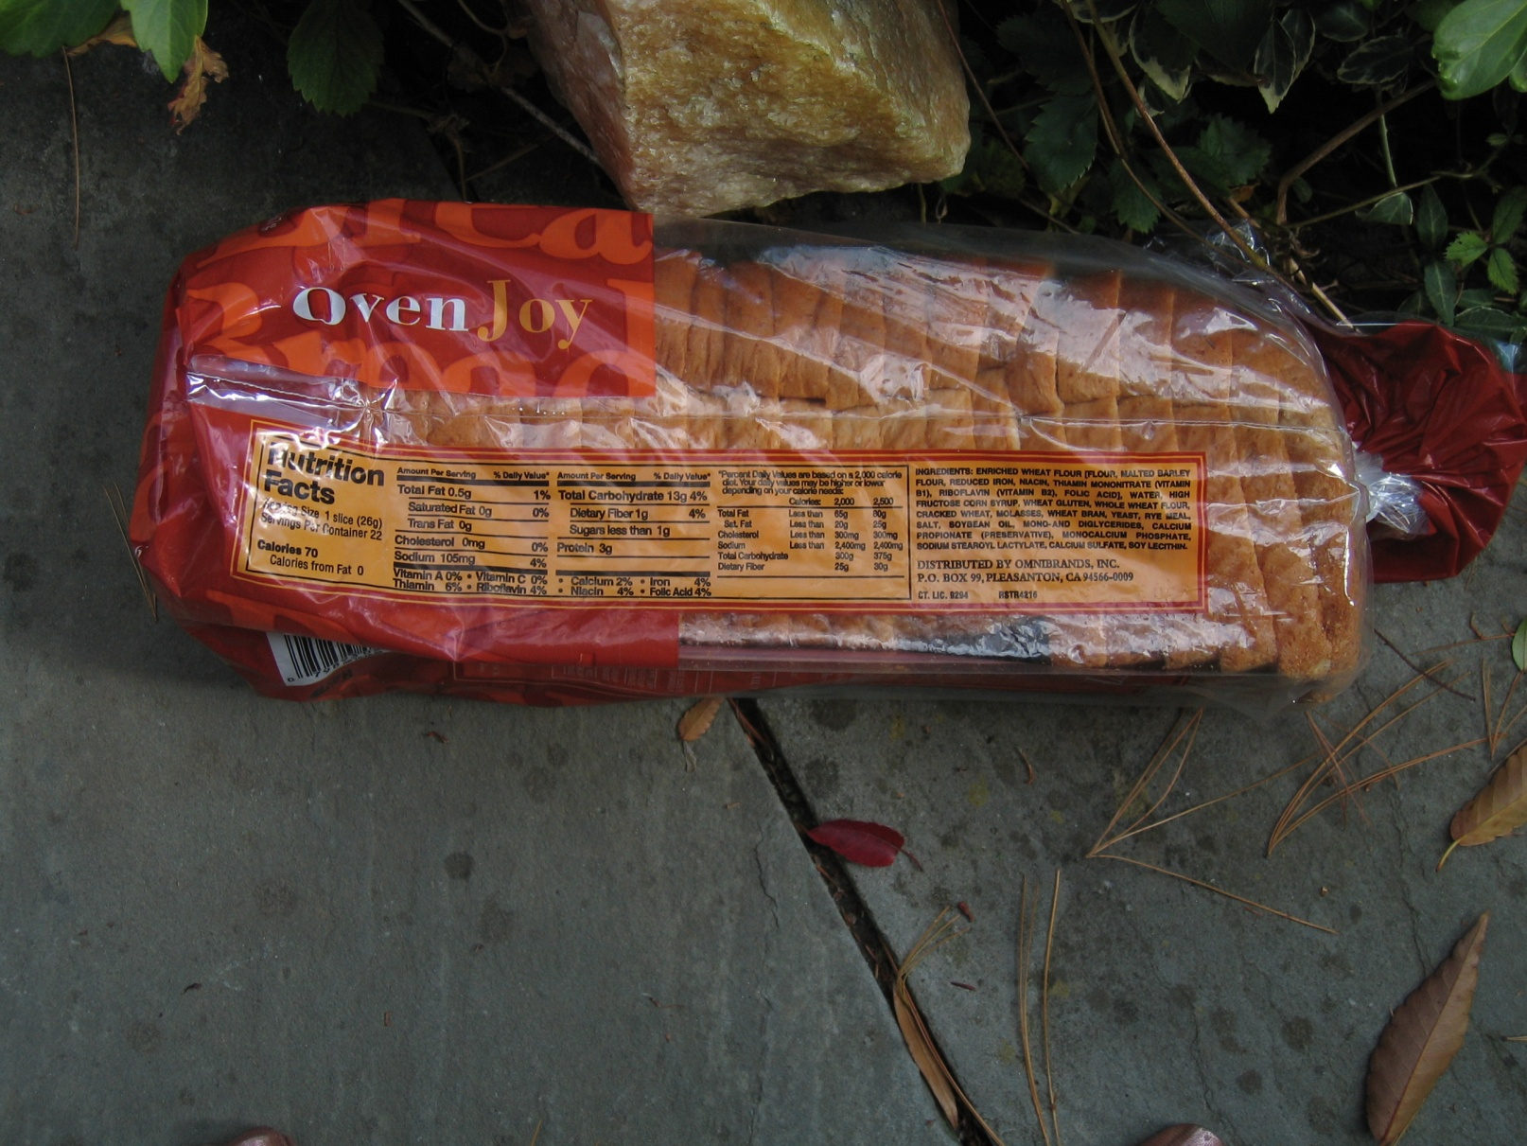
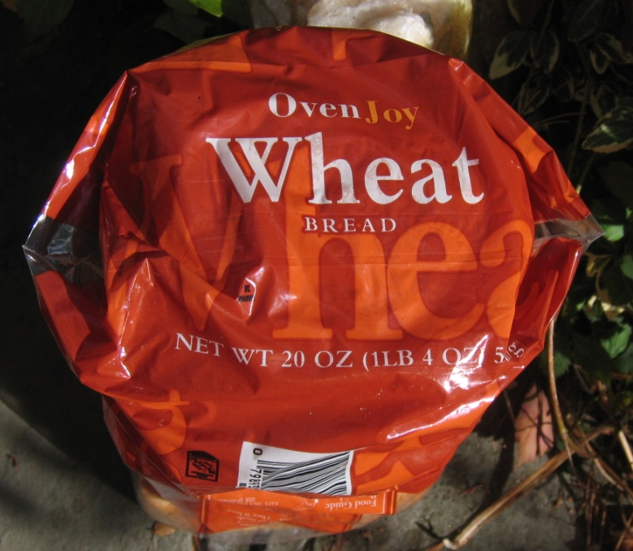
“One View Is No View”

Slide 24
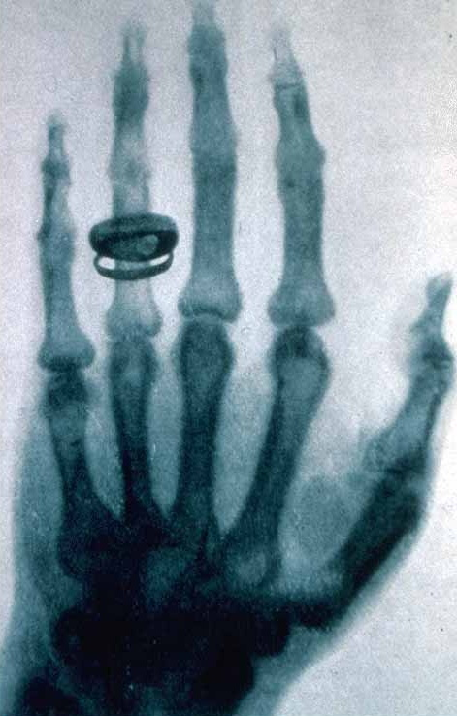
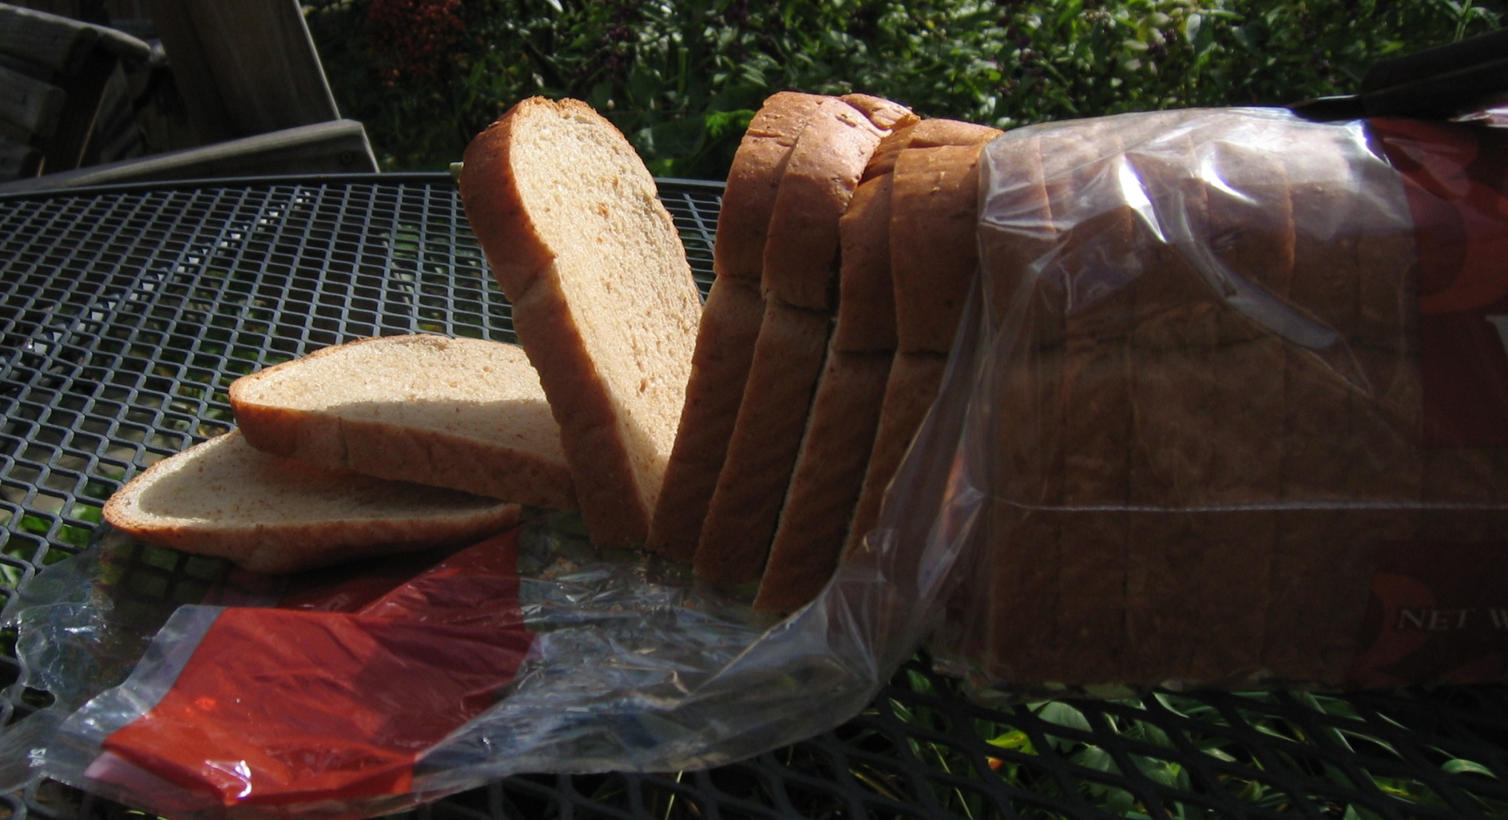
Innards: Surgery, Autopsy, or…. IMAGING
Roentgen 1895
Notes:
‘innards’ revealed by surgery, autopsy, or..imaging “I have seen my death”

Slide 25
“I was minding my own business when some Dude….” ‘Chief Complaint: New-onset stabbing chest pain’

Slide 26
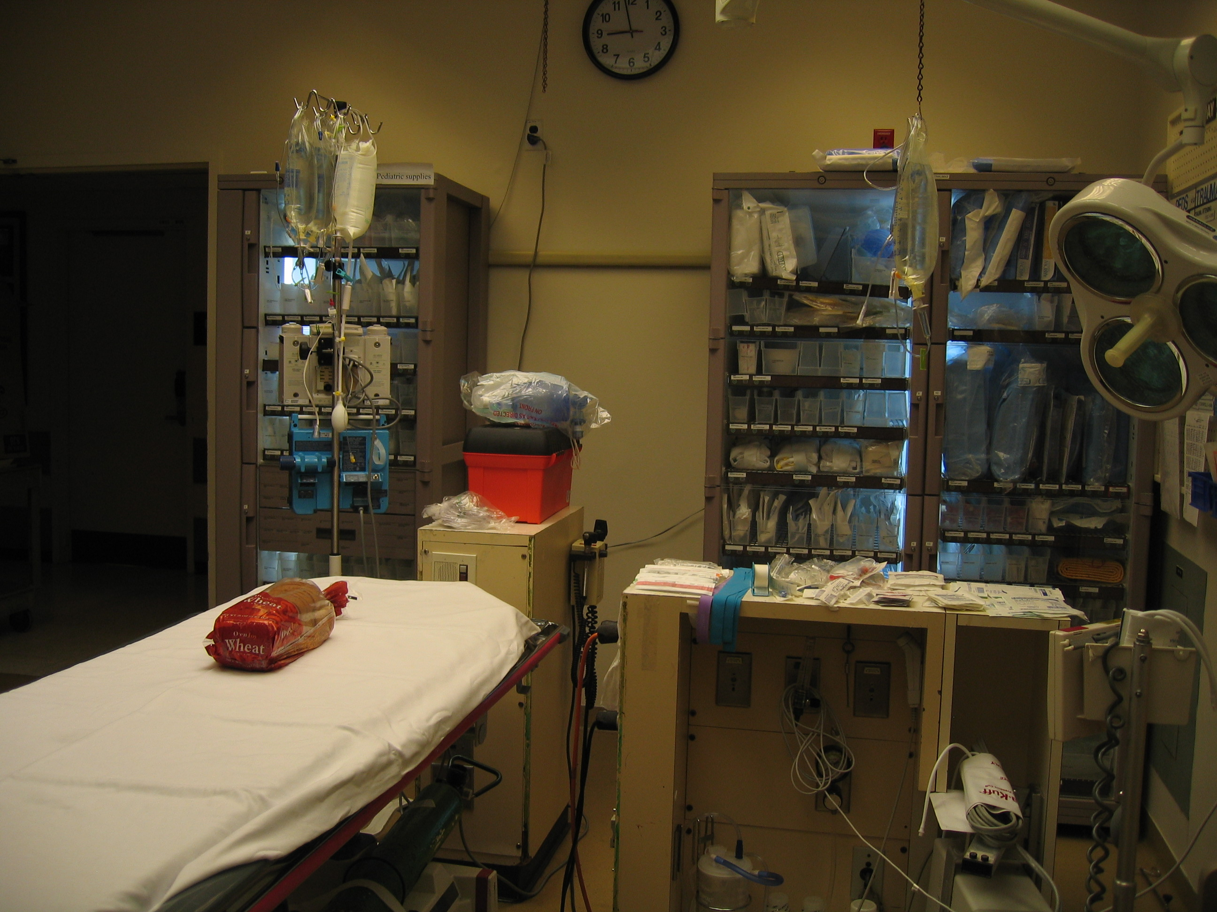

Slide 27
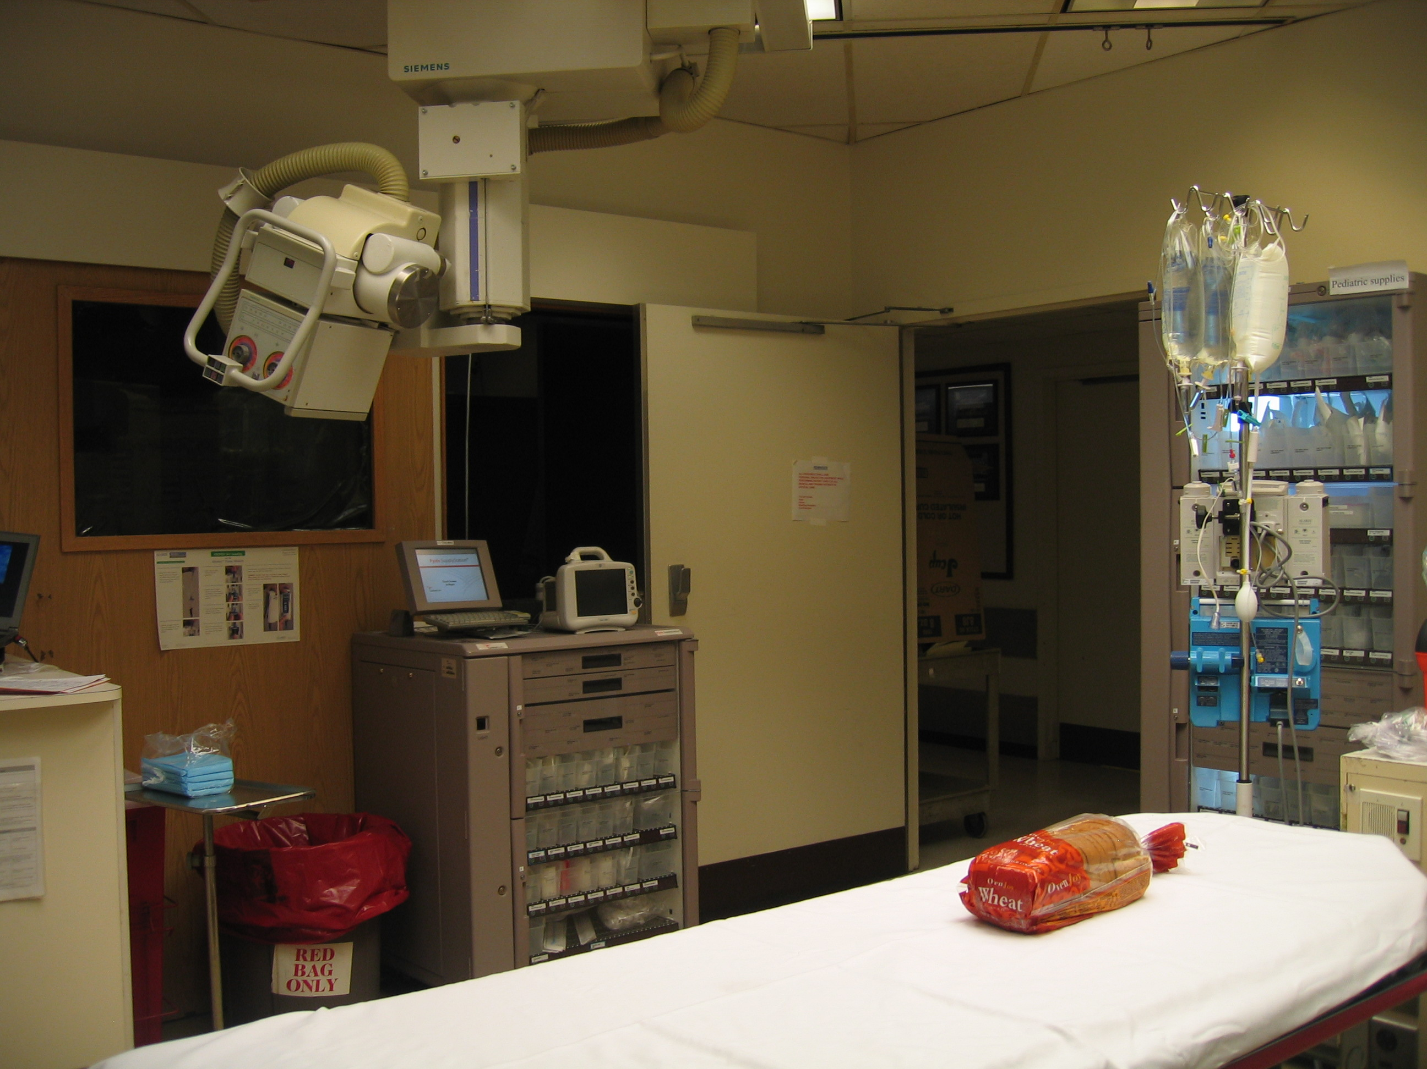

Slide 29
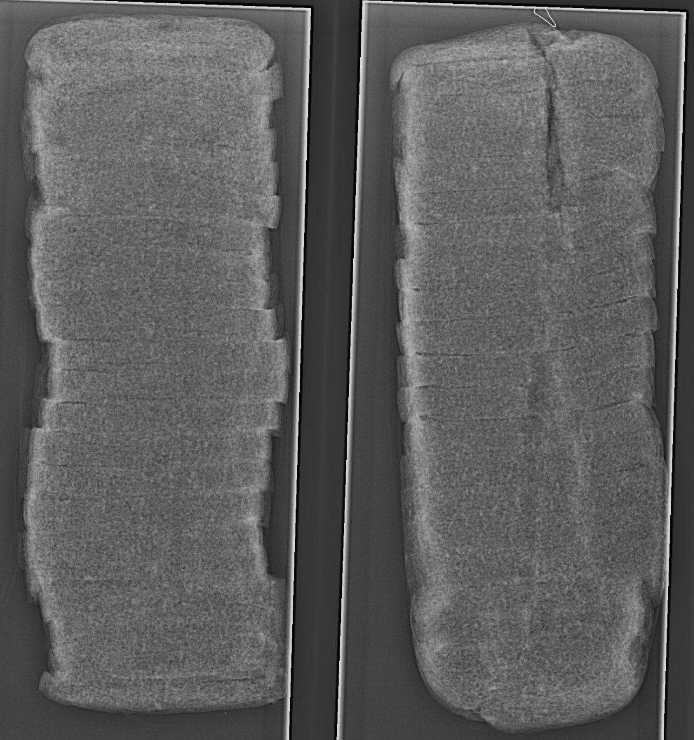
Old Images→ Patient Baseline
“NORMAL”→ huge spectrum of variation vs.
“NORMAL BASELINE FOR PATIENT” →
“Worry/Don’t Worry”
Notes:
OLD FILM

Slide 30
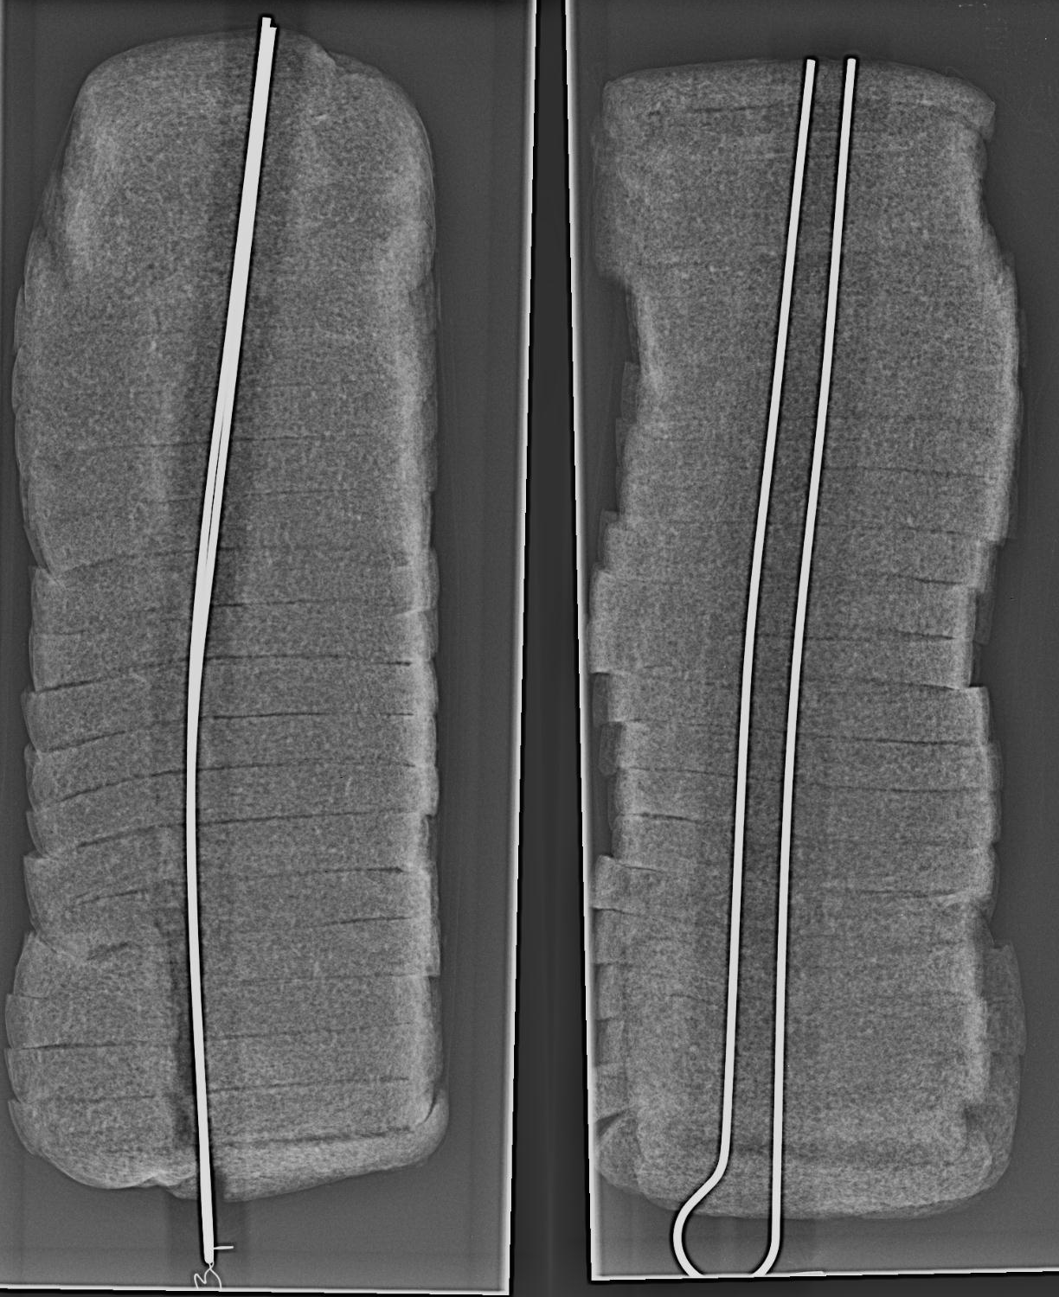
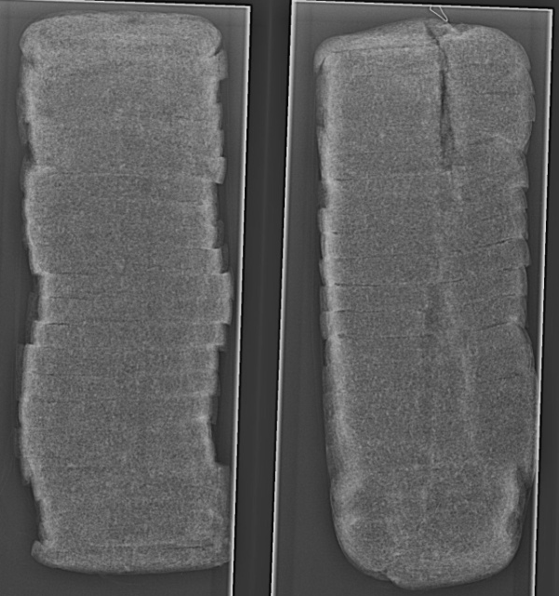
Notes:
ONE VW IS…..

Slide 31
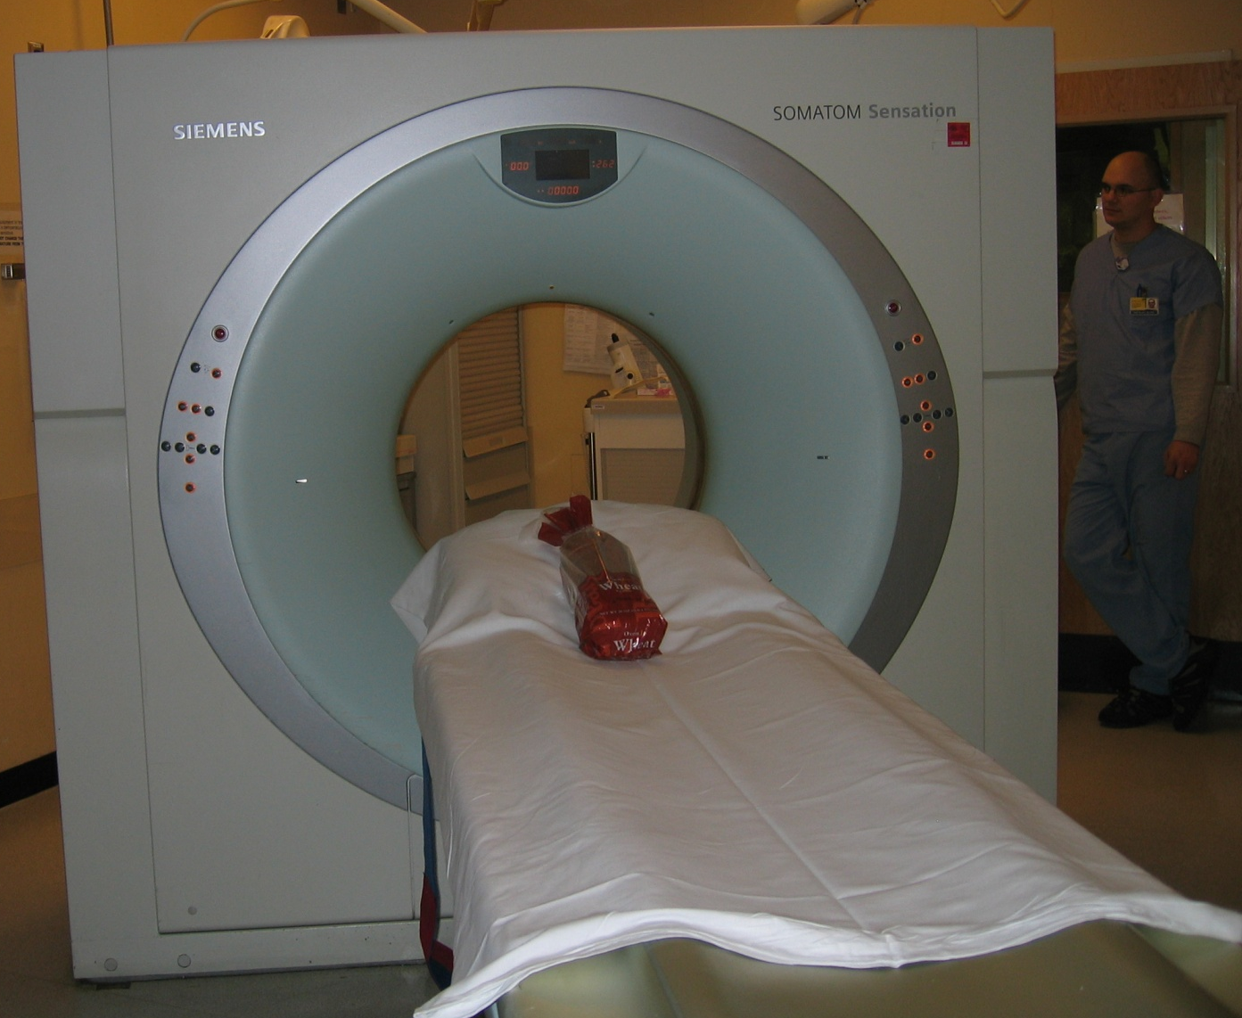
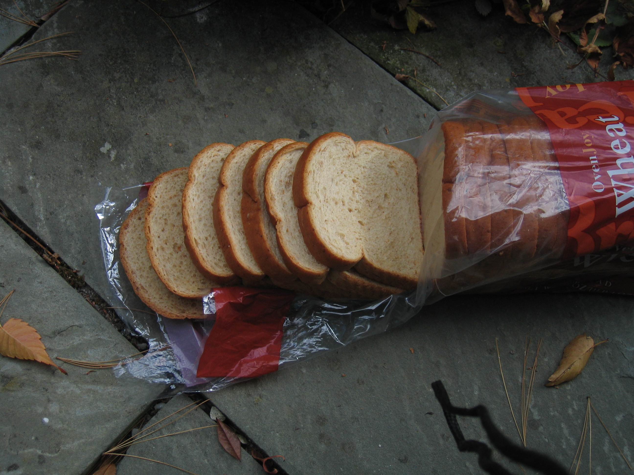
CT: “Slices patient like loaf of bread”

Slide 32
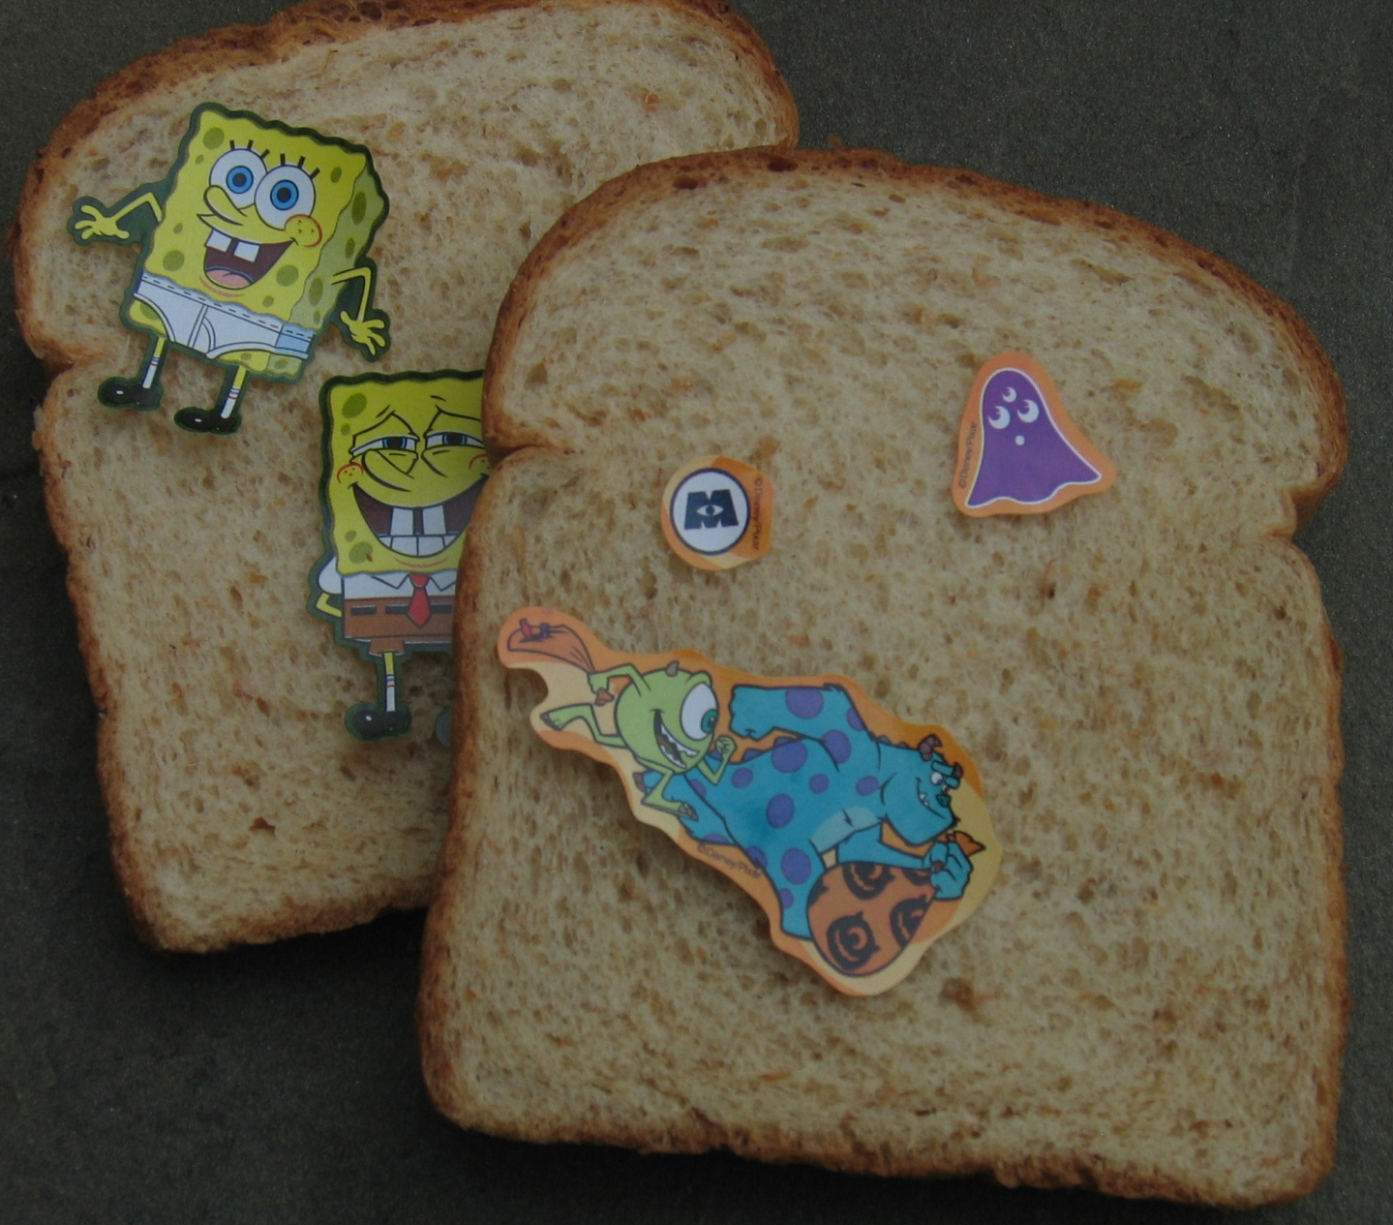
Expect The Unexpected

Slide 33
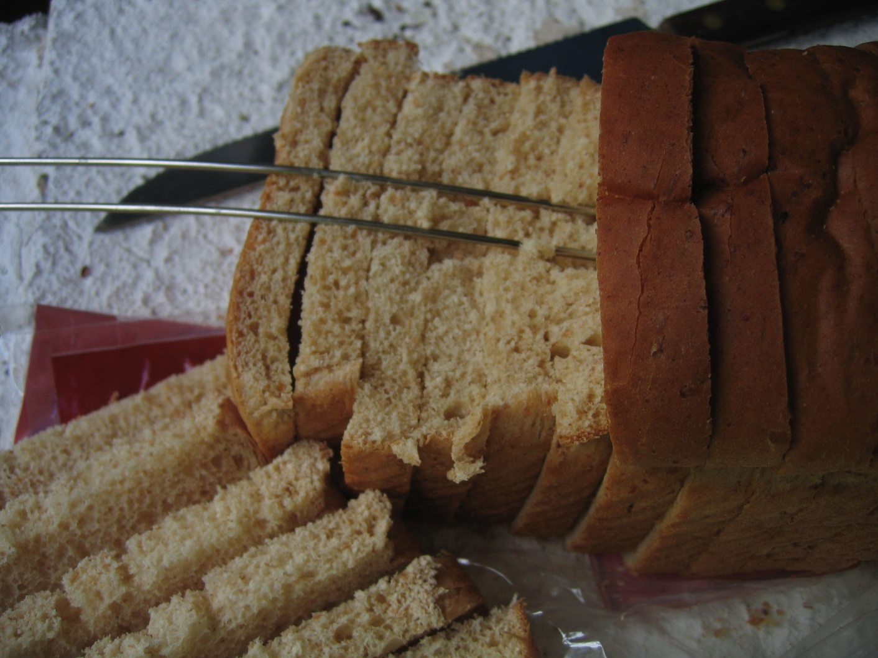
COMPUTERIZED DATA can be manipulated, reformatted into 2D and (simulated) 3D images
ANATOMYCOLLEGES.COM
Notes:
Put back together..to better expose or characterize findings

Slide 34
BACK TO REALITY…
What is this box?
What do ‘They’ want us to do with it??

Slide 35
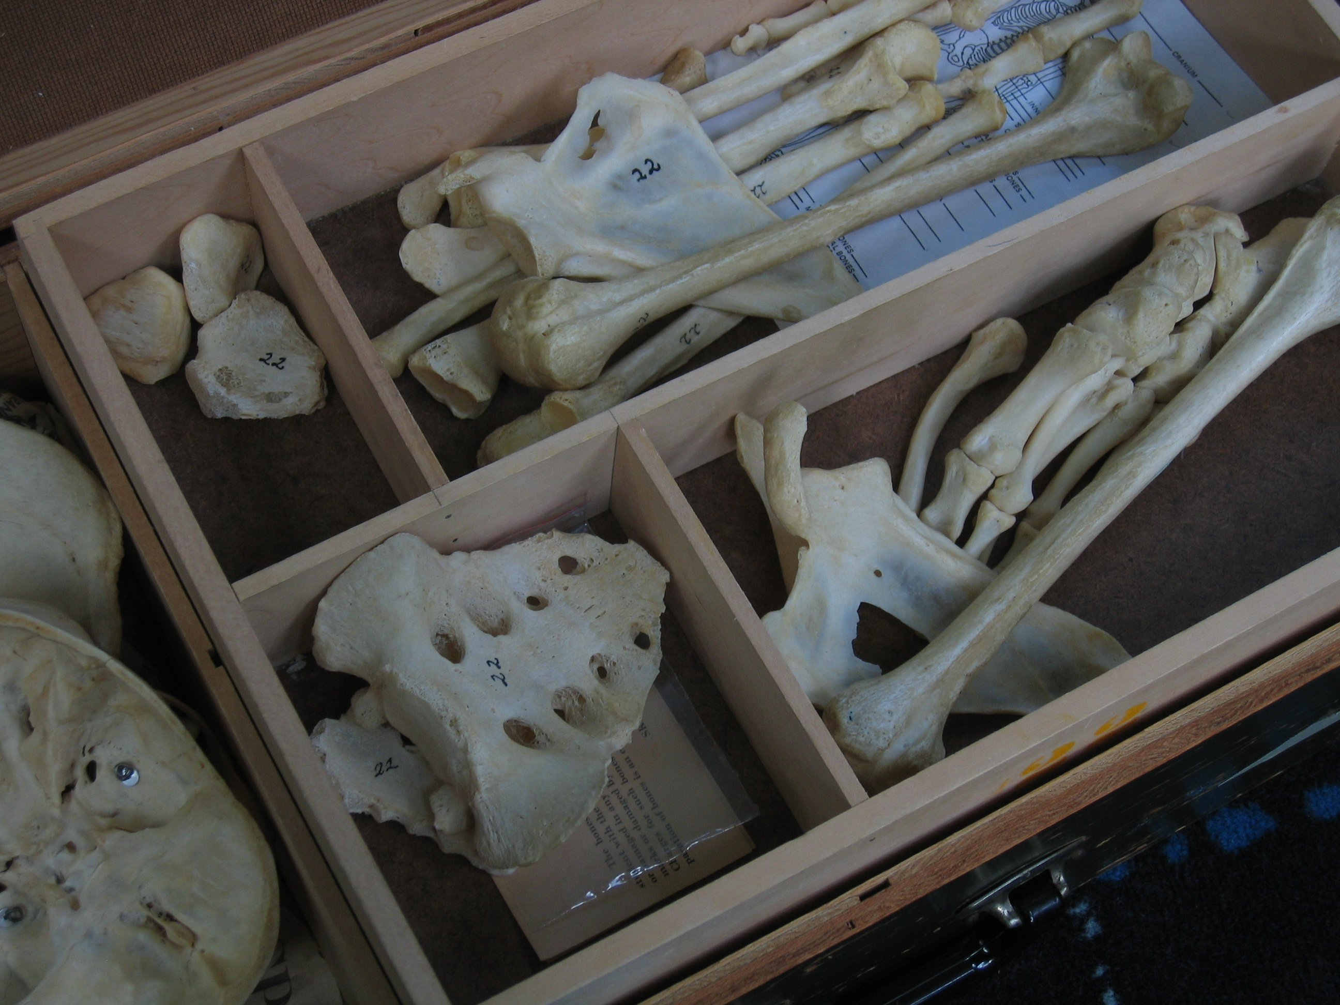
Notes:
You are carrying around pieces of a real person in that box.

Slide 36
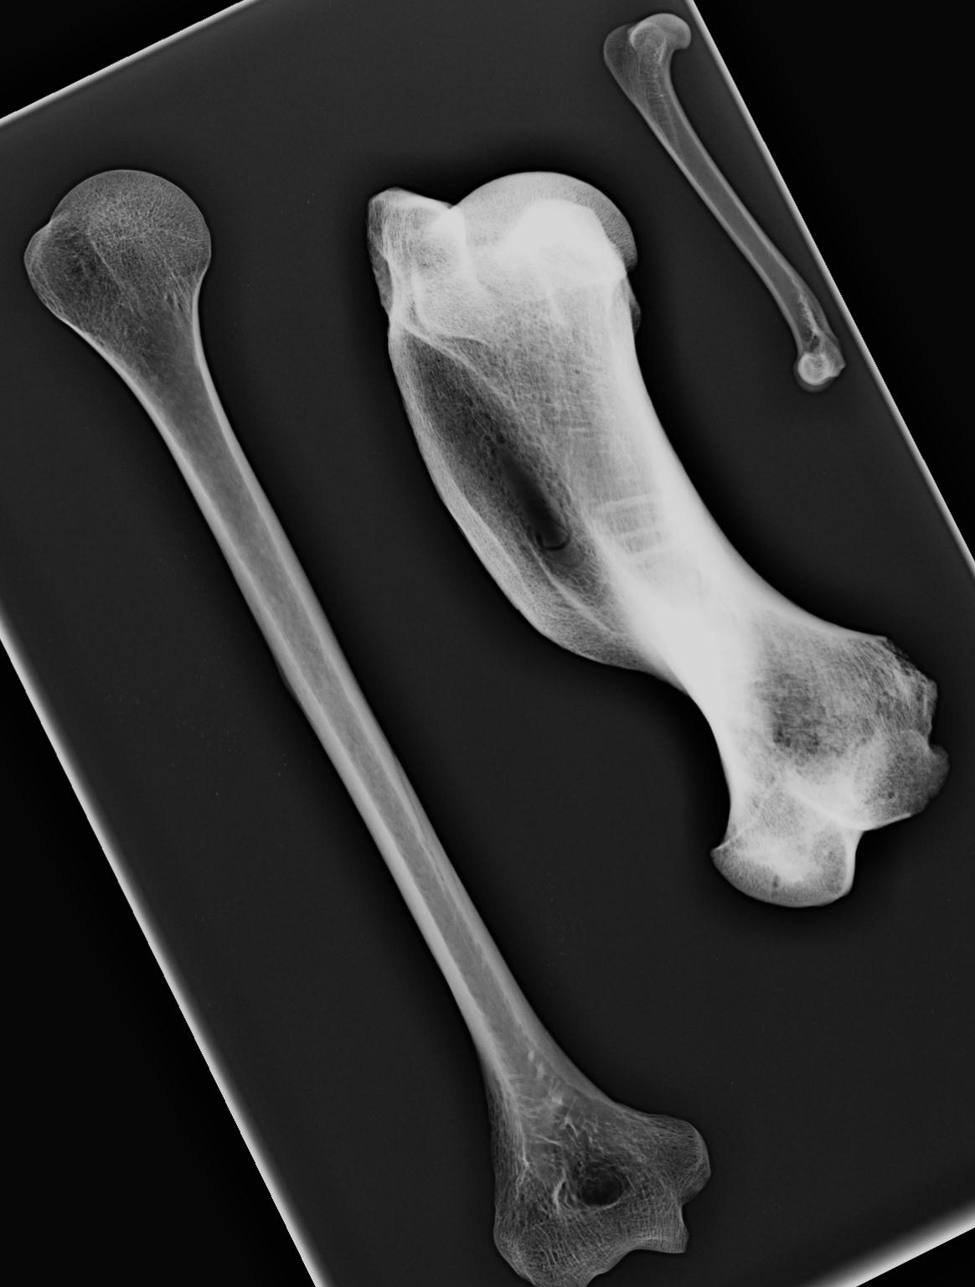
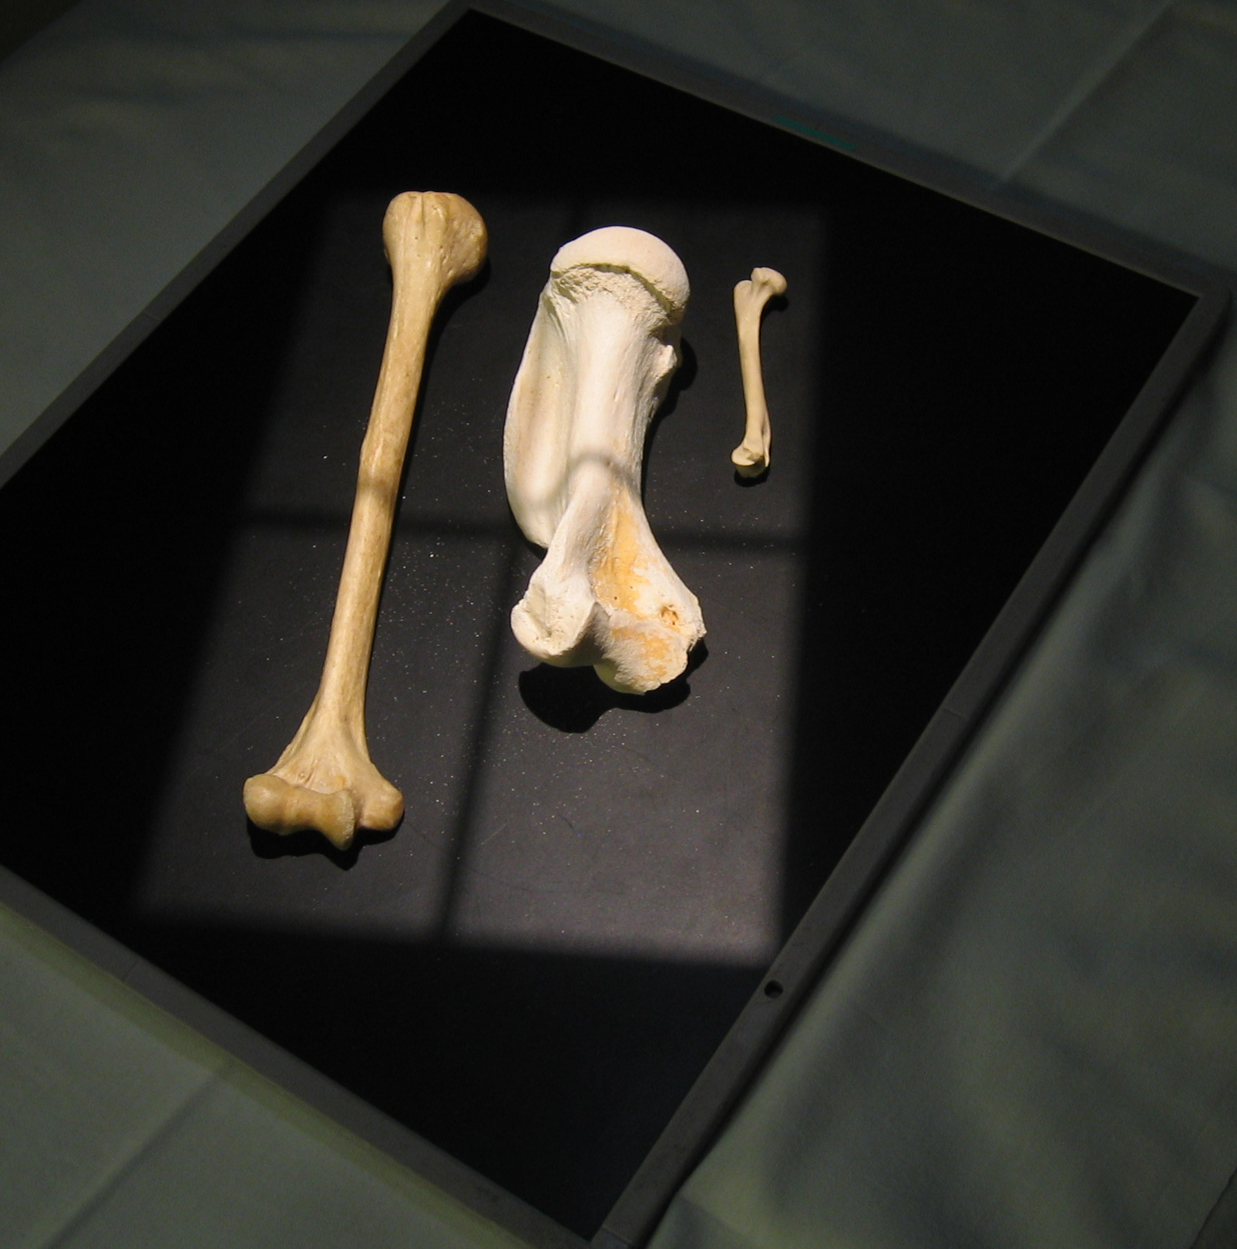
“BONES TALK”
learn to “listen”
Notes:
Subspecialty, organ system, disease process, research pursuit will ‘talk’ to you…

Slide 37
Ball and Socket Joint eg, Hip: Femoral head in Acetabulum
Notes:
Hip bone connect to the thigh bone….

Slide 38
Ball and Socket Joint Hip= Spherical Femoral head rolling in round Acetabulum

Slide 39
ANATOMY IS DESTINY Why do glenohumeral (‘shoulder’) joints dislocate often, but hips rarely? BOTH are ball-and-socket joints but glenoid socket very shallow

Slide 40
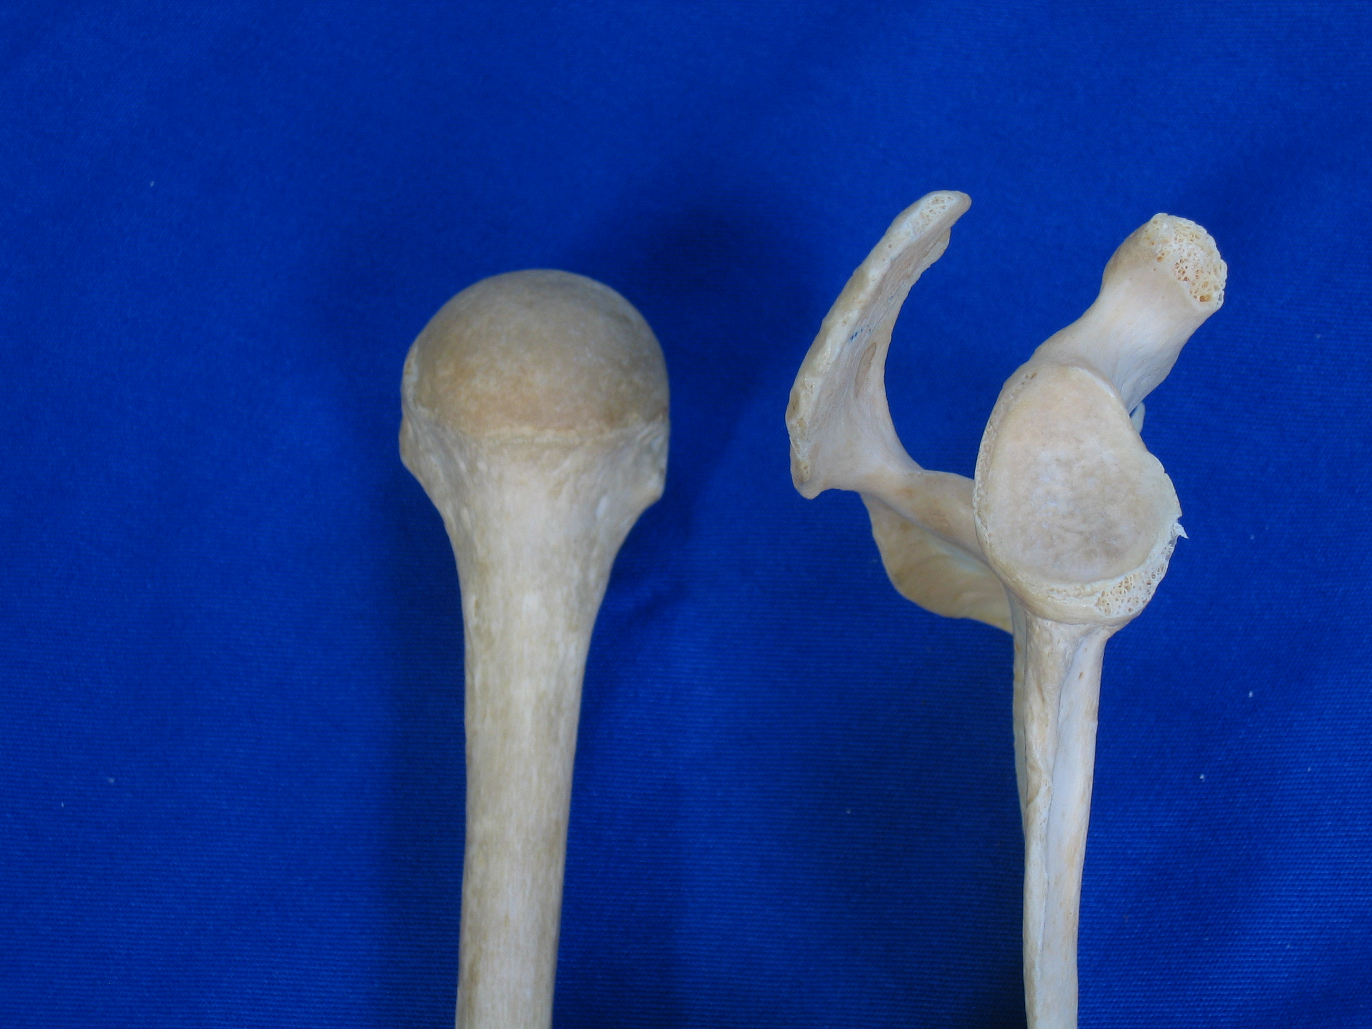

Slide 41
GLENO HUMERAL JOINT
Articular surfaces nearly spherical BUT glenoid very shallow, unlike acetabulum

Slide 42
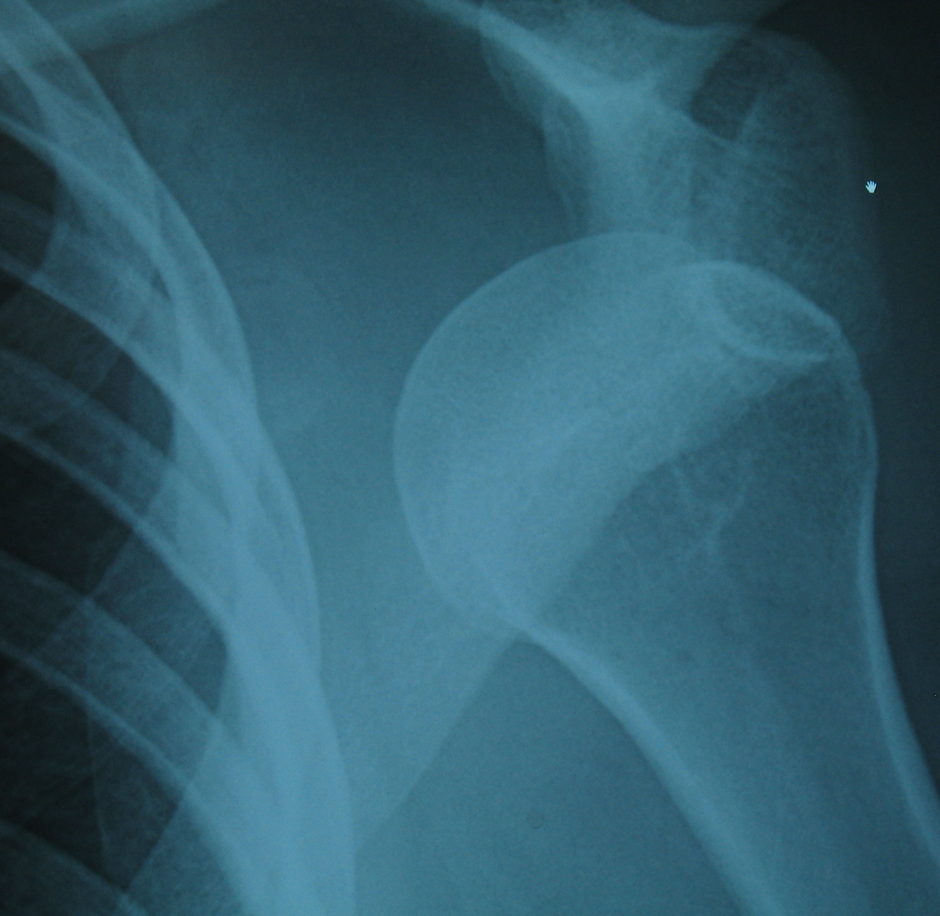
Good News Bad News:
G-H joint most mobile in body.
BUT
Head dislocates easily from glenoid.
Notes:
Why its easier for GH to disloc than fem head

Slide 43
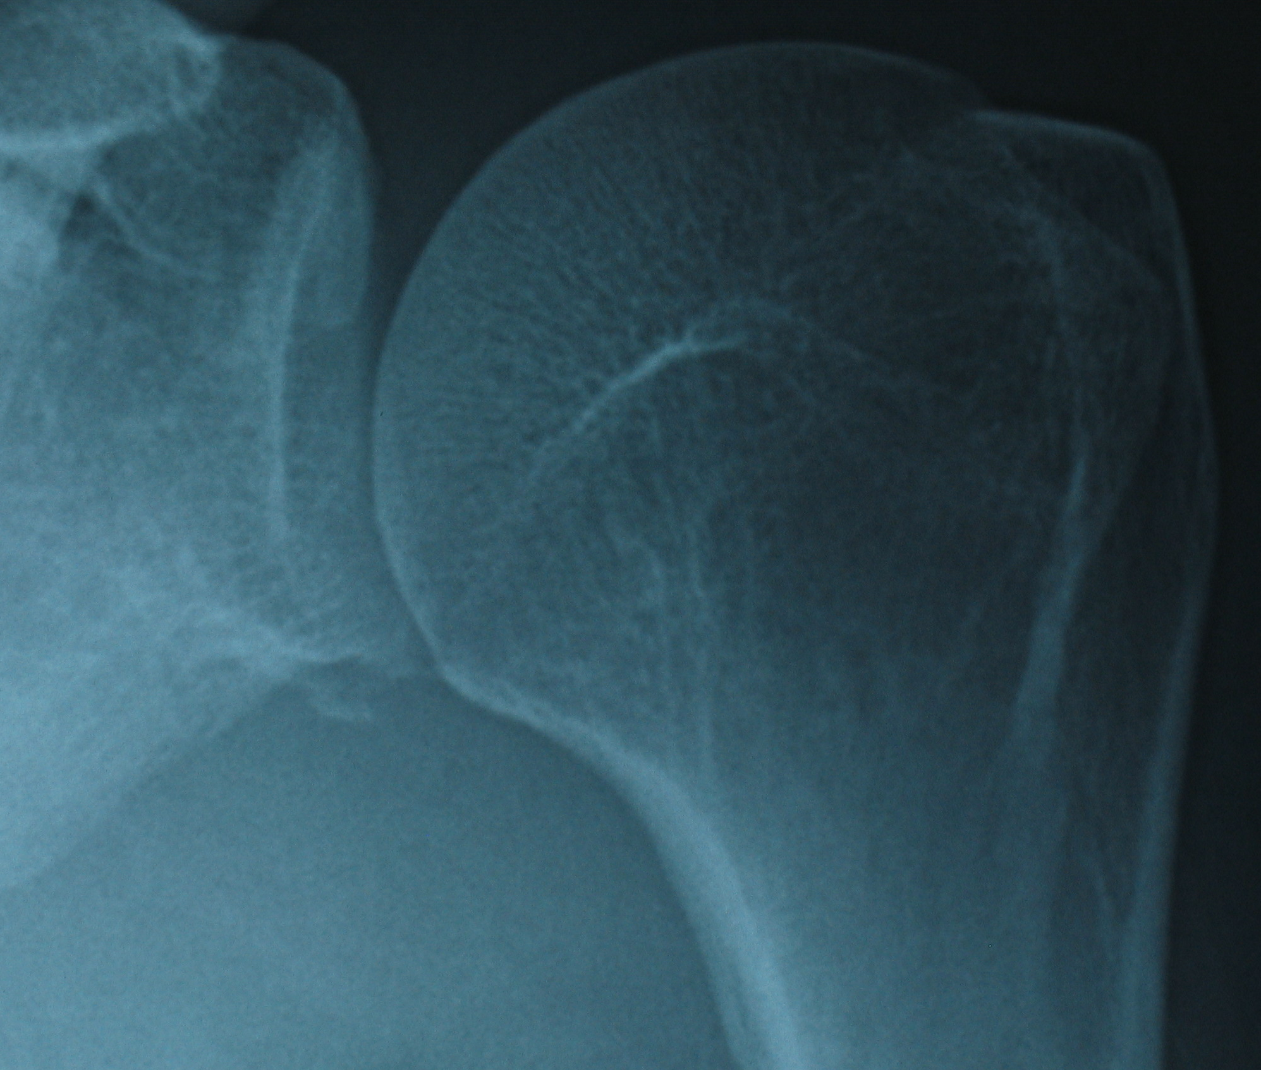

Slide 44
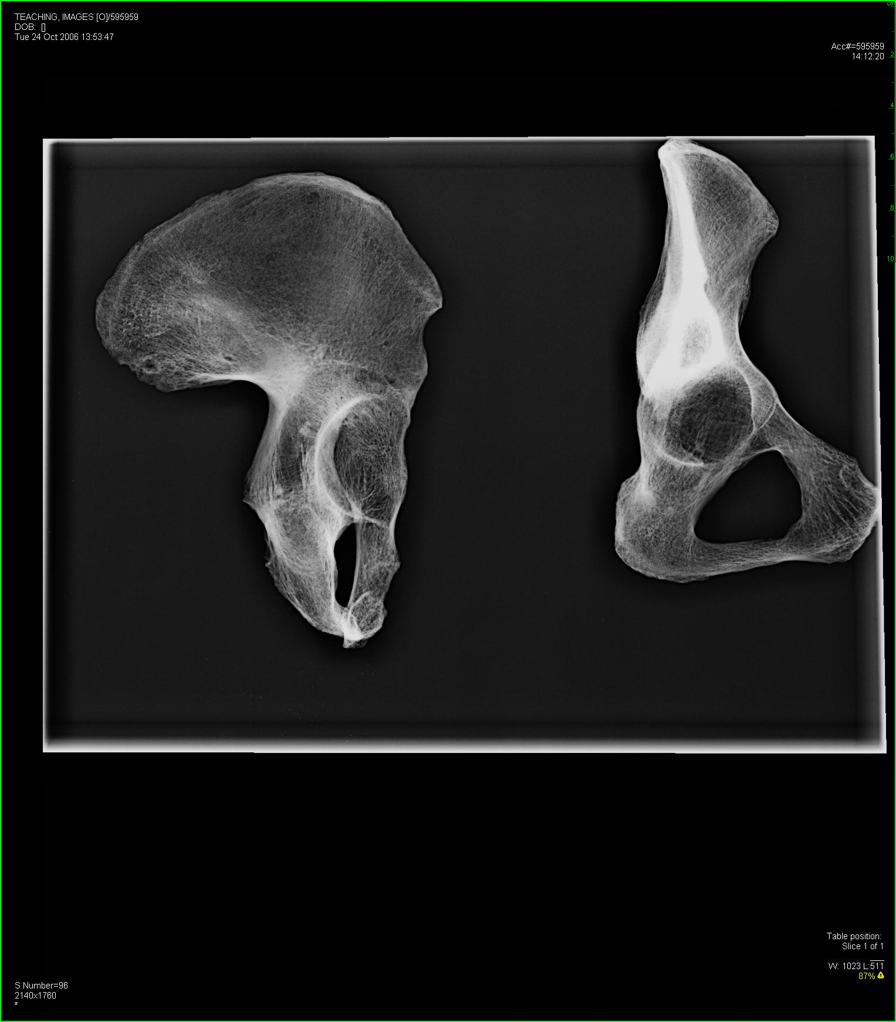

Slide 45
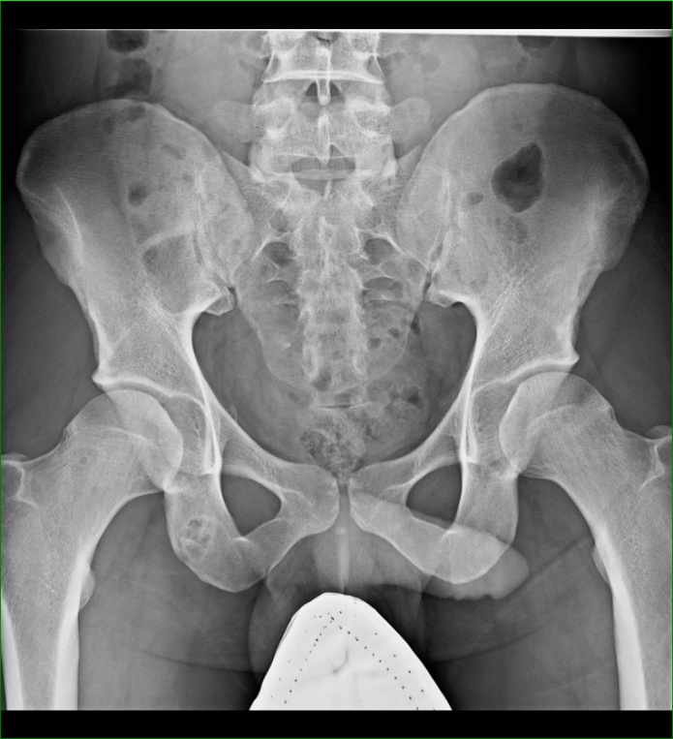

Slide 46
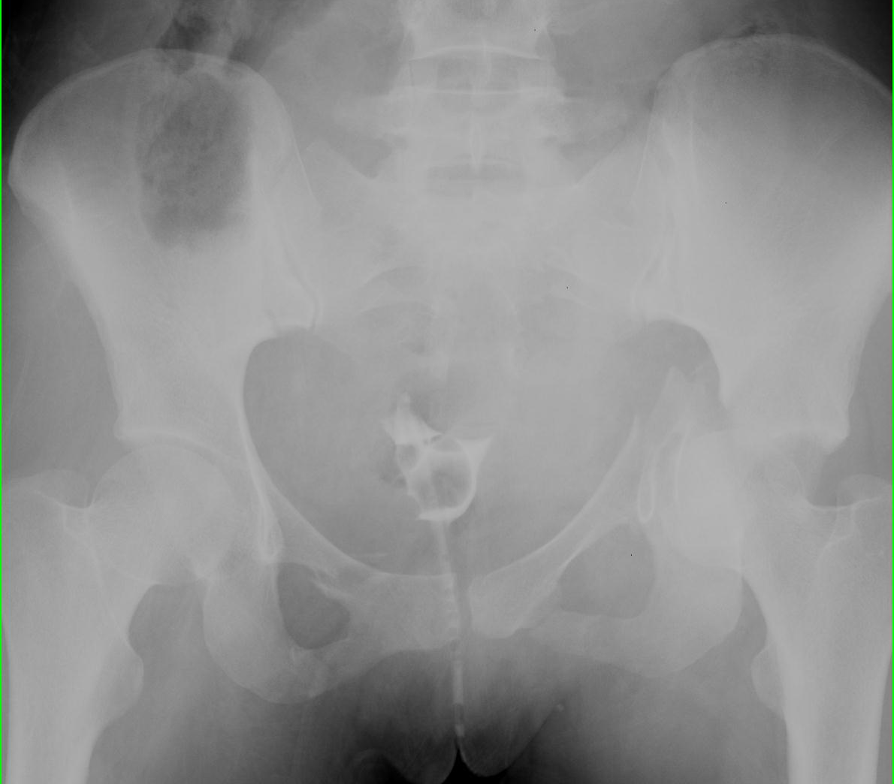

Slide 47
CT: ‘loaf of bread Pt supine,feet towards you

Slide 49
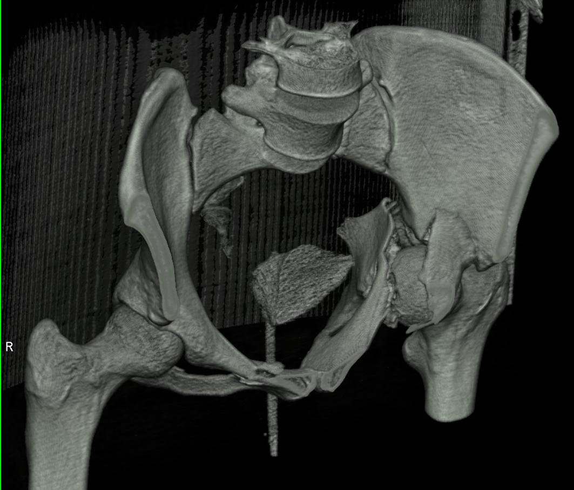
(Simulated) 3D

Slide 50
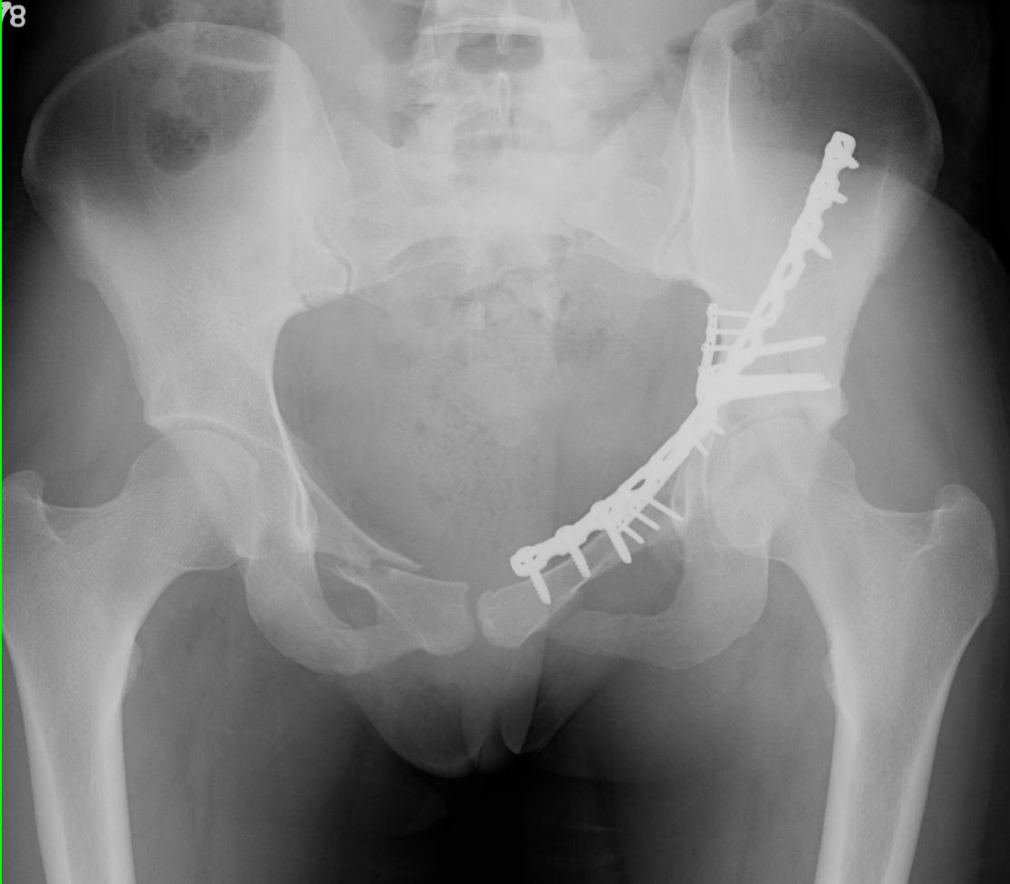

Slide 51
“Bones Talk” Learn to ‘Listen”

Slide 52
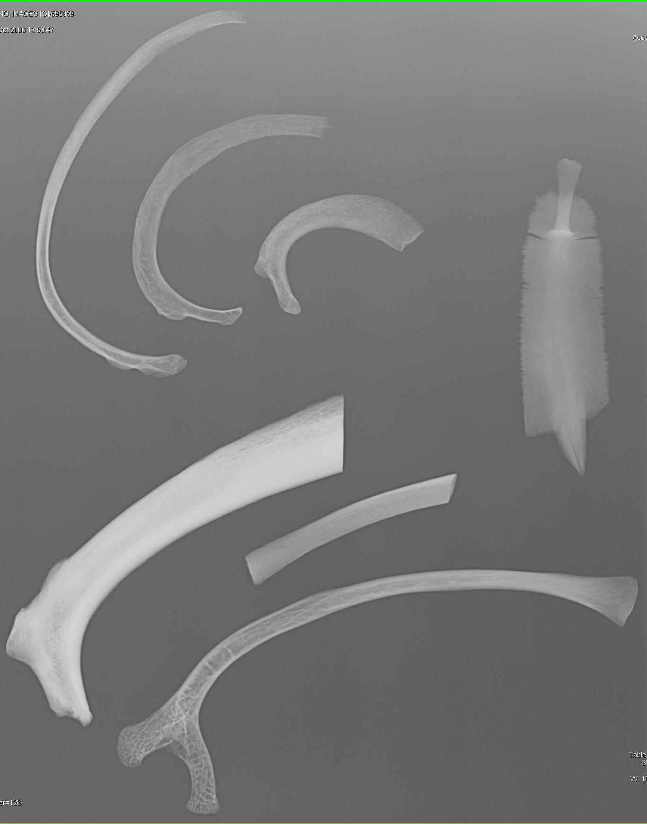
“Bones Talk”:
Which rib supports the most weight?

Slide 53
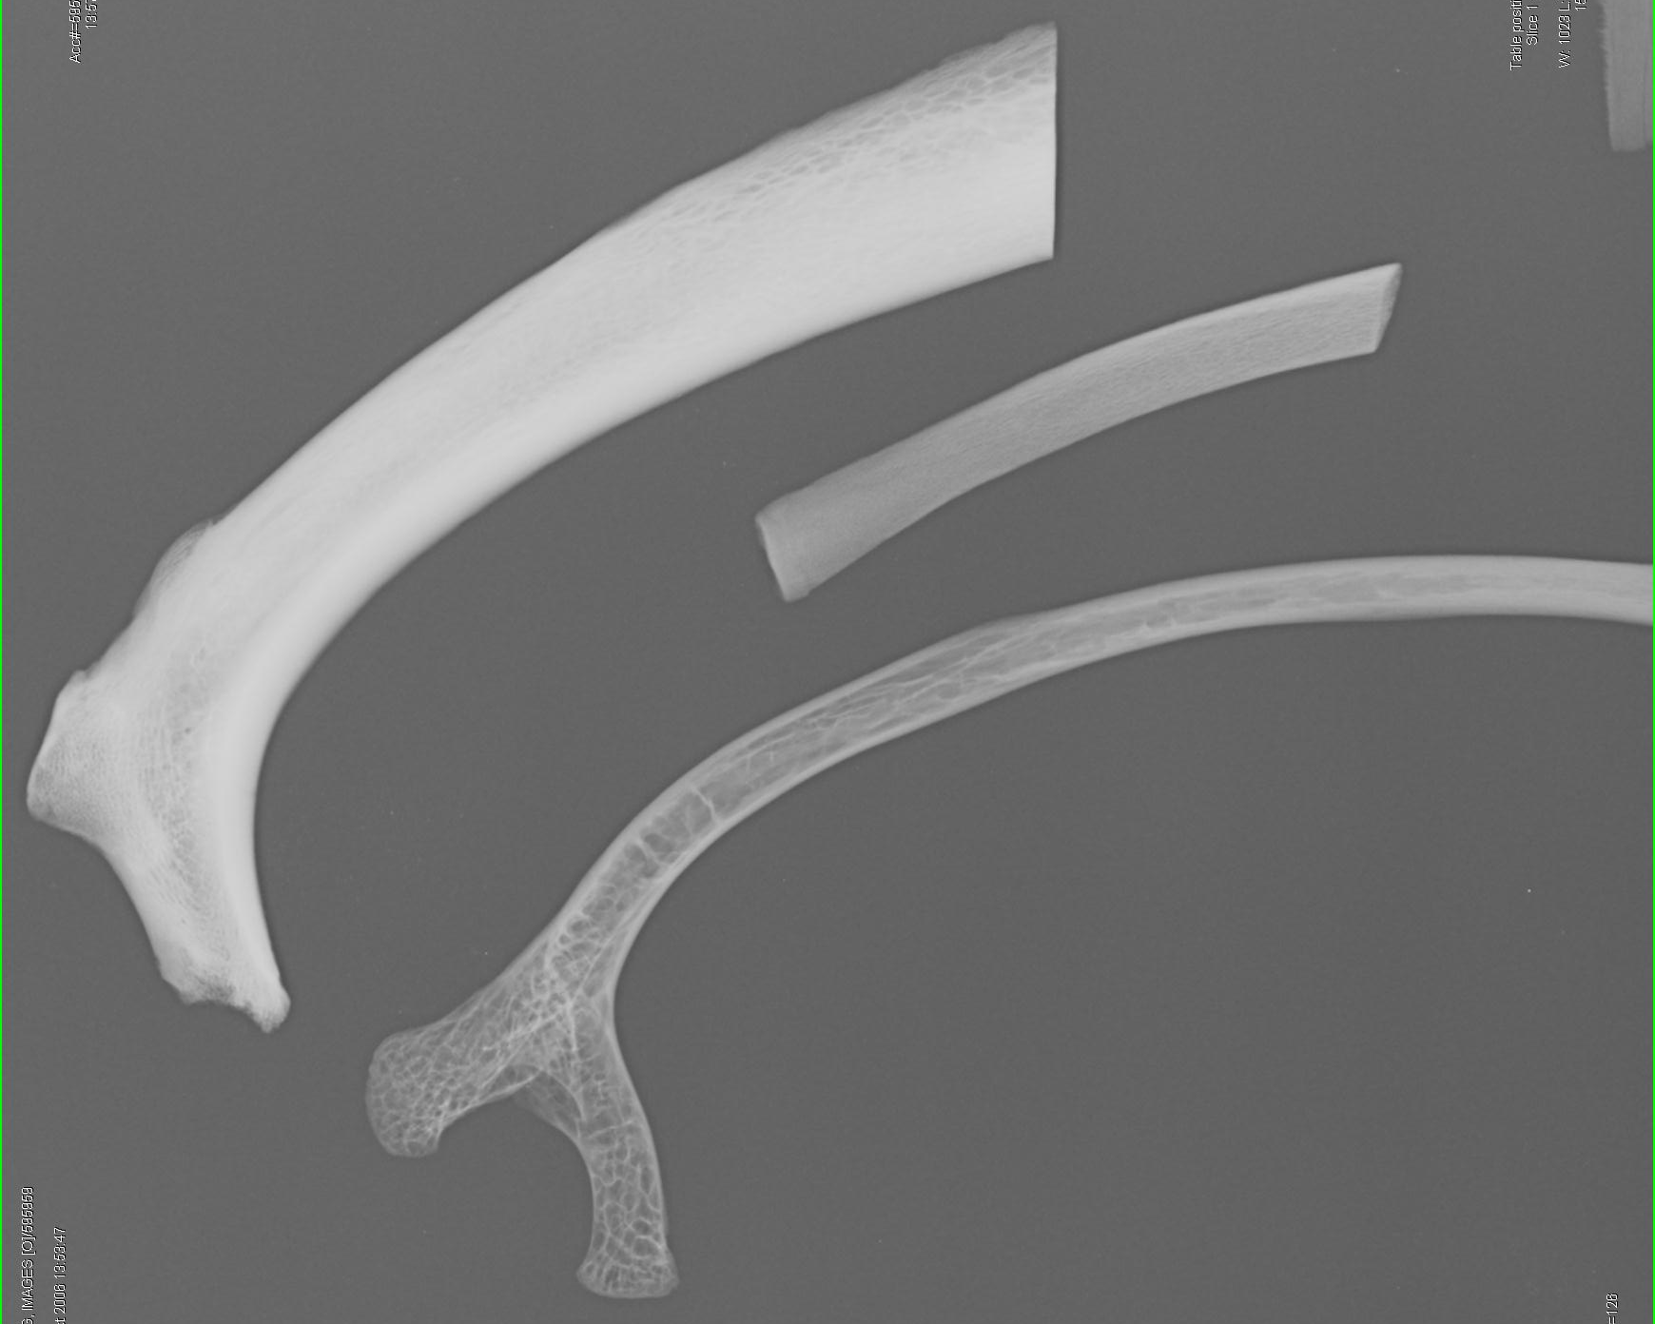
Bone responds to weight-bearing forces

Slide 54
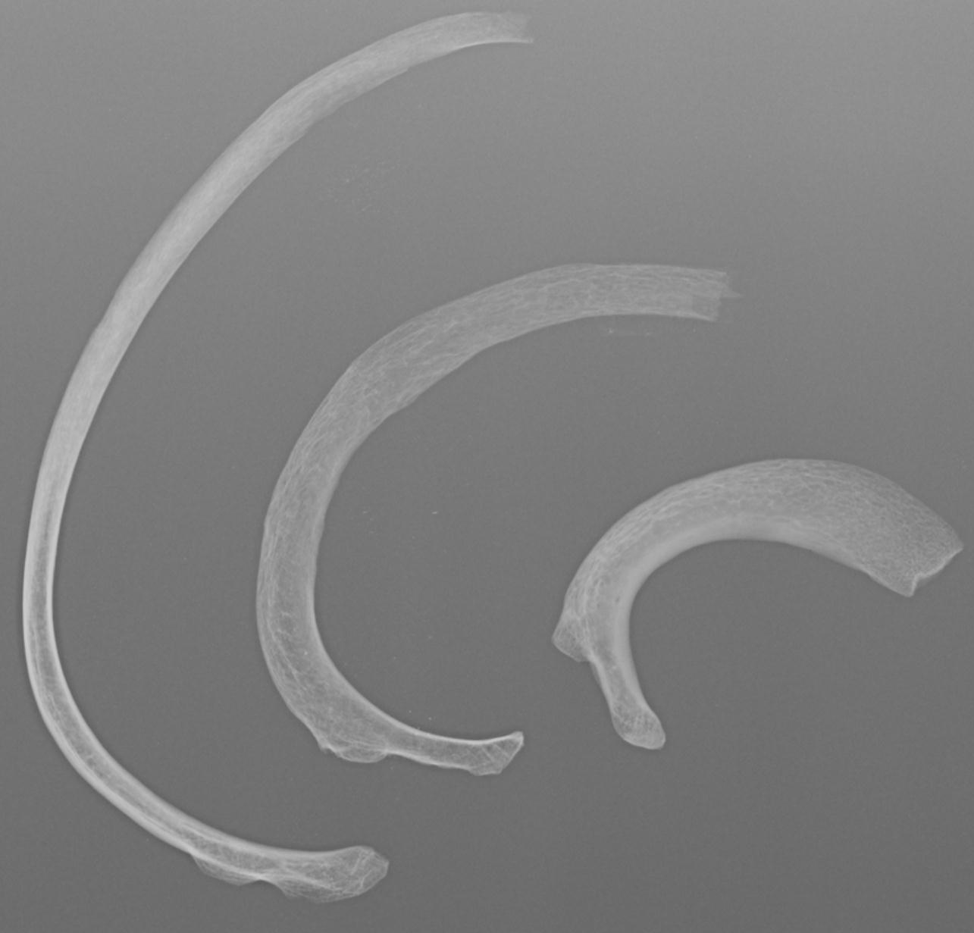
3 human ribs: which would take the most force to be fractured?

Slide 57
www.TeamRads.com ANATOMY and IMAGING SITE
Ideas and feedback!
FaceBook cases
Follow organ systems and structures; name things; see how they relate in 3 planes
Be curious!!
PS-- images ARE on exams…
Notes:
Relate to cadaver and to atlas
Lookit that!

Slide 58
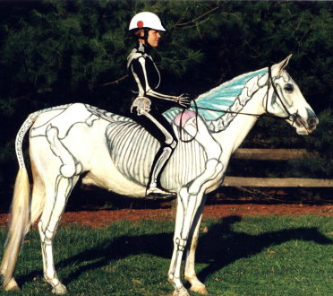
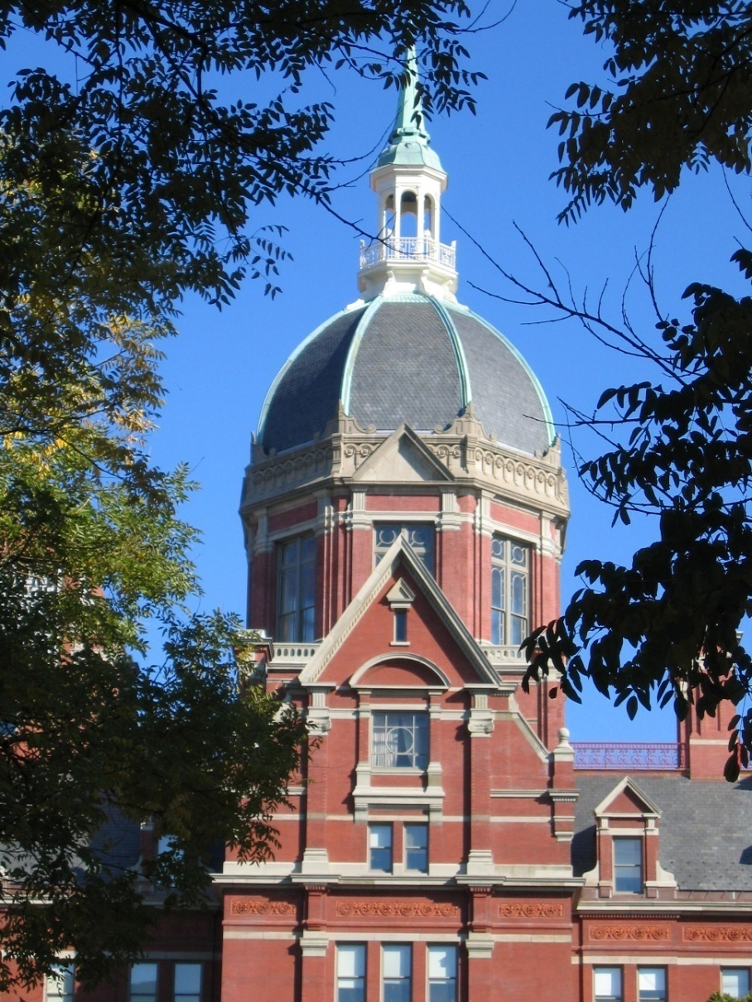
THANK YOU! Monday: Dr. Tony Lin, Chest
COMMENTS, SUGGESTIONS, WELCOME:
dmagid@jhmi.edu
Notes:
WE HOPE TO BRING BACK SOME FURTHER INSIGHTS OR CLARIFICATIONS AS THE NEW CURRICULUM ROLES OUT

Slide 59
We’ll be back!!! See you next time
Donna Magid MD M.Ed
www.TeamRads.com

Slide 60
STRAIGHT OUTTA HOPKINS

