Slide 1

BACK TO BASICS:
Basic Back
Donna Magid, MD, M.Ed
Professor, Radiology, Orthopaedic Surgery and Functional Anatomy and Evolution
Director, Horizontal Strand in Diagnostic Imaging
WebMD Health Hero
Medscape Mentor of the Year

Slide 2
OBJECTIVES (anatomy>Imaging)
Overview of vertebral body:
Neural foramina
    Joints
  Ligaments
Spinal anatomy, including
  Epidural space
  Subdural space
  Subarachnoid space
Common pathology

Slide 3
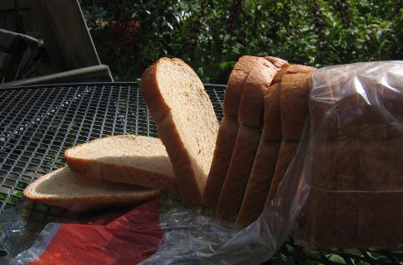

CT: Slices in 3 Dimensions

Slide 4
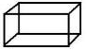
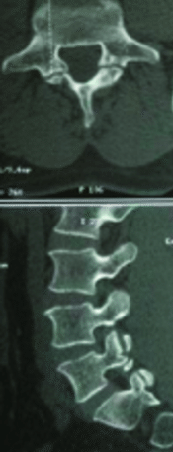

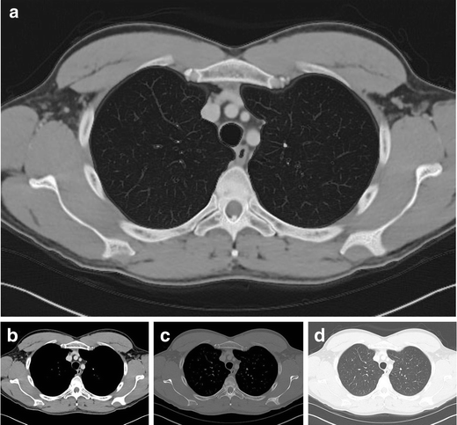
Complex 3D Anatomy: CT
Thin section CT = isotropic volume sets from axial (bread) slices
3D reconstruction software
(Re-slices Mr. WholeWheat→coronal, sagittal)
Radiodensity grey scale: select tx.
Mandell, Khurana

Slide 5
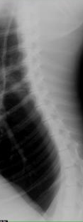
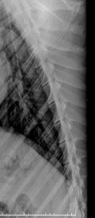
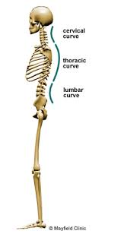
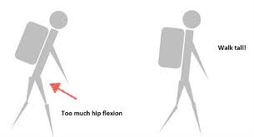
Upright Bi-pedal Posture
Mandates Changes
SPINAL CURVES: LUMBAR LORDOSIS UNIQUE to UPRIGHT
POSTURE (ARCH =s stronger support)
CENTER OF GRAVITY: ‘ PLUMB LINE’
HEAD CENTERS OVER SACRUM
SHIFTS FORWARD in PREGNANCY
MODIFIES as go UPHILL, DOWNHILL, CARRY
Warthog; Leopard

Slide 6
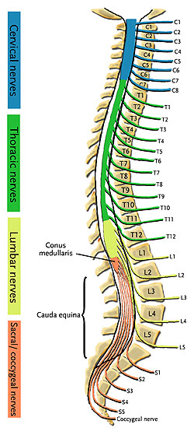

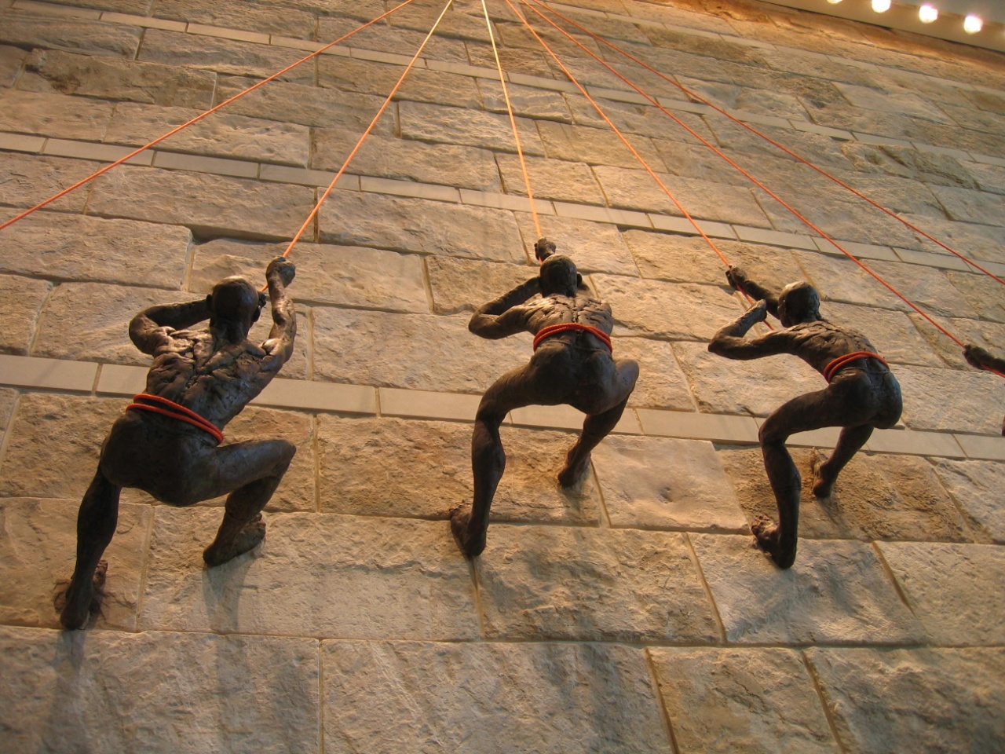
Spinal Anatomy: Overview
Notes:
Encase in concrete, precious tx --

Slide 7
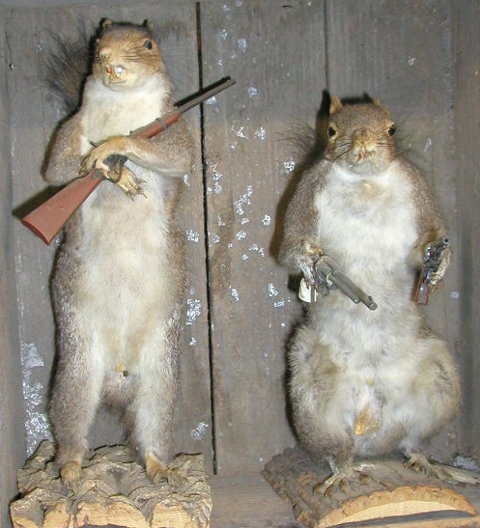
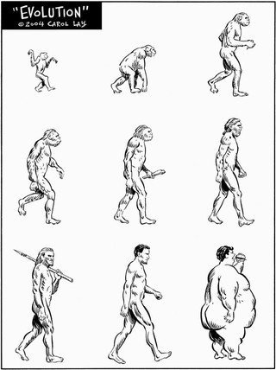
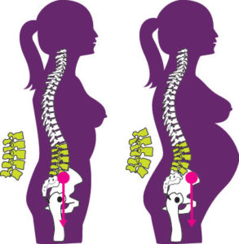

UPRIGHT POSTURE:
NEW STRESS
American Dime Museum

Slide 8
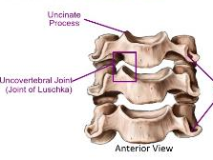

Cervical Spine
7 vertebral bodies *but*
8 cervical nerves-- exiting ABOVE vertebral body level (C8 @ T1)
5 ‘joints’ each level:
  Intervertebral disk (fibrocartilage)
  2 uncovertebral joints (‘cups”)
  2 facet joints (synovial)

Slide 9
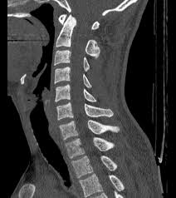
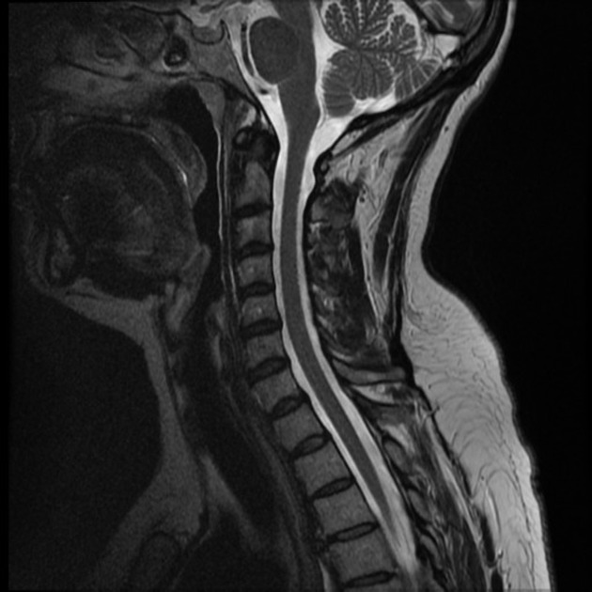
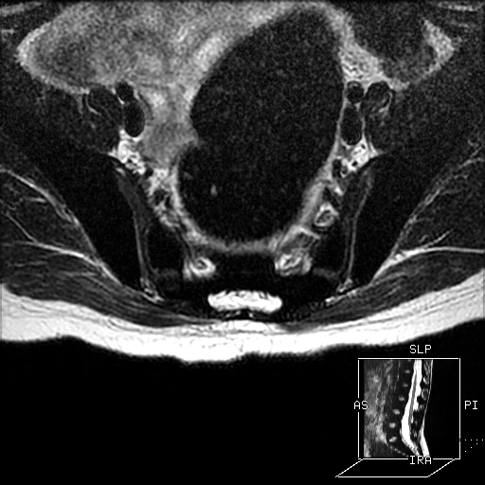

Slide 10
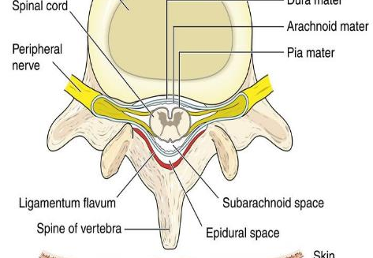
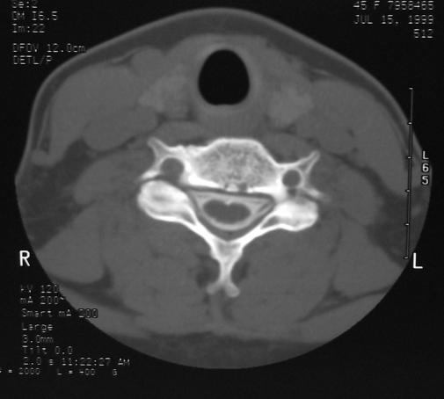
Cervical vertebral body

Slide 11
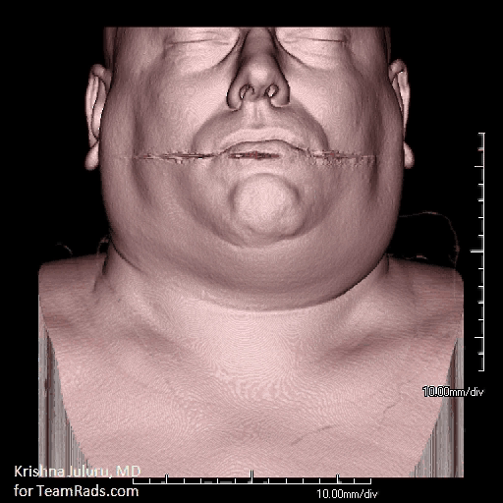
BORDERS OF THE SPINAL CANAL?
ANTERIOR
  Disc, PLL, vertebral body
POSTERIOR
  Ligamentum flavum, lamina
LATERAL
  Pedicle, medial border of facet
Notes:
Skip this animation 2019

Slide 12
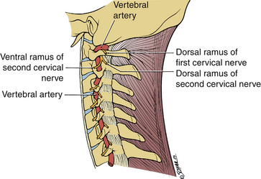
Relationship, vertebral artery: vertebral body
LONGITUDINAL descend on surface
FEEDERS enter through FORAMINA q. level

Slide 13
GENERAL OVERVIEW
Thoracic spine: Five ‘joints’ each
  Intervertebral disk
  Two facet joints
  Two costovertebral joints (RIBS)
Lumbar spine: Three joints each
  Intervertebral disk
  Two facet joints

Slide 14
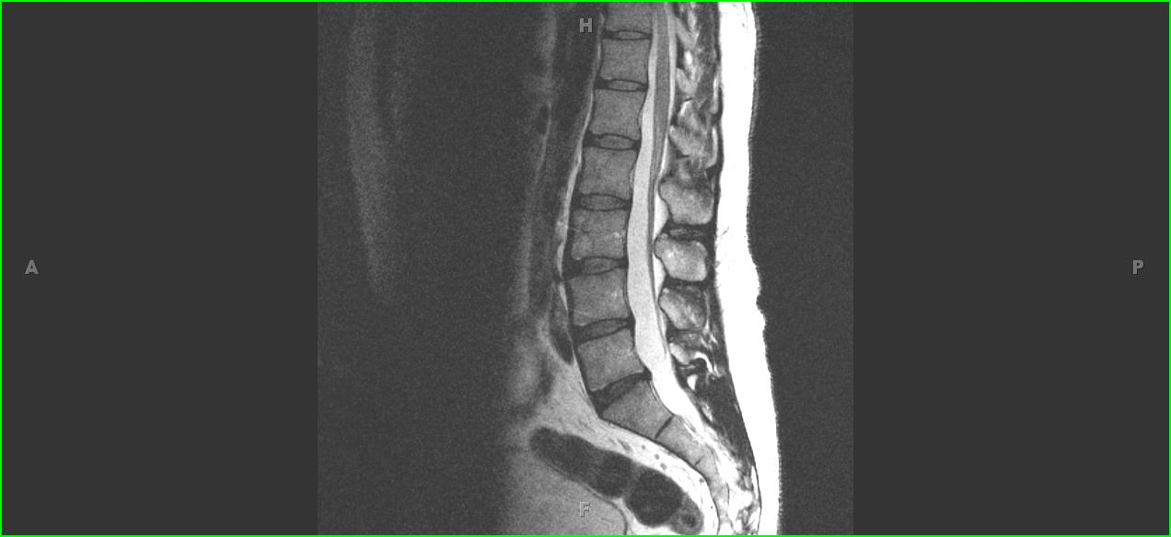
At what level does spinal cord terminate?
Conus medullaris: L1-2
Cauda Equina distally
At what level is a spinal tap performed?

Slide 15
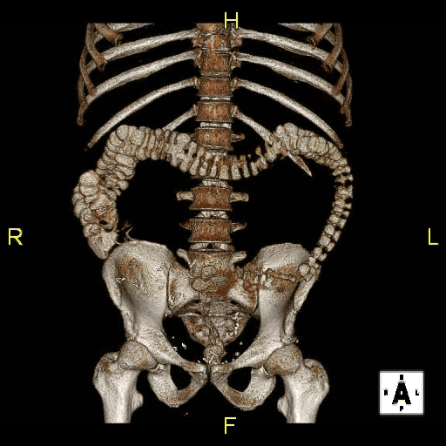
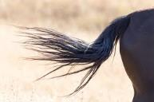

THORACIC / LUMBAR OVERVIEW
At what lumbar spine level are the iliac crests?
L4 … and LUMBAR PUNCTURES go in at L3-4 or 4-5

Slide 16
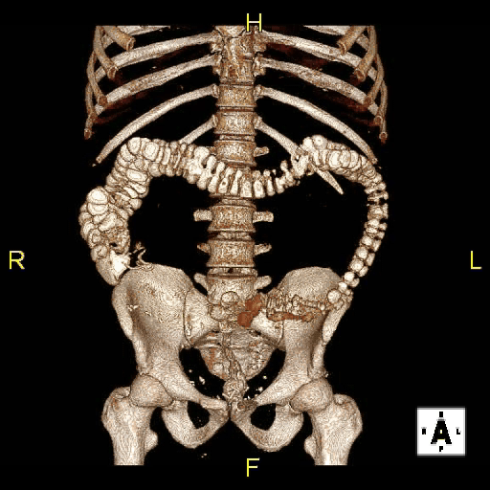
Lumbar spine: Close up
Borders of the NEURAL FORAMINA?
Borders of the SPINAL CANAL?

Slide 17
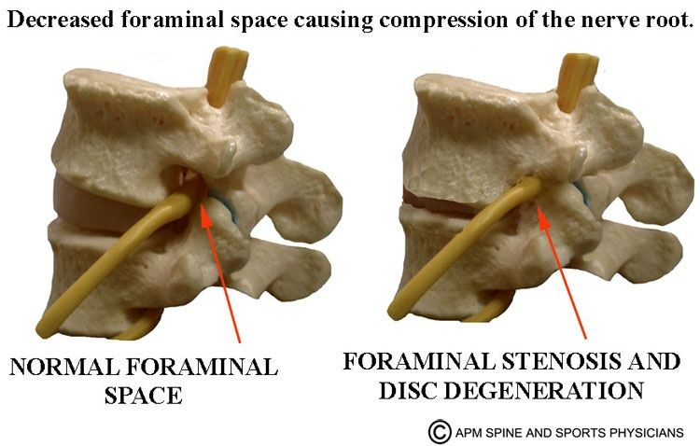
How does irritated tissue respond?

Slide 18
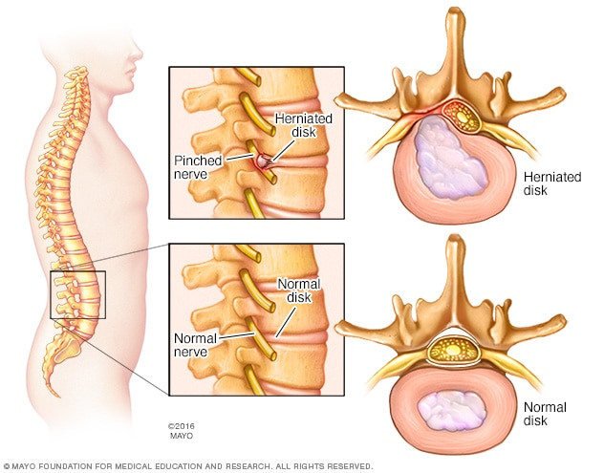
Nerve roots: Thoracic / Lumbar
Nerve roots in lumbar spine exit UNDER pedicle—
“Pinched” by either DISC HERNIATION and/or FORAMINA narrowing

Slide 19
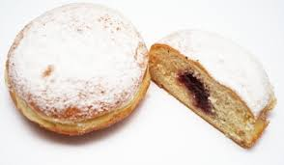
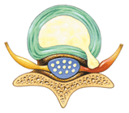
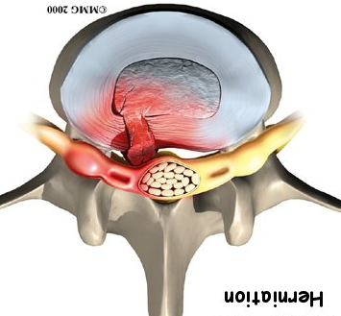
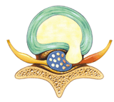

Slide 20
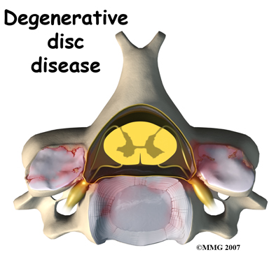
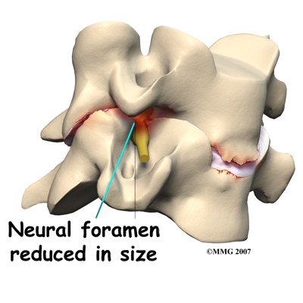
Degenerative disc disease

Slide 21
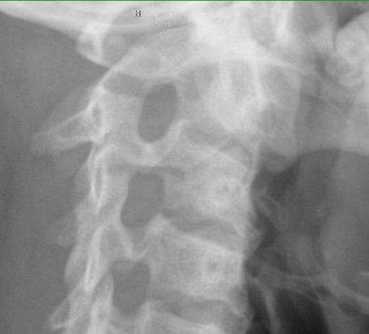
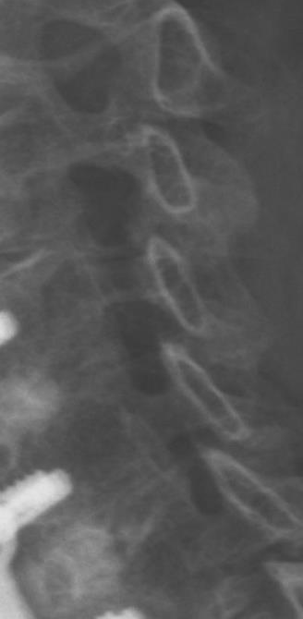

Slide 22

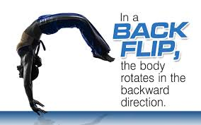
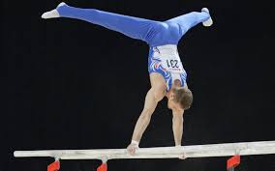


Stable yet Flexible: How??

Slide 23
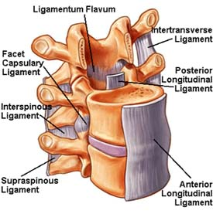
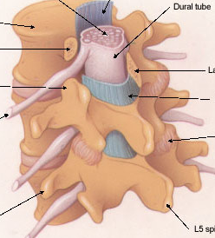
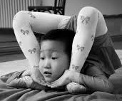
Ligaments:
Anterior longitudinal
Posterior longitudinal
Ligamentum flavum
Interspinous

Slide 24
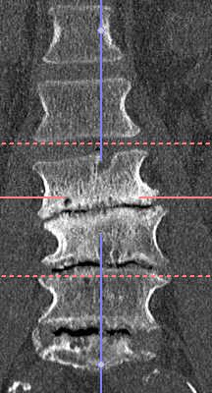
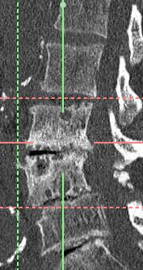
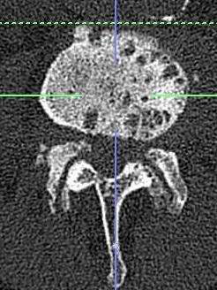
78 y.o. male,
paresthesias

Slide 25
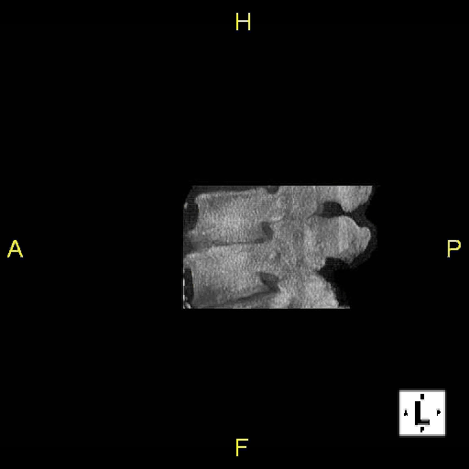

Slide 26
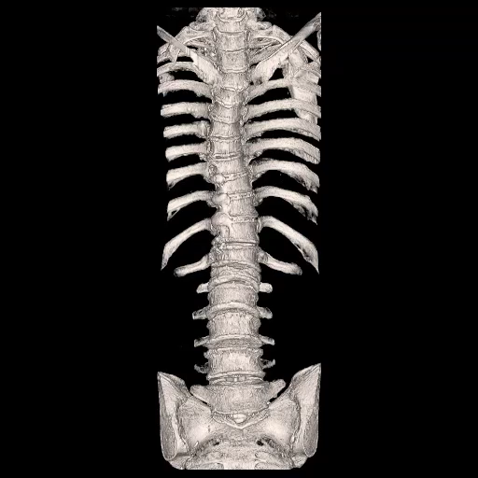
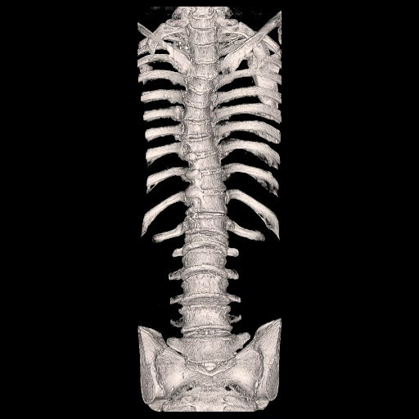
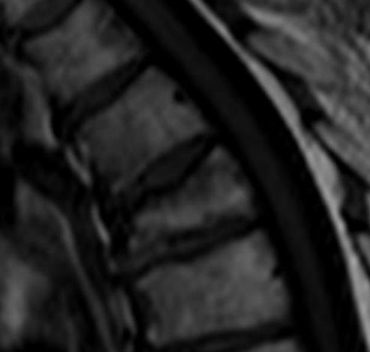
68 y.o. female,
osteoporosis

Slide 27
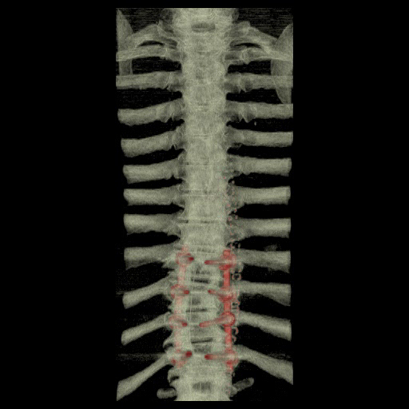
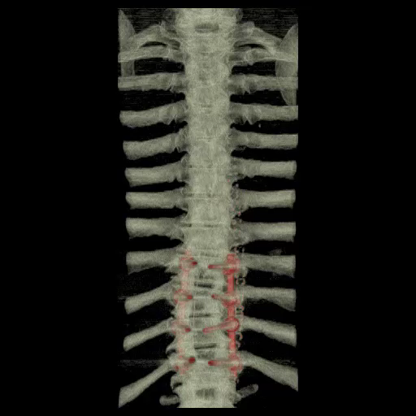

Slide 28
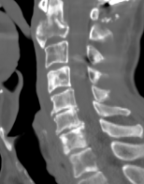
52 y.o. female, breast cancer

Slide 29



Slide 30

Terminology: Canal layers
Extradural
Intradural, extramedullary
Intramedullary
POSITION important for DDx (possible diagnoses)

Slide 31


Slide 32

Extradural
Intradural,
Extramedullary
Intramedullary (in CORD)

Slide 33

Anesthesiologist, about to place an ‘epidural’. Where will needle go?
EPIDURAL → analgesia,
not total anesthesia (labor;
post-op pain)
Emergency Medicine Physician, about to do spinal tap on patient with possible meningitis. Where will needle go?
SUBARACHNOID
Measure CSF pressure
Sample CSF for testing

Slide 34



Slide 35





“ISOTROPIC”:
having the same
value when measured
in different directions

Slide 36


SHAPE OF THECAL SAC
At what levels were these images obtained?

Slide 37


Slide 38


Slide 39


1) Symptoms?
2) What ligaments likely torn?
1) Paralysis!
2) Anterior spinal
Posterior spinal
Ligamentum flavum
Intraspinous ligs.

Slide 40




Slide 41


Slide 42




Slide 43
TEACHING POINTS
Orientation, neural foramina
Understand structure, spinal canal
Understand different spinal spaces
  *Epidural space
  *Subdural space
  *Subarachnoid space
Spinal ligaments

Slide 44
Take Home: C Spine
Cervical spine: 5 joints
Vertebral arteries lie lateral to cervical vertebral bodies in foramen transversarium
Cervical spine nerve roots exit ABOVE vertebral bodies

Slide 45
TAKE HOME: T Spine
Thoracic spine: 5 joints
Nerve roots exit UNDER pedicle
Depending on the type of disc disease, either the nerve root at or below the level of the disc will be affected

Slide 46
TAKE HOME : L Spine
Lumbar spine: 3 joints
Spinal cord terminates at L1-2
at conus medullaris
Iliac crests lie at L4-5 level
Spinal tap should be performed at L3-4 level
Dural (thecal) sac extends throughout the length of the spinal canal (compartments → implications for both disease and treatment)

Slide 47




Comparative Anatomy: GIRAFFE
Notes:
Only 7 but together longer than human body

Slide 48

This anatomy will be relevant:
Lumbar Puncture localization
Fractures, fragment displacement
Degenerative disk disease
Metastatic disease to spine
Spinal fusion hardware
Myelograms → extent/abnormalities of thecal sac
Spaces for titrated anesthesia
Compartments for chemotherapy

Slide 49


Thank you!
Any questions?
Donna Magid MD, M.Ed
dmagid@jhmi.edu
TeamRads.com
#TheRealTeamRads

