Slide 1
Radiology-Gross Anatomy Correlations
Donna Magid MD, M.Ed, FAUR
Professor, Radiology
Professor, Orthopaedic Surgery
Professor, Functional Anatomy and Evolution
Hopkins Lifer: med school, residency, Fellowship, Faculty…

Slide 2

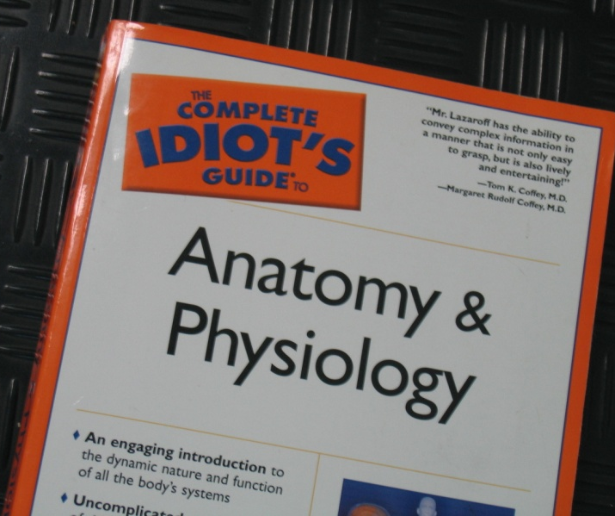
REPEAT AFTER ME
ANATOMY WILL NEITHER MAKE SENSE NOR BE RETAINED UNTIL IT ‘HOOKS UP’ WITH MORE PRAGMATIC KNOWLEDGE.
DIAGNOSTIC IMAGING LEADS THE TRANSITION FROM PAGE TO PATIENT.
REPETITION IS THE KEY TO RETRIEVABLE LEARNING.

Slide 3
Future Clinicians:
Non-interpretive skills: Intelligent selection, timing, of consultations for optimal care.
(When to send for Surgery, not do-it-yourself…When to call Ophthalmology, Orthopaedics, Imaging, Urology, etc …)
Goal: Patient Safety and Clinical Efficacy: win-win.
American College of Radiology Appropriateness Criteria (ACR-AC) acr.org
What-to-request-when, and why.
Ranks studies from 9 (best choice) to 1.
Dose, safety, variables (age, gender, co-morbidities, past med history, ability to comply,…)
“Pocket Bible” for Imaging selection
Notes:
This is Anat so contents count but non-interpretive skills drive the future. Increasing focus on non-interpretive skills– appropriate timely safe care– medicine so complex, knowing which service to call or which study to request not always clear

Slide 4
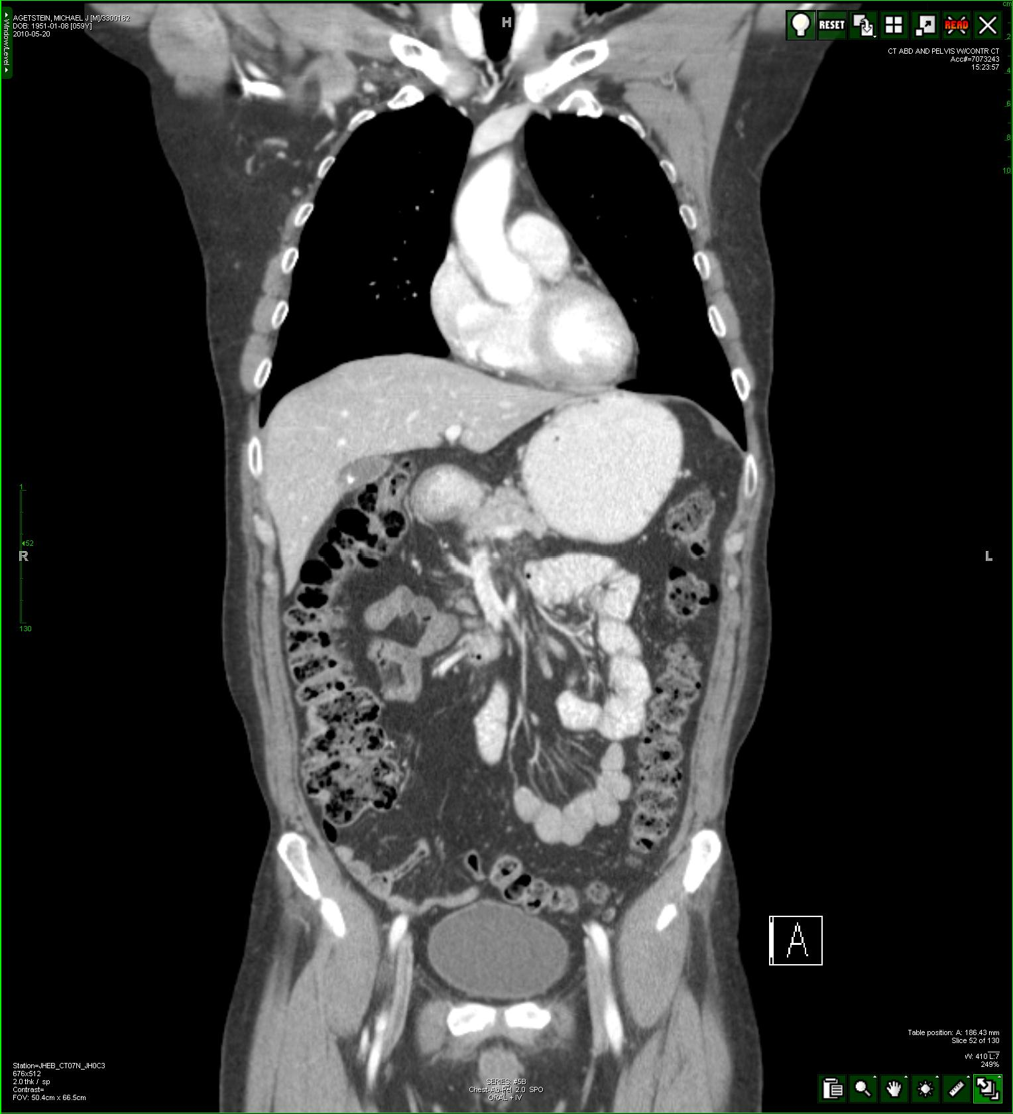
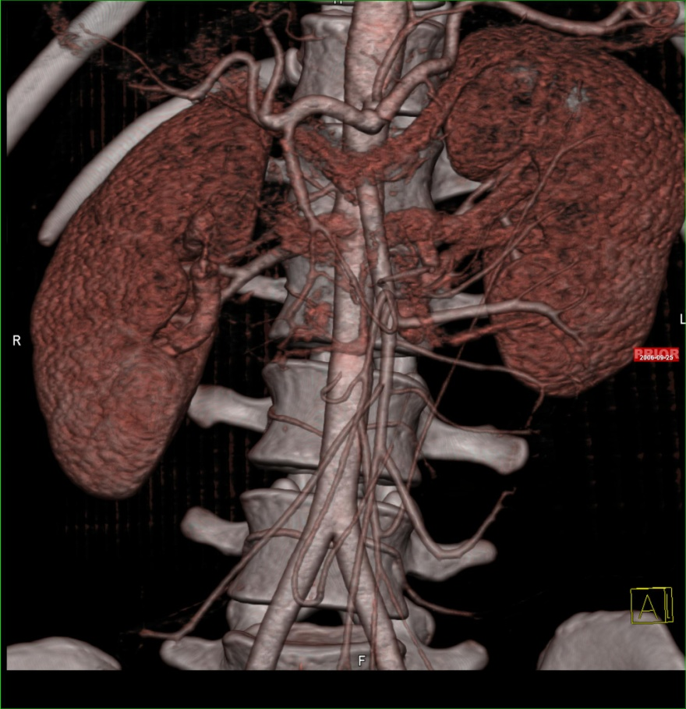
Notes:
We can show you anatomy simulating and surpassing that seen in the Gross Lab

Slide 5
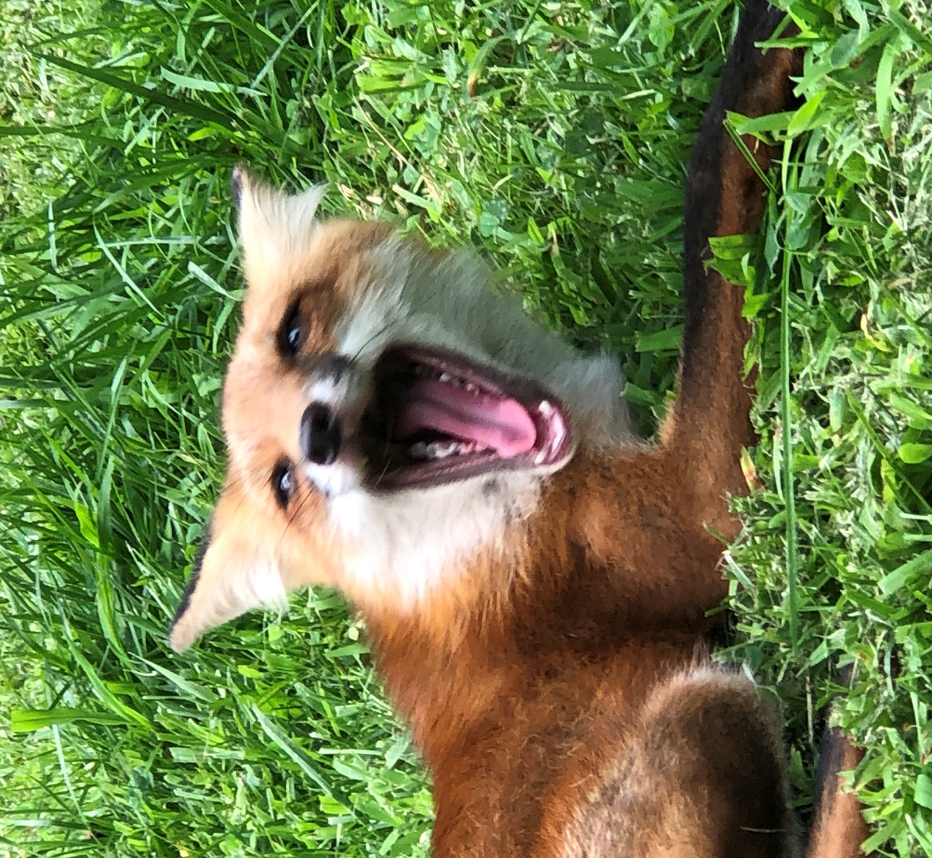

THE BONY PELVIS:
ANATOMY: MORE THAN YOU EVER
WANTED TO KNOW (OR MEMORIZE).
RADIOLOGY: RE-ASSEMBLES THE PIECES INTO A WHOLE
Notes:
Spent a maternity leave trying to understand the embryology and ‘why’ of the hip…began to understand how little we knew and what am iracle it all is….tried to explain it in clinic, starting an argument amongst the hip, knee and ankle Orthopods as to whther it was the fem hd, the fem condyles, or the distal tibial plafond.

Slide 6
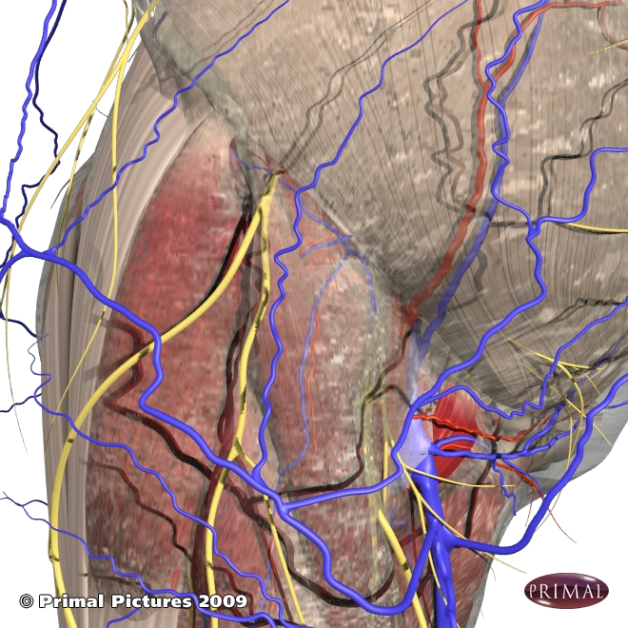
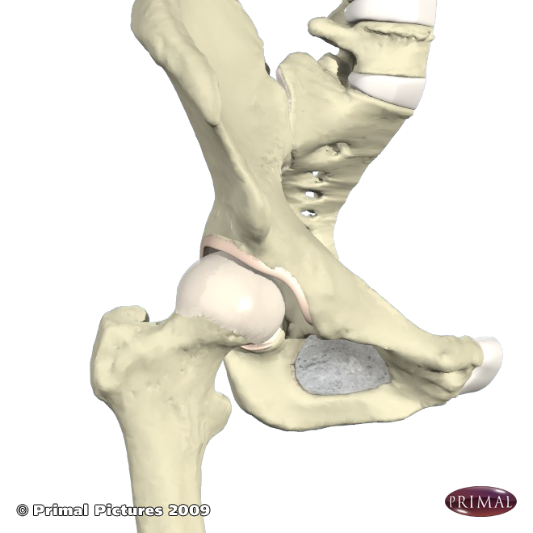
THE BONY PELVIS:
HIPS HIPS HOORAY!!
Notes:
You are obliged to go skin in—get bogged down in the relative minutia of muscles, superficial twipgs of vesels and nerves

Slide 7
WHAT HAS IT DONE FOR ME LATELY??
SUPPORT STAND, SIT; MOVE; GRAVITY
WEIGHT TRANSFER SPINE → LEGS
BALANCE AND GAIT: FLEXIBLE YET STABLE;
EXPANDED SURFACE AREAS FOR HUGE MUSCLES
PROTECTION OF MANY ORGAN SYSTEMS, TISSUES: GI, GU, NEUROVASCULAR…
FETAL SUPPORT/PROTECTION
→ AUTO-MODIFYING FOR DELIVERY
MARROW PRODUCTION

Slide 8
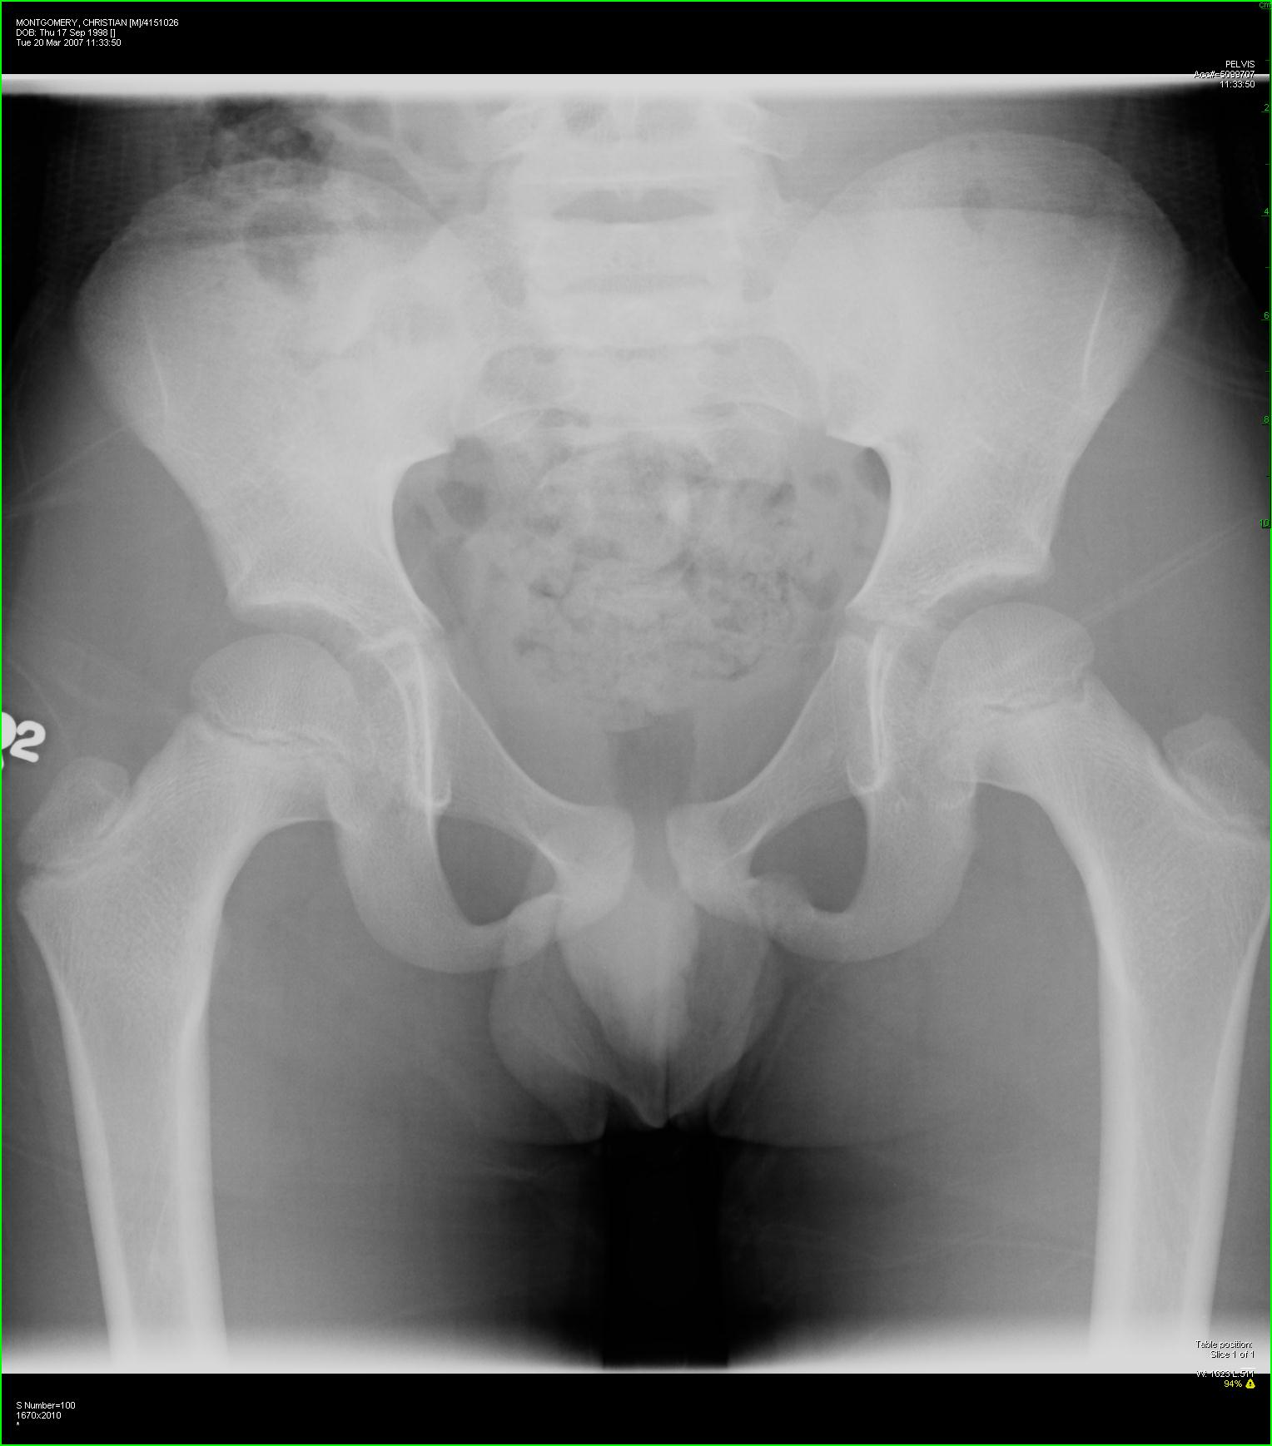
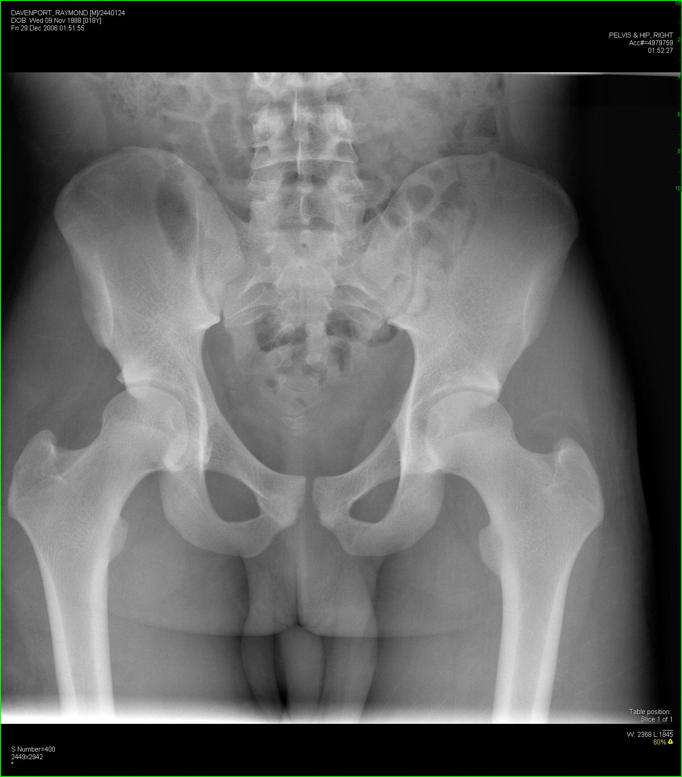
NORMAL: 11yo vs.18yo

Slide 9
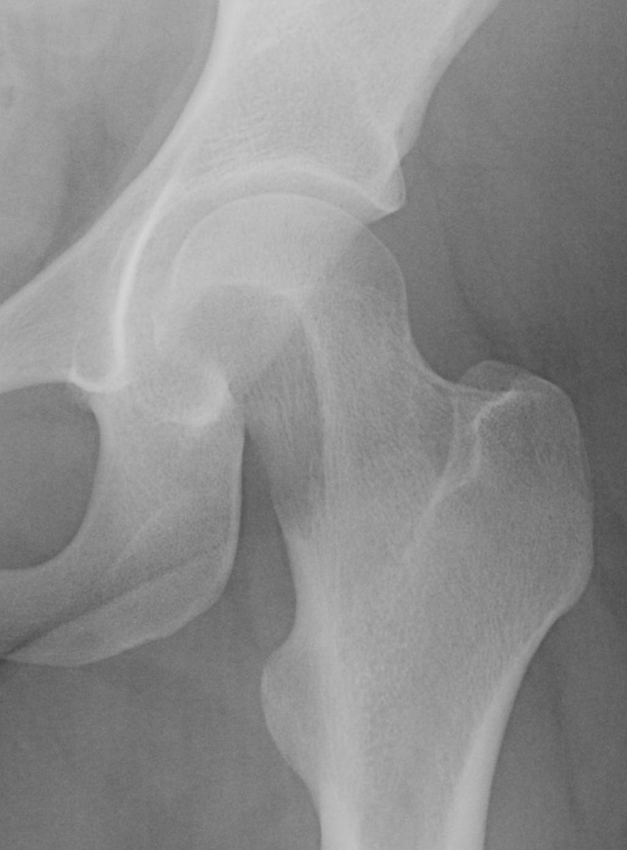

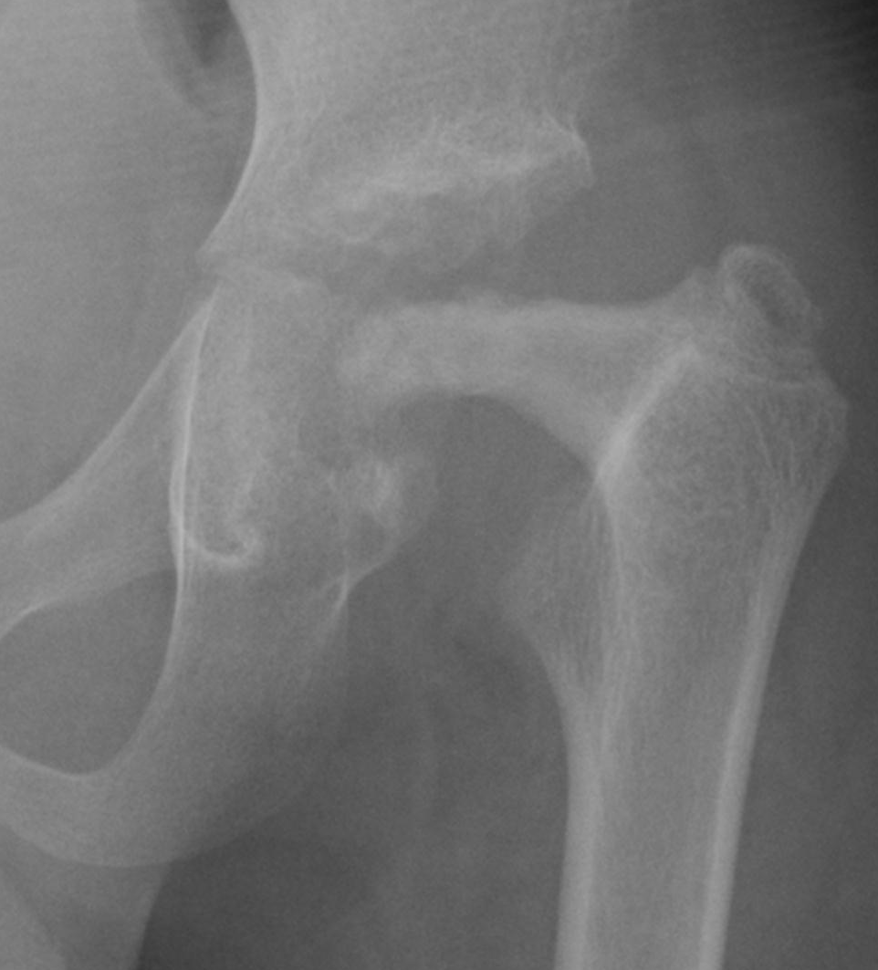
BONES TALK (WOLFFE’S LAW)
→DATING ONSET OF ABNORMALITIES
CONGENITAL
IN CHILDHOOD
NOT UNTIL ADULT

Slide 10
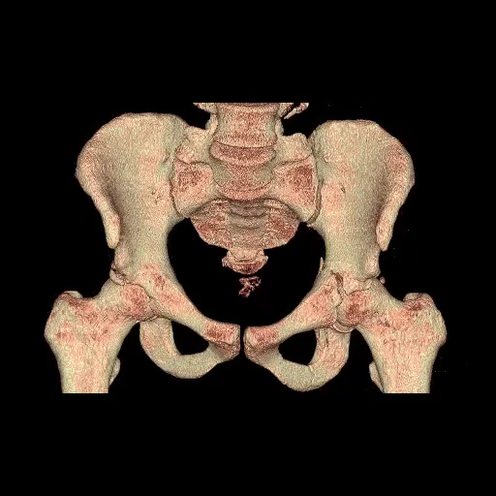

Slide 11
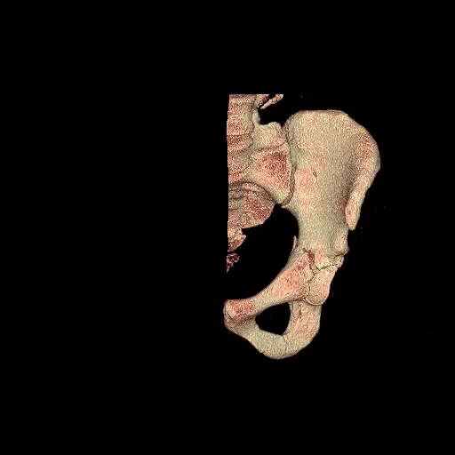

Slide 12
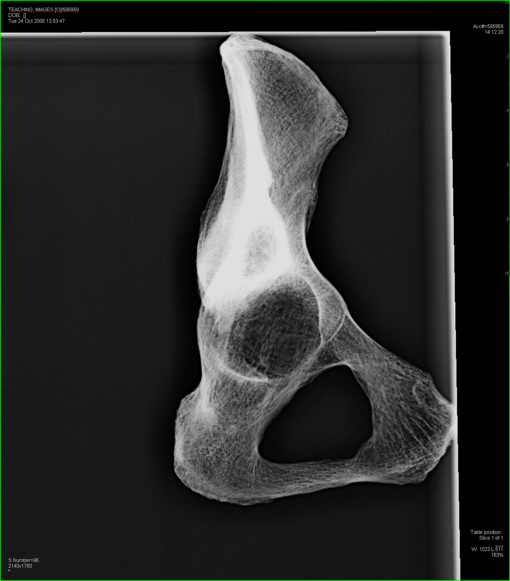
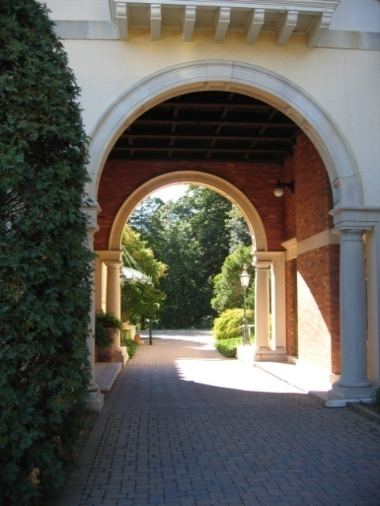
WEIGHT BEARING: ARCH
STRUCTURALLY SOUND CURVES & ARCHES ARE INHERENTLY STRONG AND STABLE (pelvis, skull, ribs, foot…)
(CAN BEAR, TRANSFER, MORE WEIGHT)

Slide 13
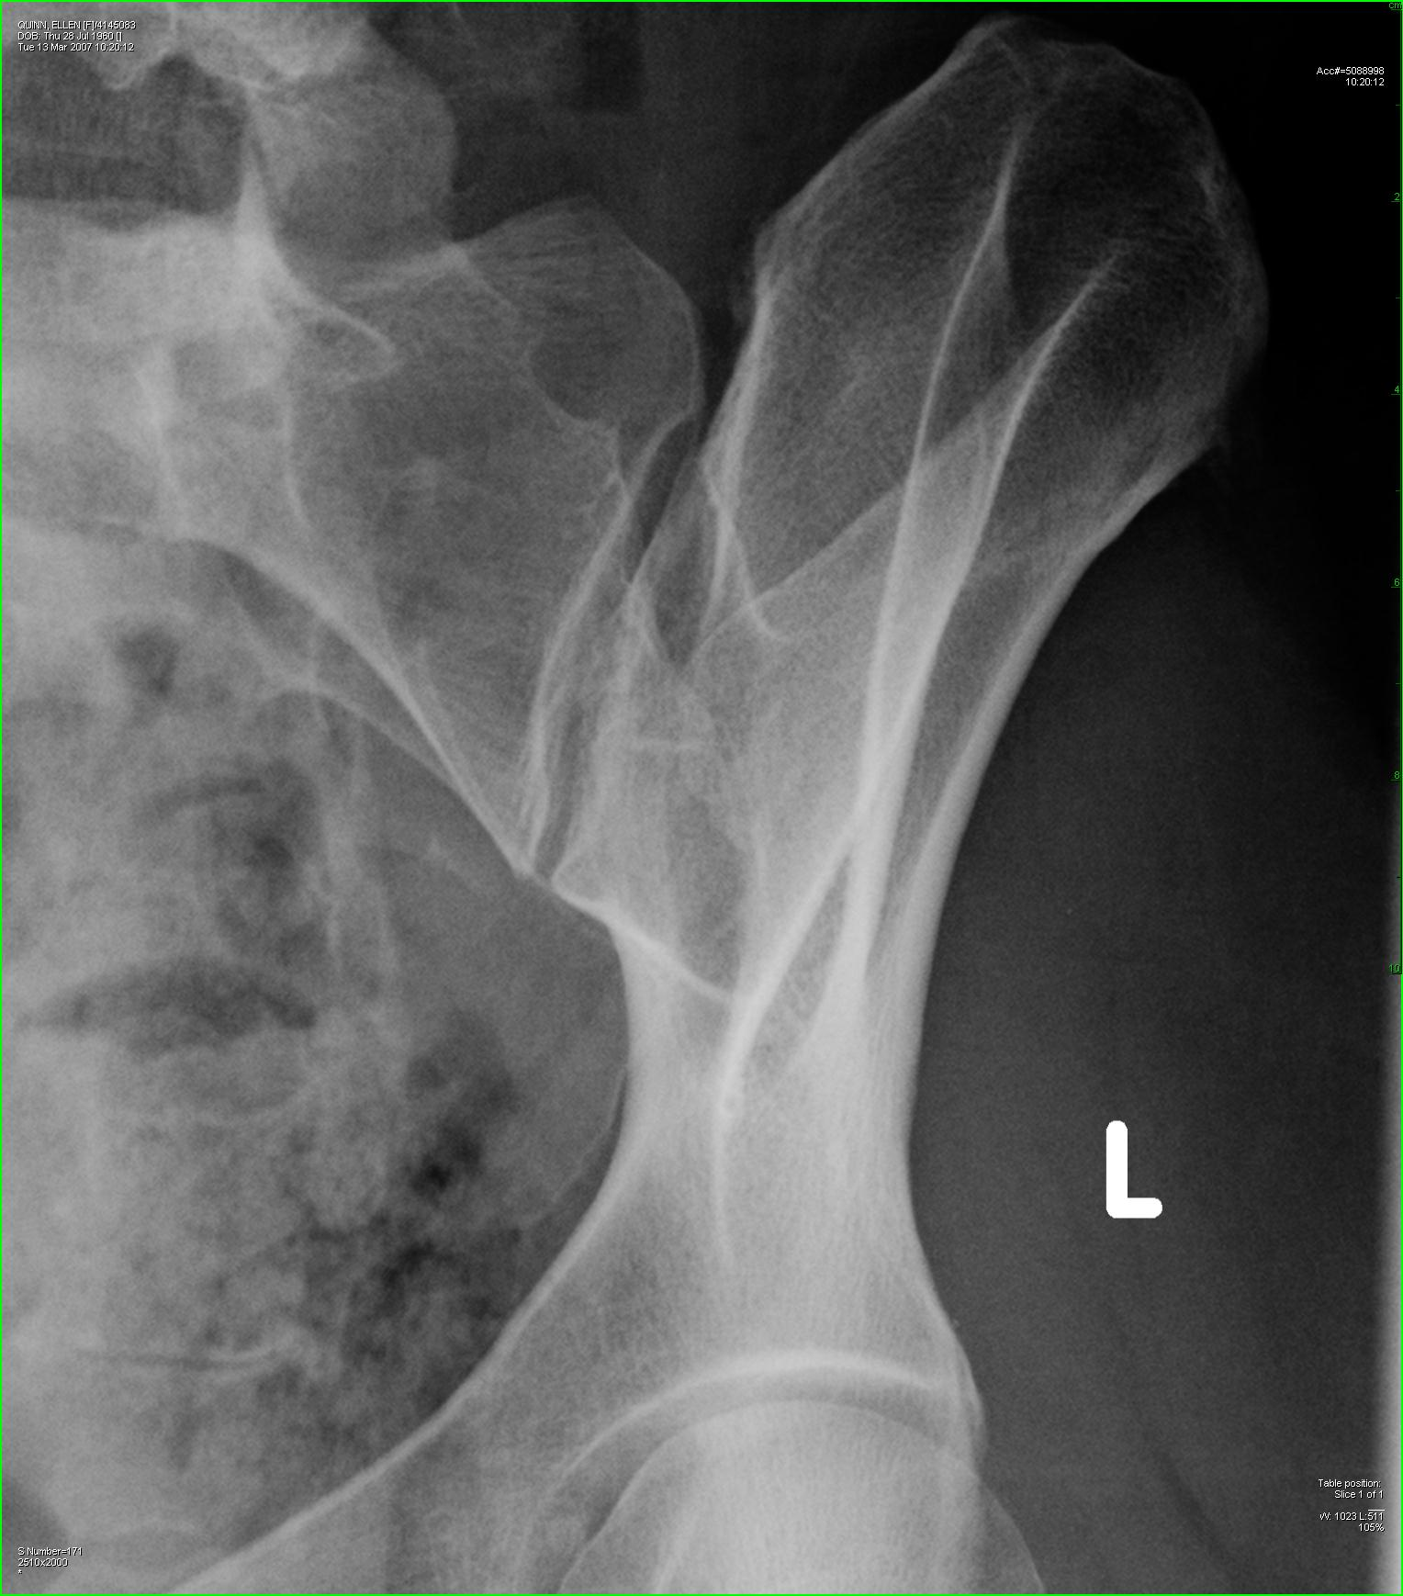
SI (sacroiliac) JOINT STABILITY
MINIMAL INHERENT BONY INTERLOCK;
STRONGEST LIGAMENTS IN BODY BIND SI JOINTS, RING TOGETHER
TRAUMA: PELVIC INSTABILITY (BY PHYSICAL EXAM OR IMAGING) IMPLIES MASSIVE INJURIES

Slide 14

“BONES TALK”: WOLFF’S LAW
BONE (OSTEOCYTES- ’blasts, ’clasts)
CONSTANT WORK-IN-PROGRESS
PRODUCE and REPAIR
DESTROY or REMODEL
GRAVITY, MOTION, etc. MODIFY PREDETERMINED GENETIC BLUEPRINT (‘NATURE vs NURTURE’)

Slide 15
BIOMECHANICS AND LOAD
BODY WEIGHT TRANSFER:
TINY ACETABULAR ROOF →
SUPERIOR POLE FEMORAL
HEAD (ditto) → FEMUR
100 lb LOAD FEM. HEAD
BECOMES +800 lb RACING DOWN STEPS
FOCAL COMPRESSIVE LOAD MAY REACH *1200* lb AT MEDIAL SUBTROCHANTERIC FEMUR!!

Slide 16
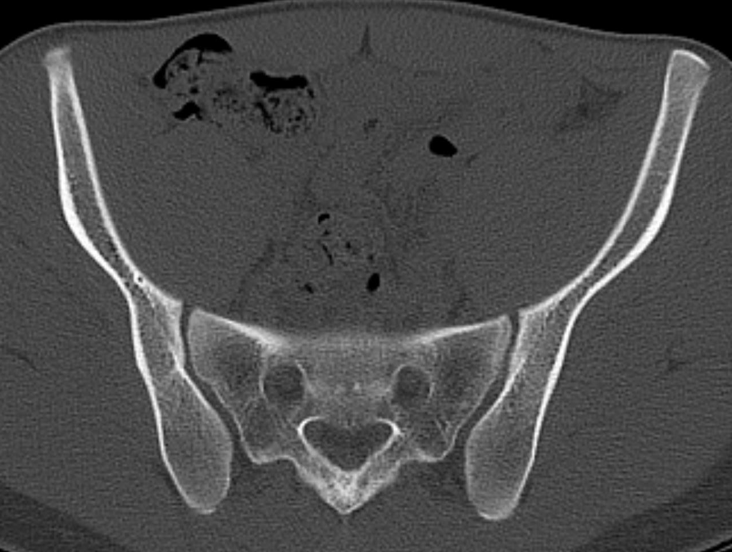

Slide 17
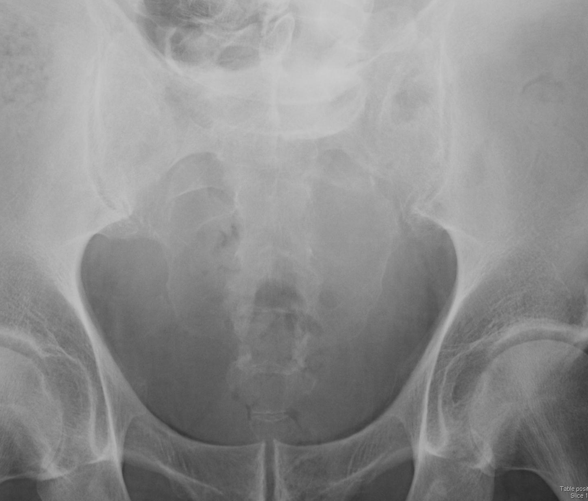
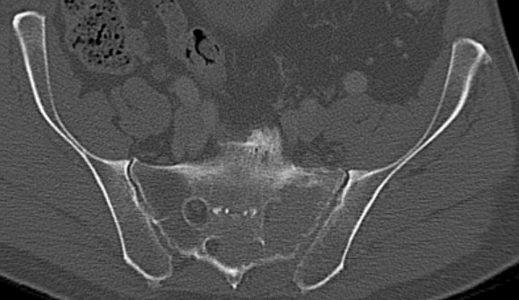

Slide 18
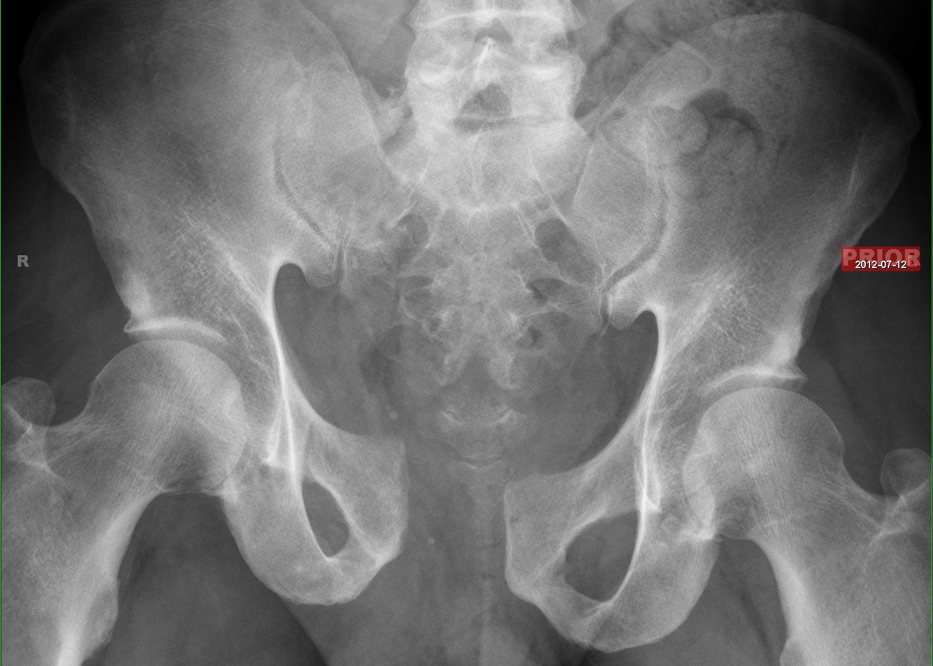
Where is the abnormality??

Slide 19
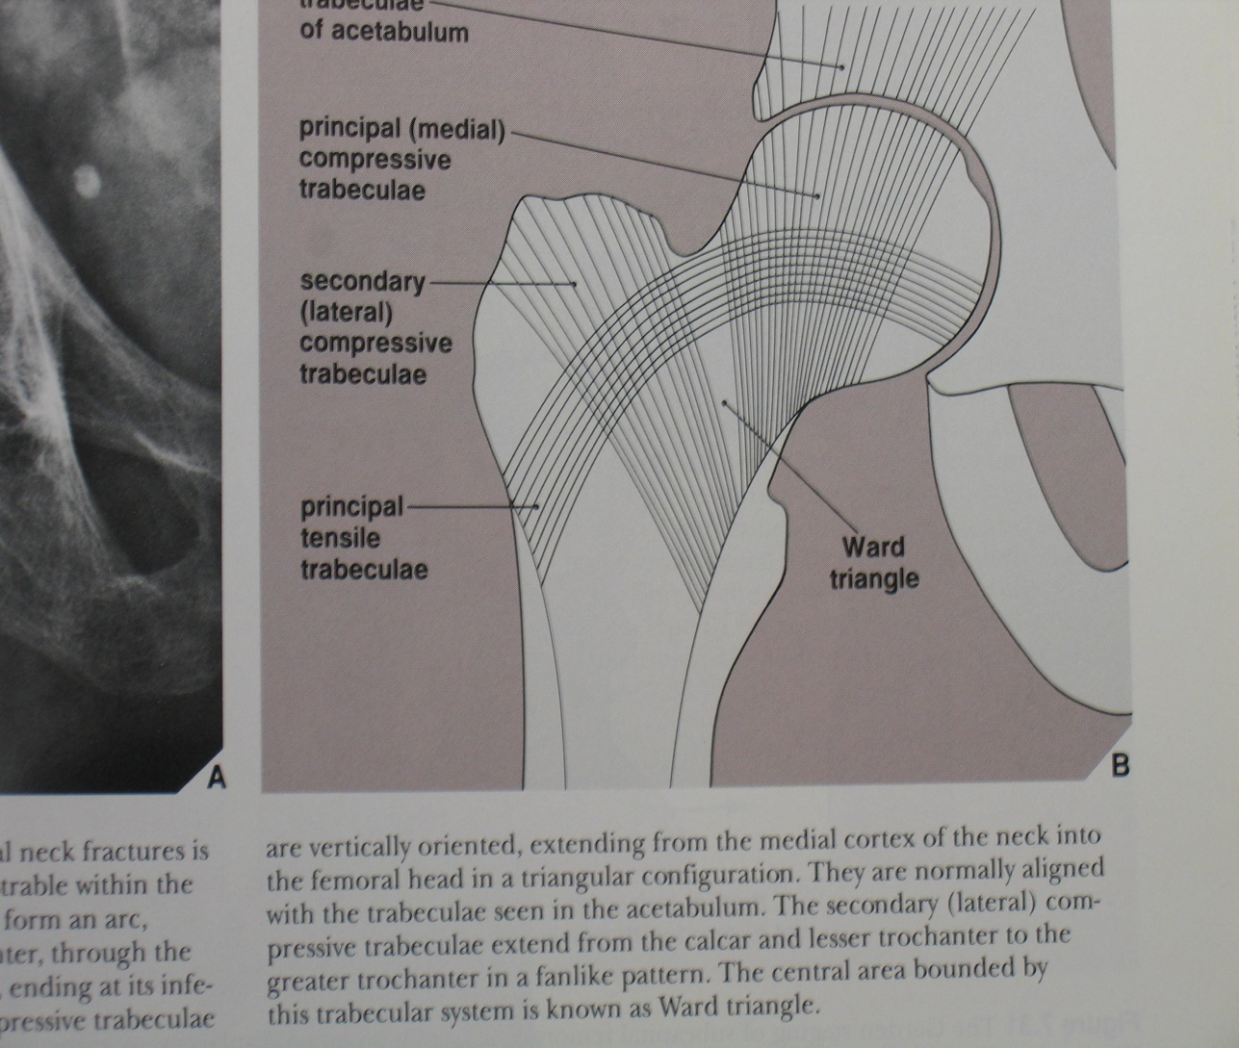
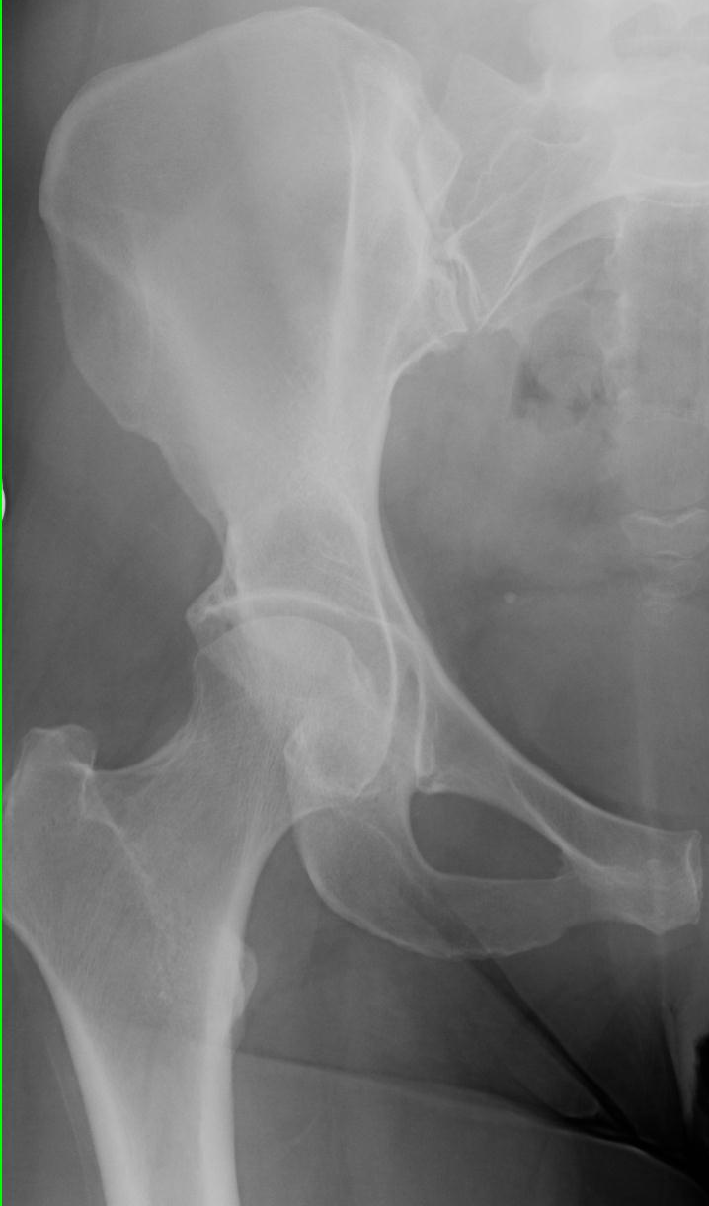
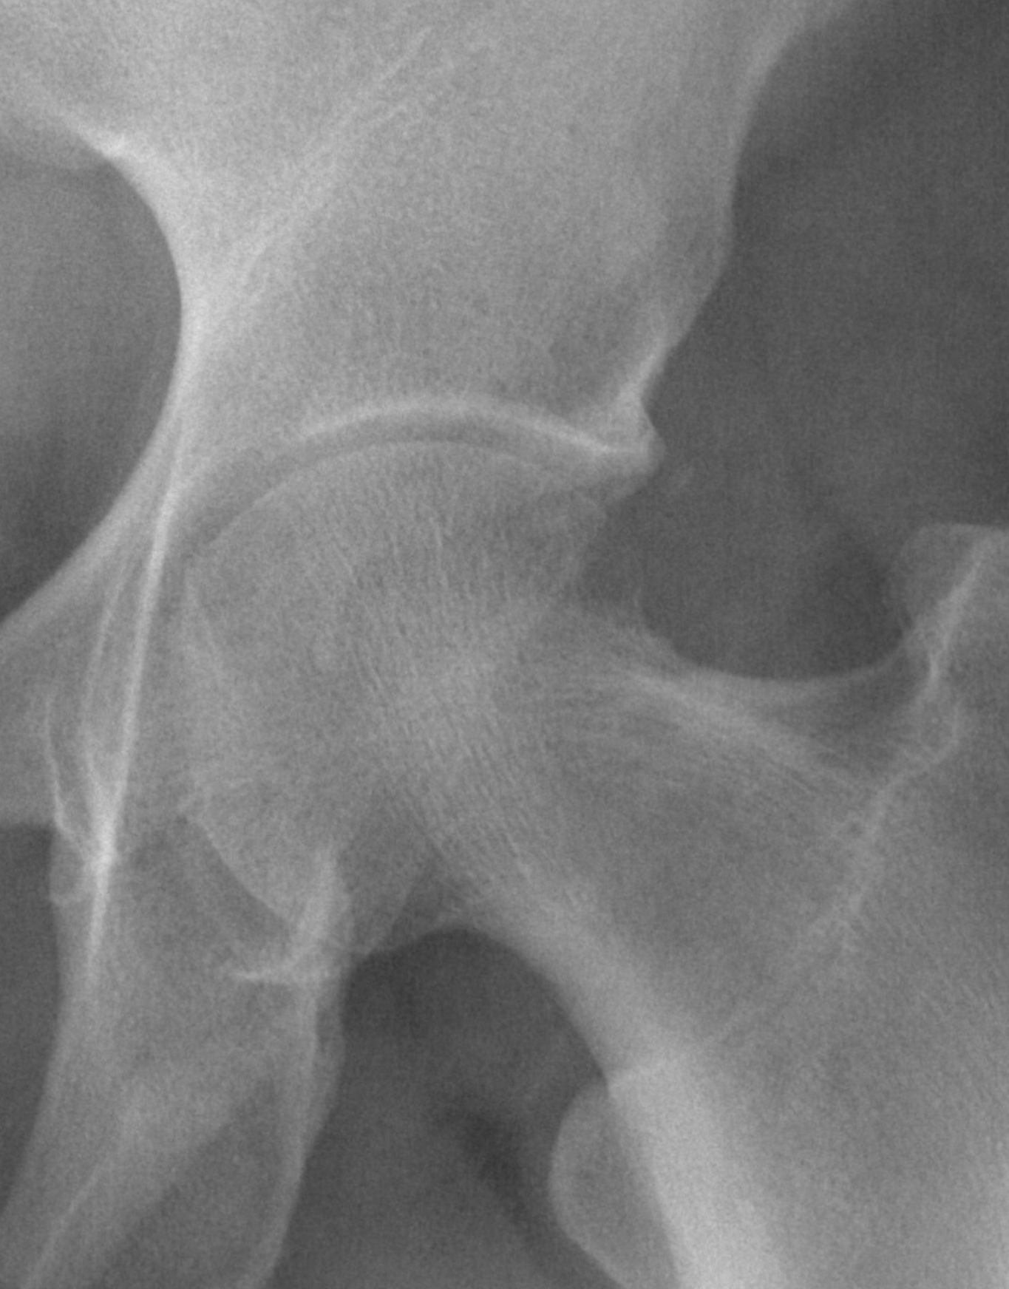
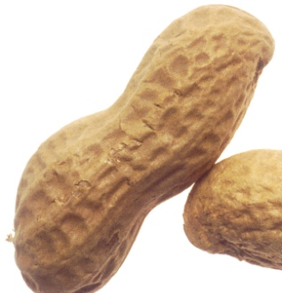
Greenspan, A. Orthopedic Imaging 3rd Ed.

Slide 20
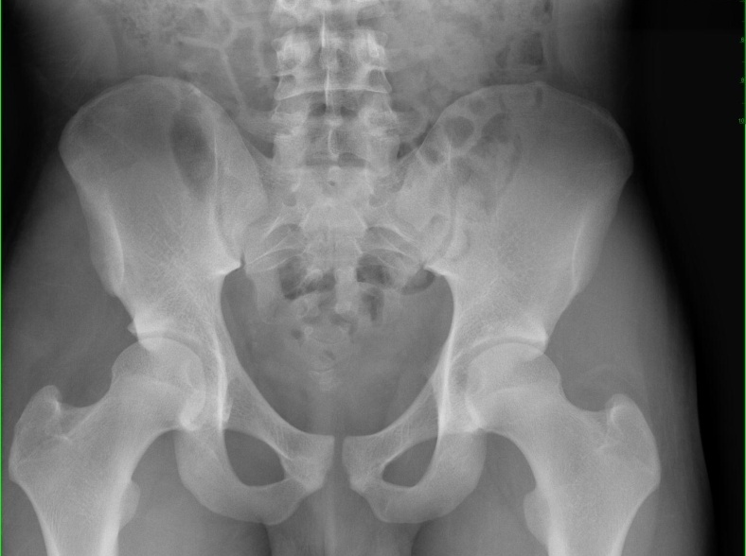
THE PELVIC RING
RINGS: ‘FX. IN TWO PLACES AT ONCE’
THINK ‘STALE BAGEL’, NOT ‘PRETZEL’
(MAY GIVE WAY, DEFORM, A BIT WITHOUT BREAKING; RIGID BUT NOT BRITTLE)

Slide 21
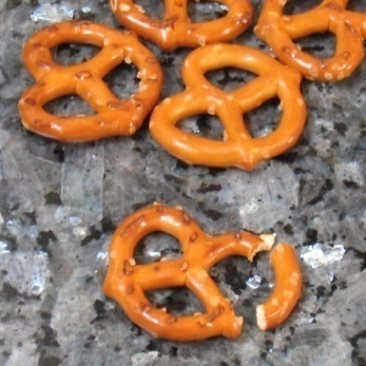
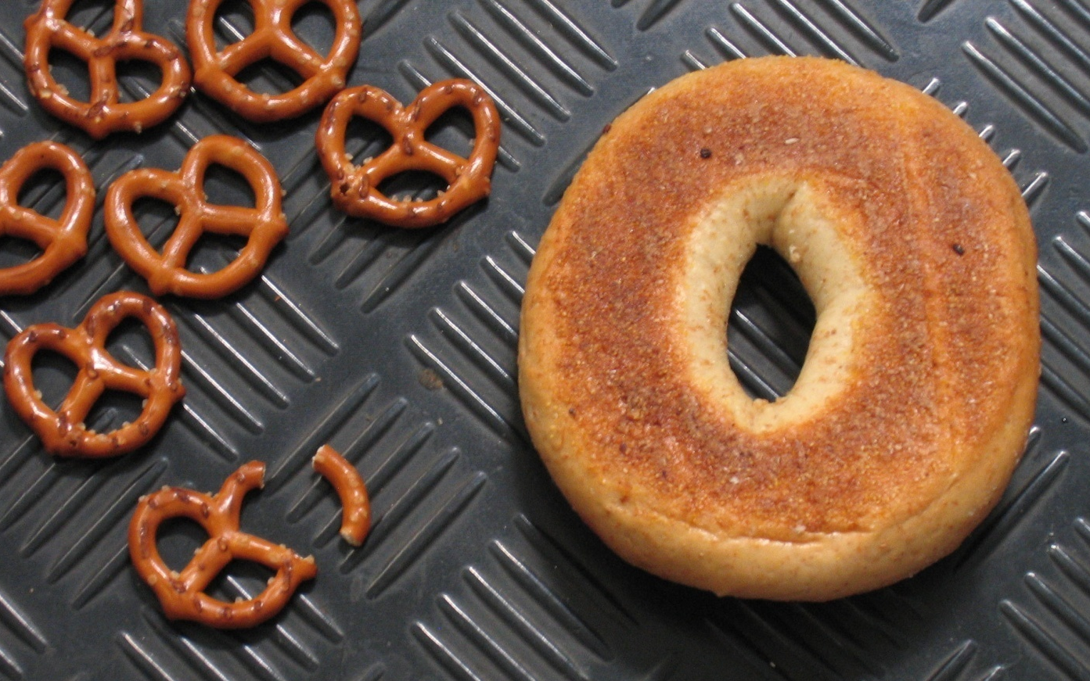
PELVIC RING:
‘OPENS IN 2 PLACES’
(BUT NOT ALWAYS…)

Slide 22
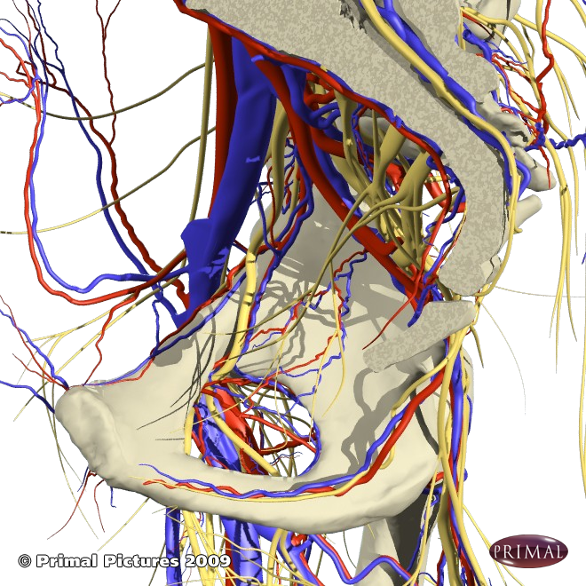
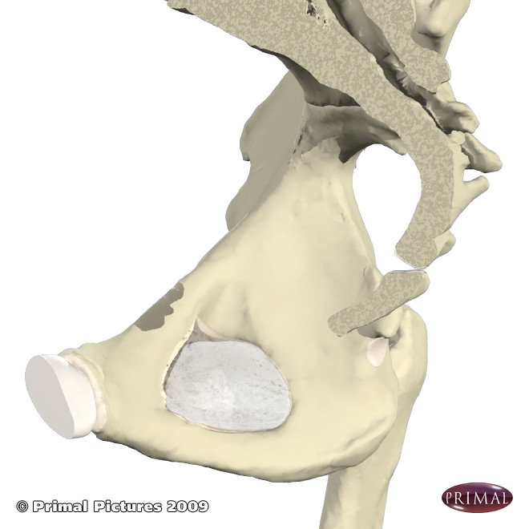
BONY PELVIS: TRAUMA

Slide 23
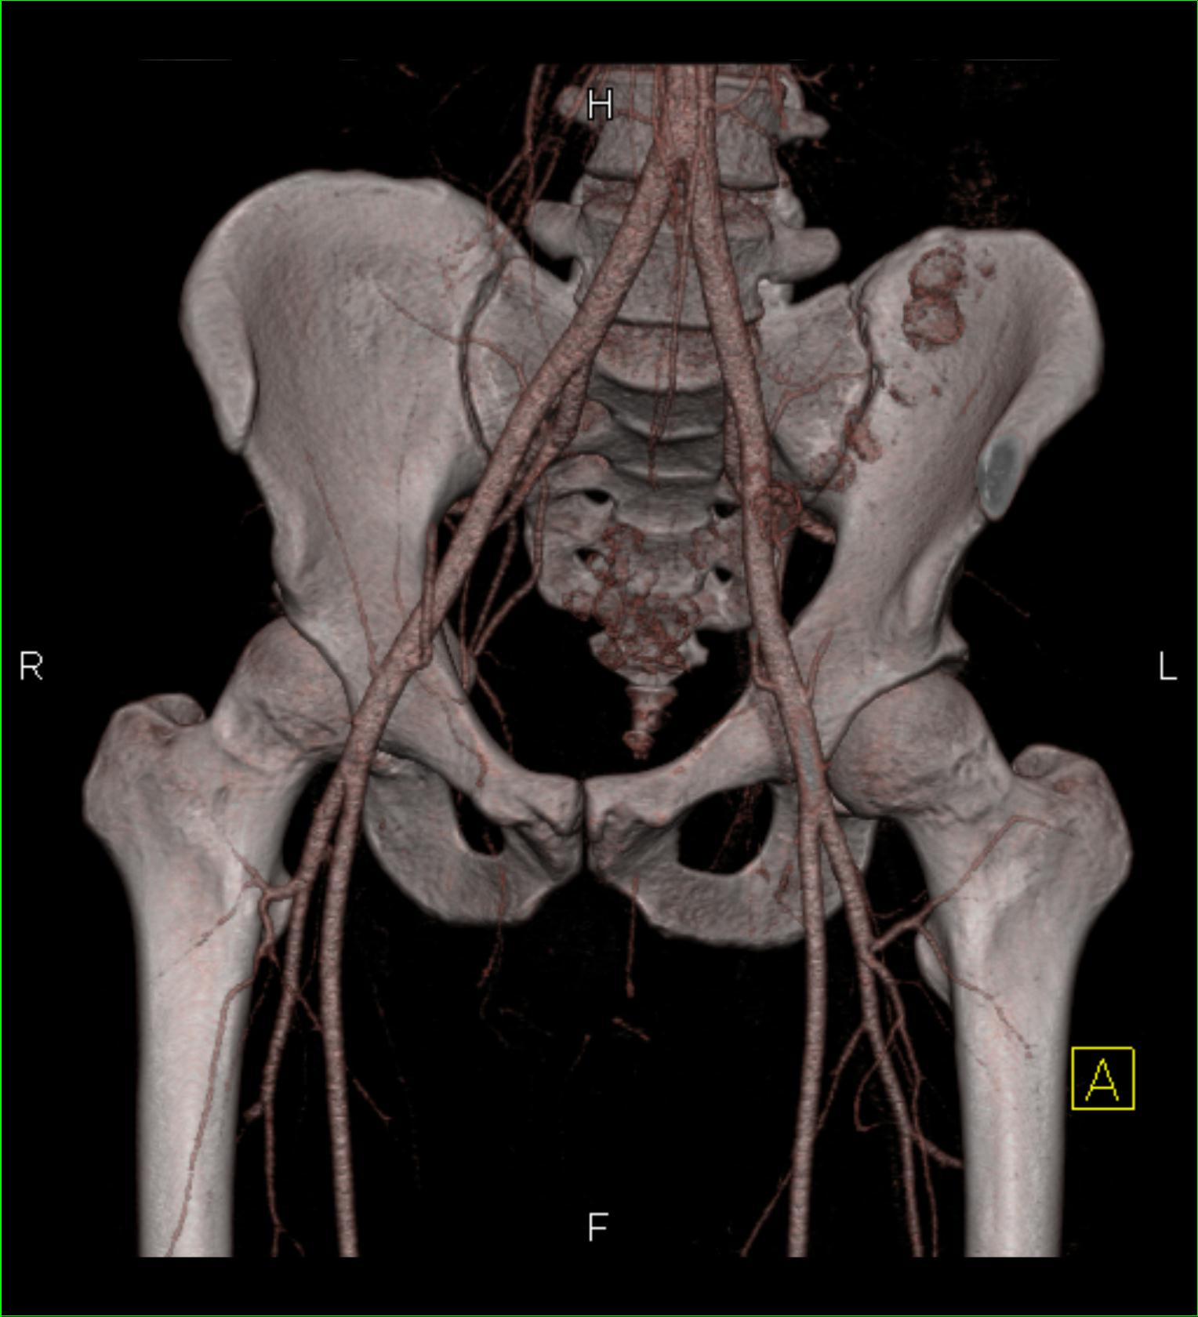
PELVIC RING FRACTURES
SMALL % OF ALL FXS.
BUT
3RD CAUSE OF DEATH IN POLYTRAUMA
GI (GASTROINTESTINAL)
GU (GENITOURINARY )
NEUROVASCULAR SHOCK HEMORRHAGE

Slide 24
PELVIC RING DISRUPTION
Enormous force, esp younger, to disrupt
Therefore multiple associated injuries
Intensely vascularized →exsanguinate
Average transfusions = 6 Units* blood (50%)
Anterior-Posterior (‘open book’) can =15 U*
2%→ embolization (Rads: transart. rescue)
Retroperitoneum holds 4 L (8 U) ‘til tamponades
Rectosigmoid, urethra, bladder, major vessels/nvs, kidneys, hemidiaphragm, L-S
* BODY =s 8-12U!

Slide 25
PELVIC RING FRACTURES
> half = in elderly; usually = fall from stance, less force → 95% are minor
Greatest morbidity/mortality involve high forces (MVC, ped-x, fall from height)
3-20% mortality: hemorrhage, multi-organ, PE
PE: hemorrhage, marrow, pain, immobility
Long-term: GI, GU, Gyn, infections, pain
Ob: infertility, abortion, obligatory C-Section
Sexual dysfunction, chronic pain
CC Mechem, U.Penn, WebMD 2010

Slide 26
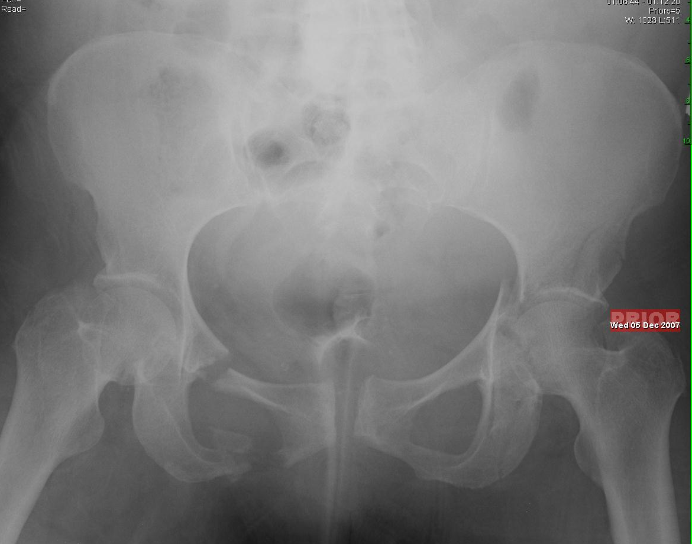

Slide 27
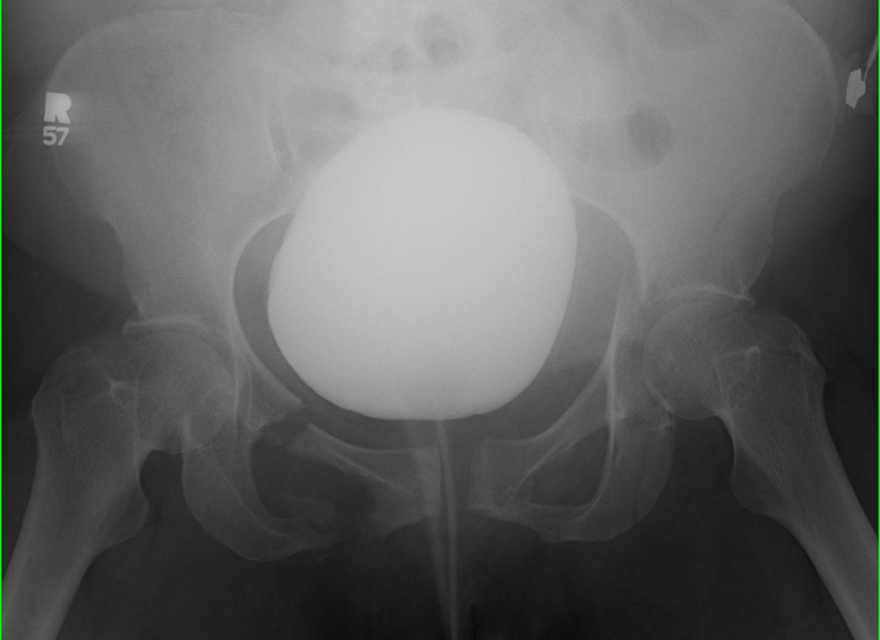

Slide 28
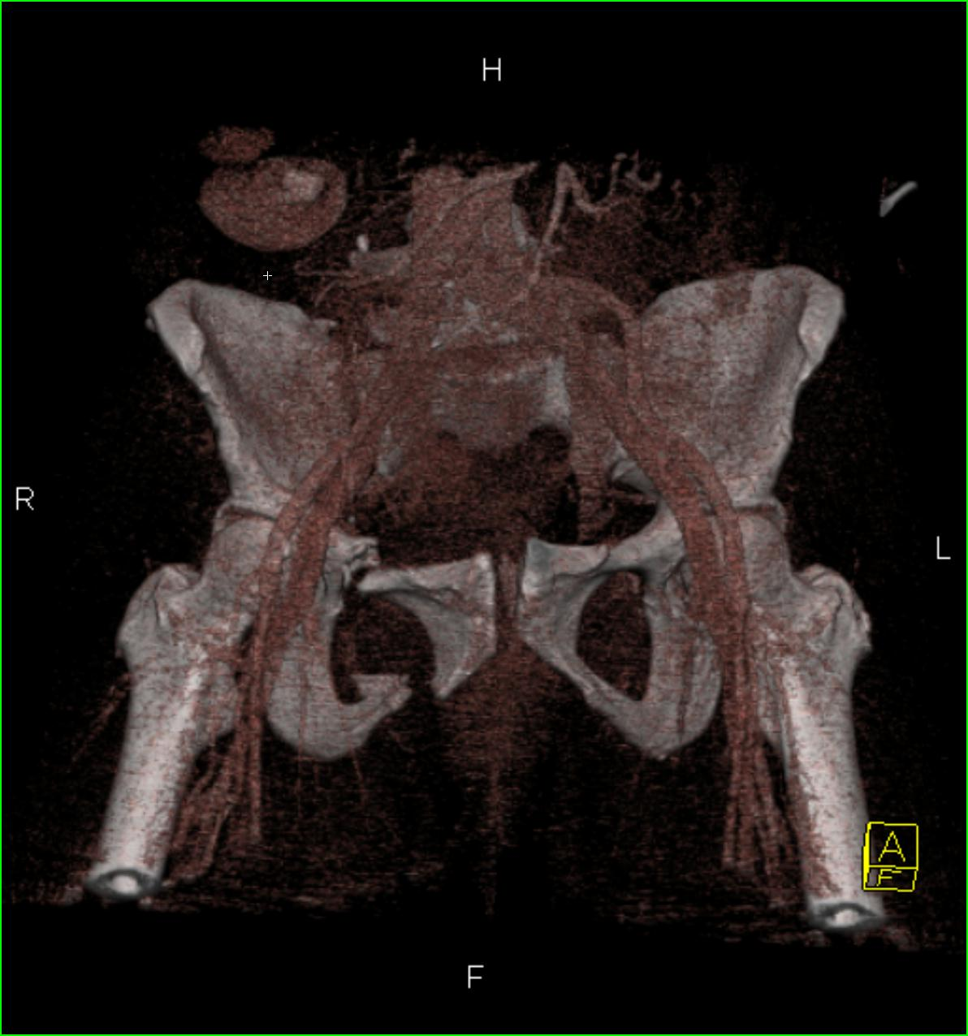
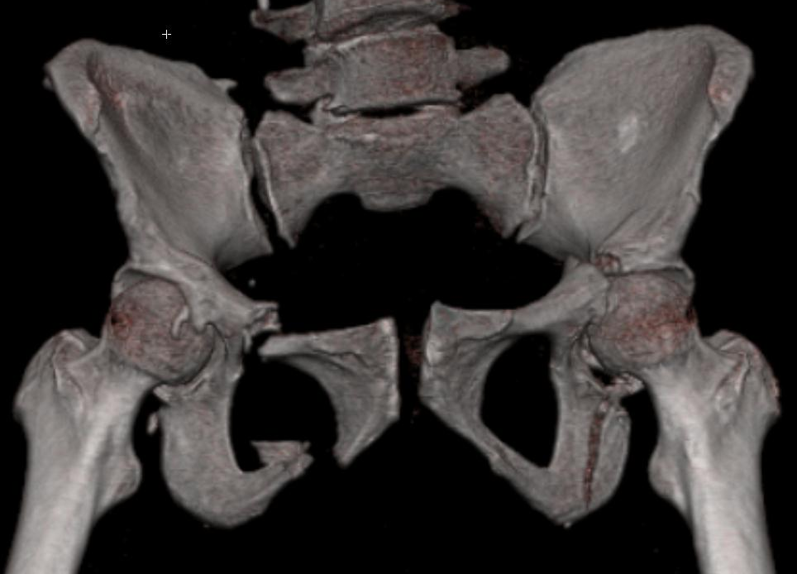

Slide 29
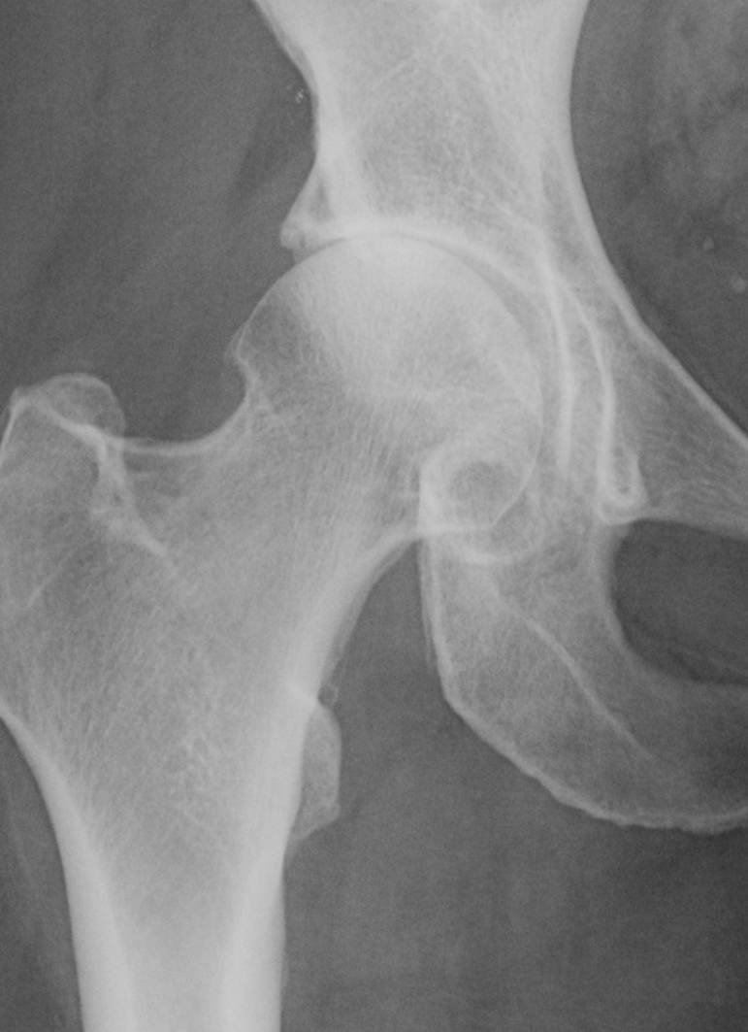
‘HIP’ FRACTURES AKA
PROXIMAL FEMUR FRACTURES
UBIQUITOUS MISUSE
‘HIP’ =S PROX. FEMUR + ACETABULUM
‘HIP FX’ =S PROXIMAL FEMORAL NECK FRACTURES
PROX. FEMUR: 14% ALL FXS
BUT
>50% ALL FX COSTS
USA

Slide 30
FEMORAL NECK FRACTURES
250,OOO/yr in US → $10 billion
Most relate to falls esp. elderly
Assoc’d with osteoporosis (WF), anything increasing risk of fall:
afib, hypoglycemia, seizures, neurologic deficit, diabetic neuropathy, slowed response time, decreased balance, deconditioning, diminished vision, …

Slide 31
PROXIMAL FEMUR FXS (‘HIP’)
By 80 YO: 10% Female, 5 % Male
90 YO: 1/3 F, 1/6 M
MORTALITY (DEATH):
up to 20% FIRST YEAR
33% BY YEAR 2
50% BY YEAR 3
HIGHEST RISK: “Co-Morbidities”:
VERY OLDEST, IMMOBILE, INSTITUTIONALIZED, OTHER PROBLEMS (SEIZURE, ARRYTHMIA), DEMENTIA

Slide 32
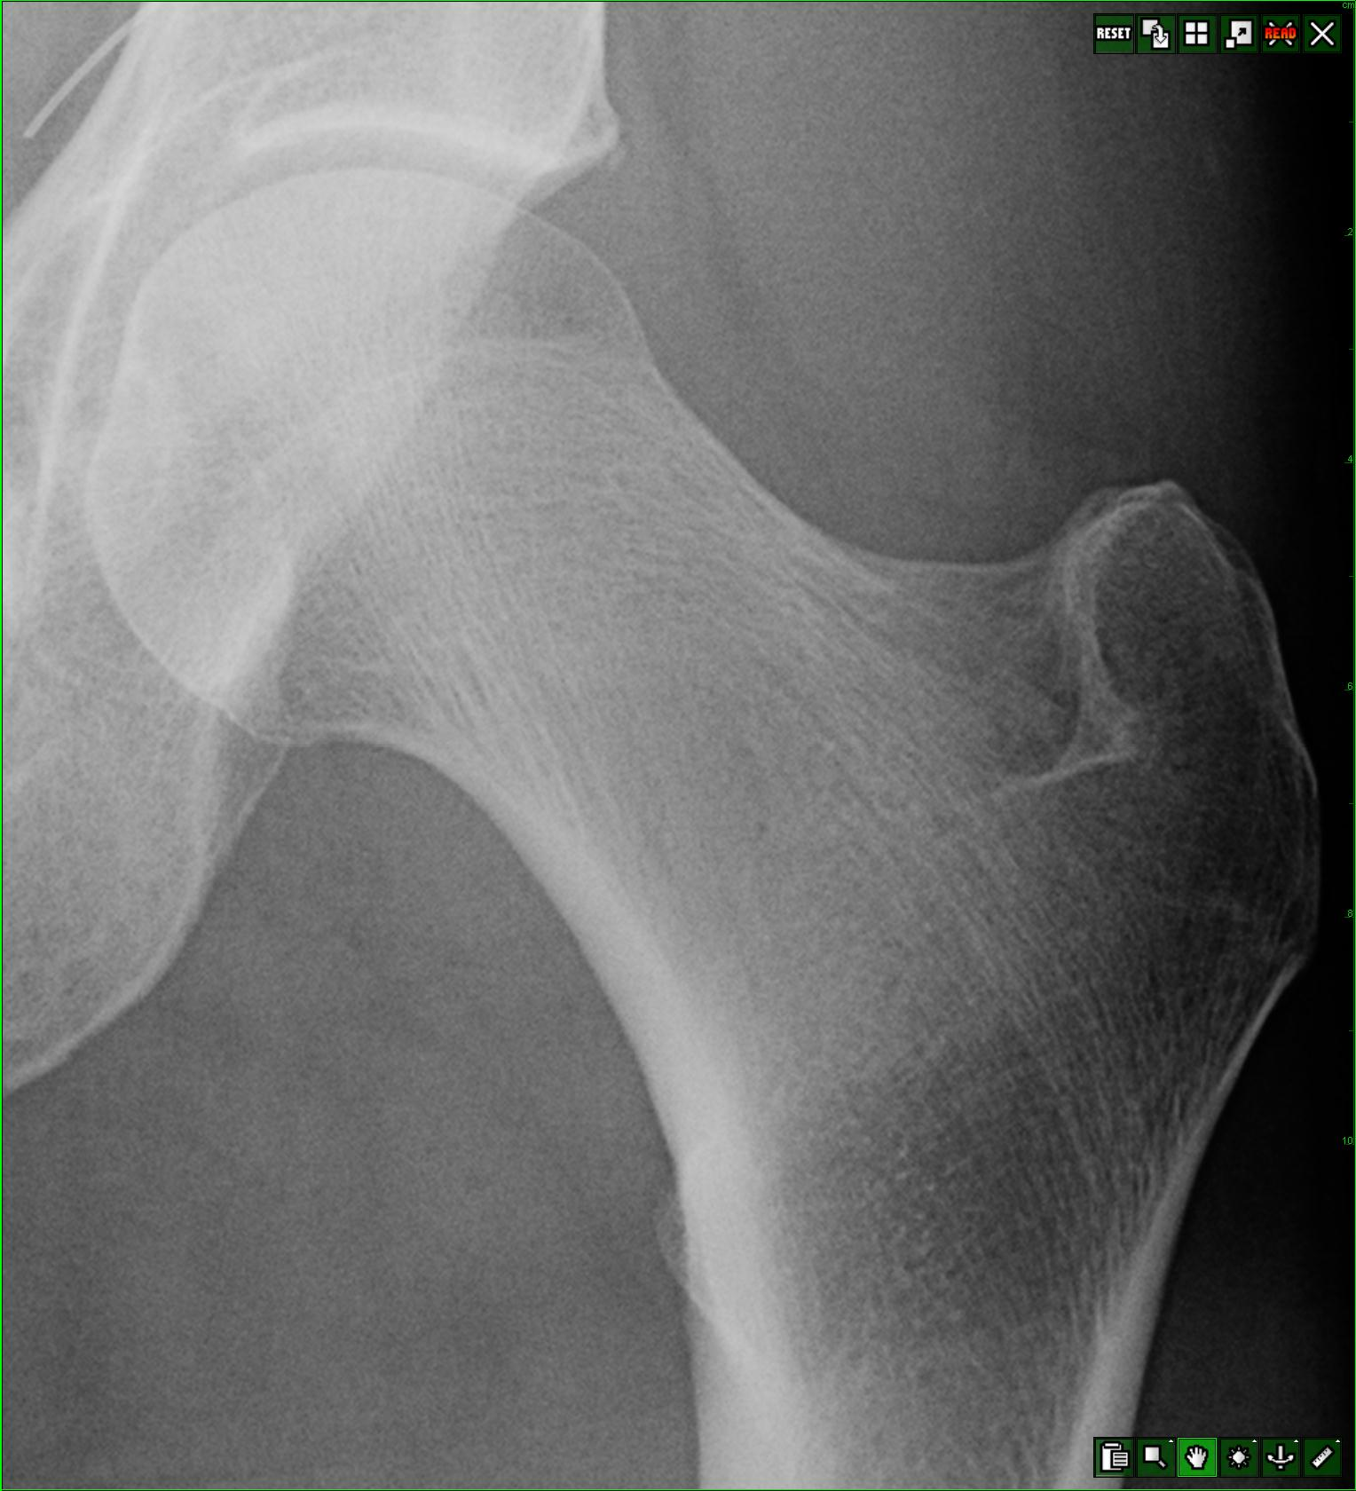
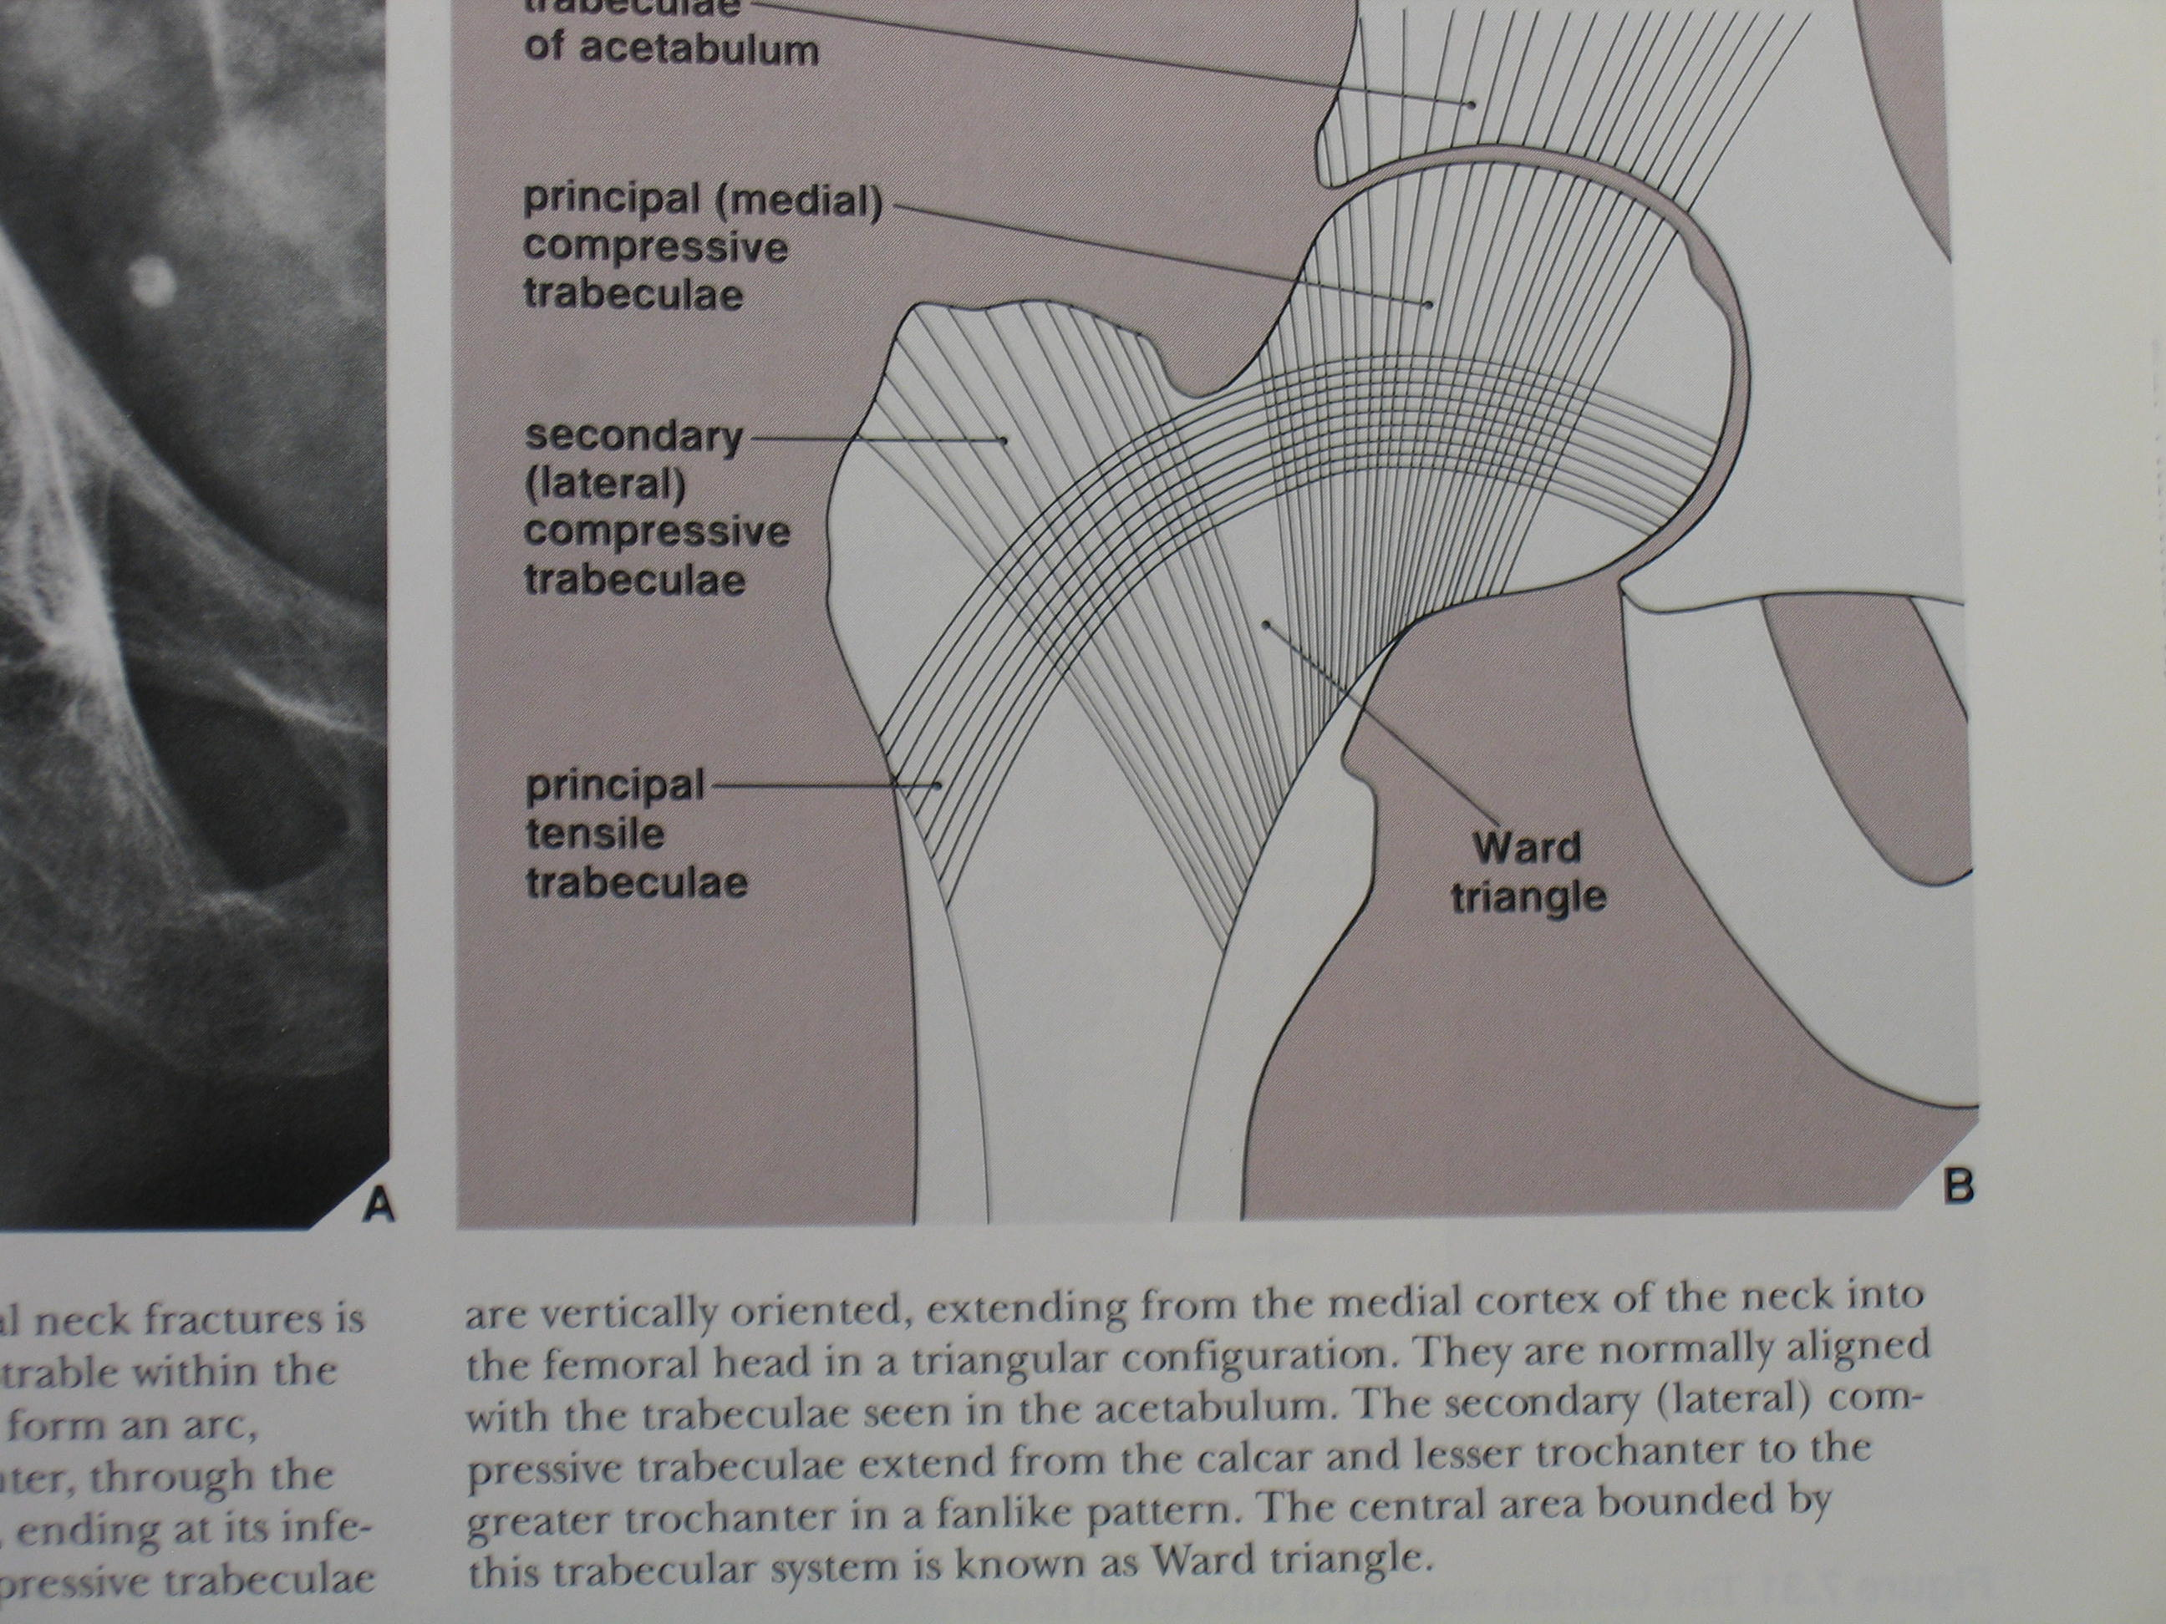
WEIGHT-BEARING TRABECULAE
Greenspan, A. Orthopedic Imaging, 3rd Ed.

Slide 33
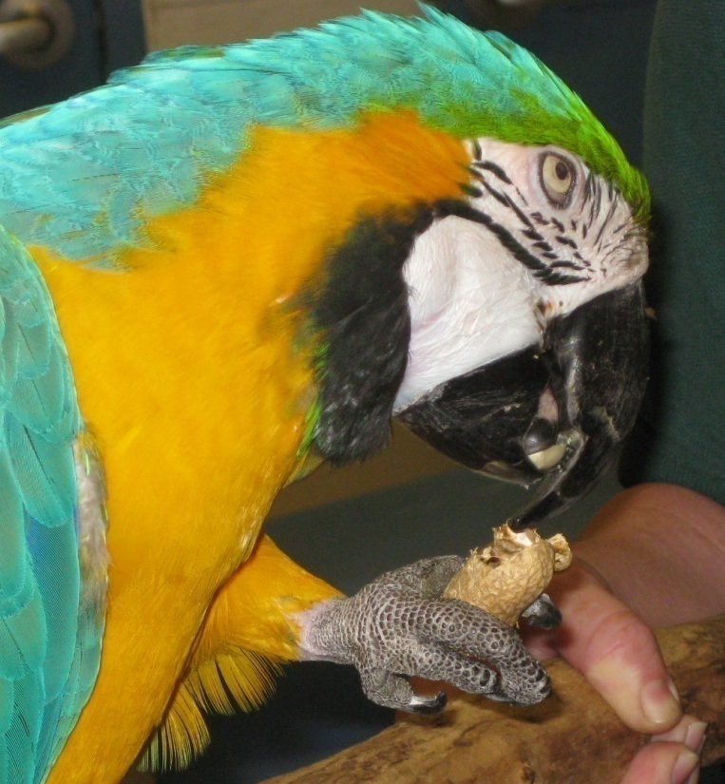
BIOMECHANICS IS DESTINY
“PEANUT SHAPED’ bones fracture through the waist when flexed
FEMORAL NECK is biconcave or ‘peanut shaped’
DOUBLE WHAMMY: retrograde blood supply
(Like talus, scaphoid)

Slide 34
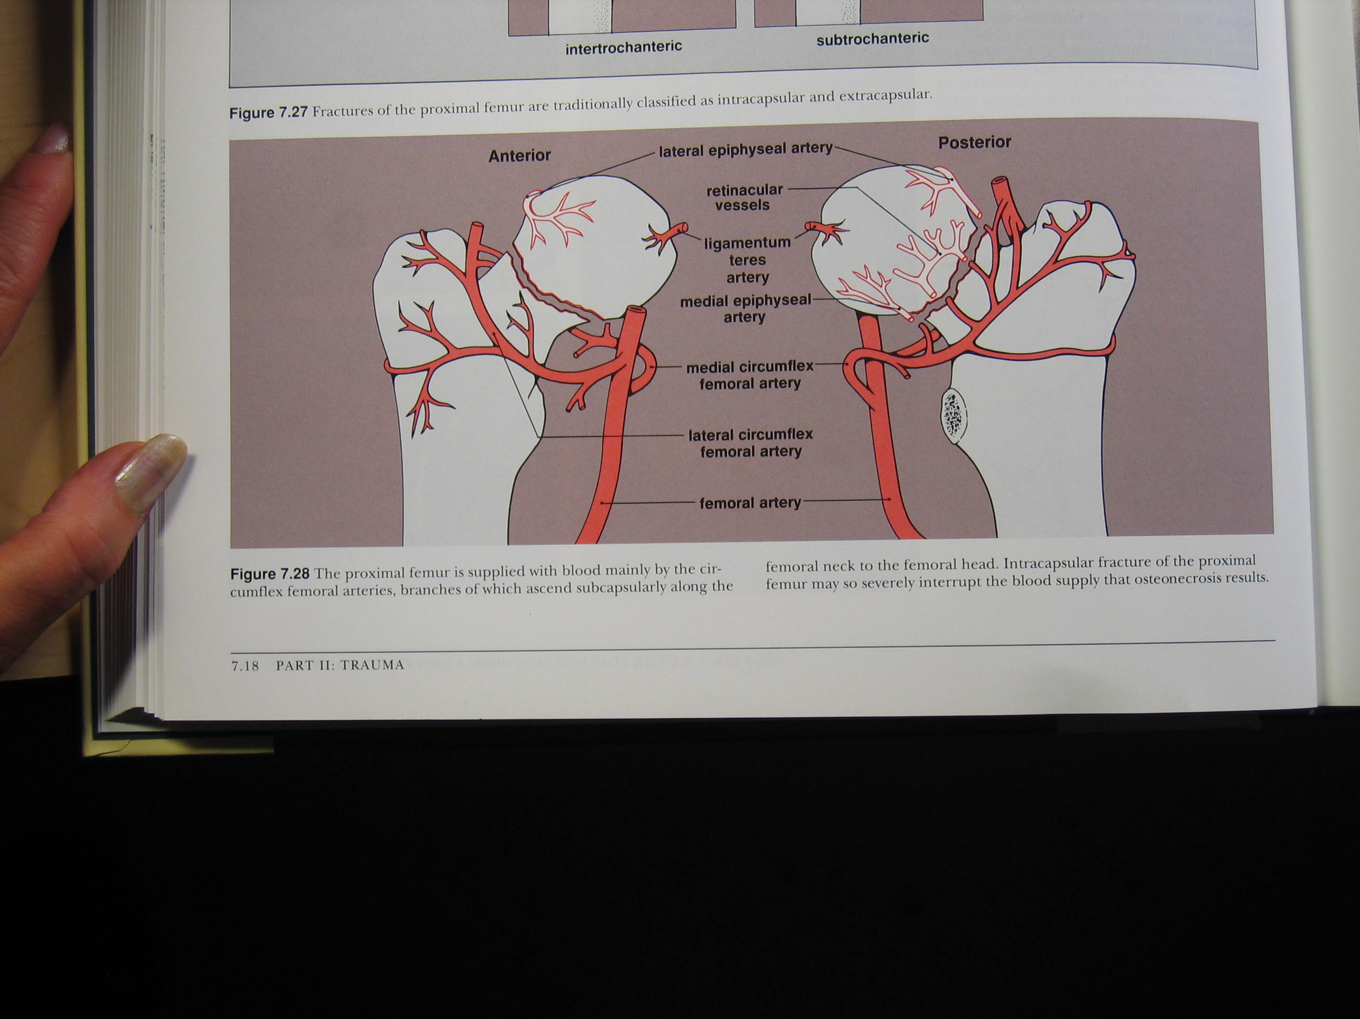
DIAGNOSIS AND TREATMENT-
IF YOU KNOW ANATOMY!
Greenspan, A. Orthopedic Imaging
3rd Ed.

Slide 35
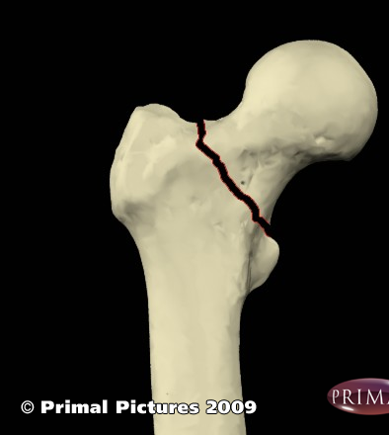
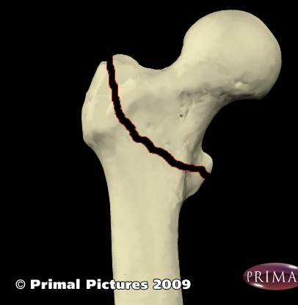
PROGNOSIS and TREATMENT
How will each fracture be treated??

Slide 36
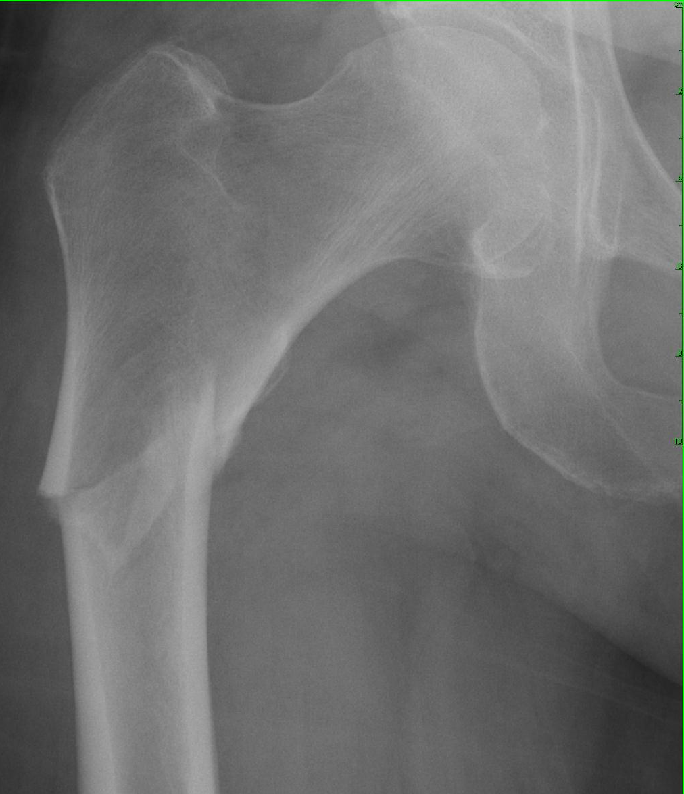
VASCULARITY DICTATES HEALING POTENTIAL
How will this be treated?? Surgery with excision, or chance to heal??

Slide 37
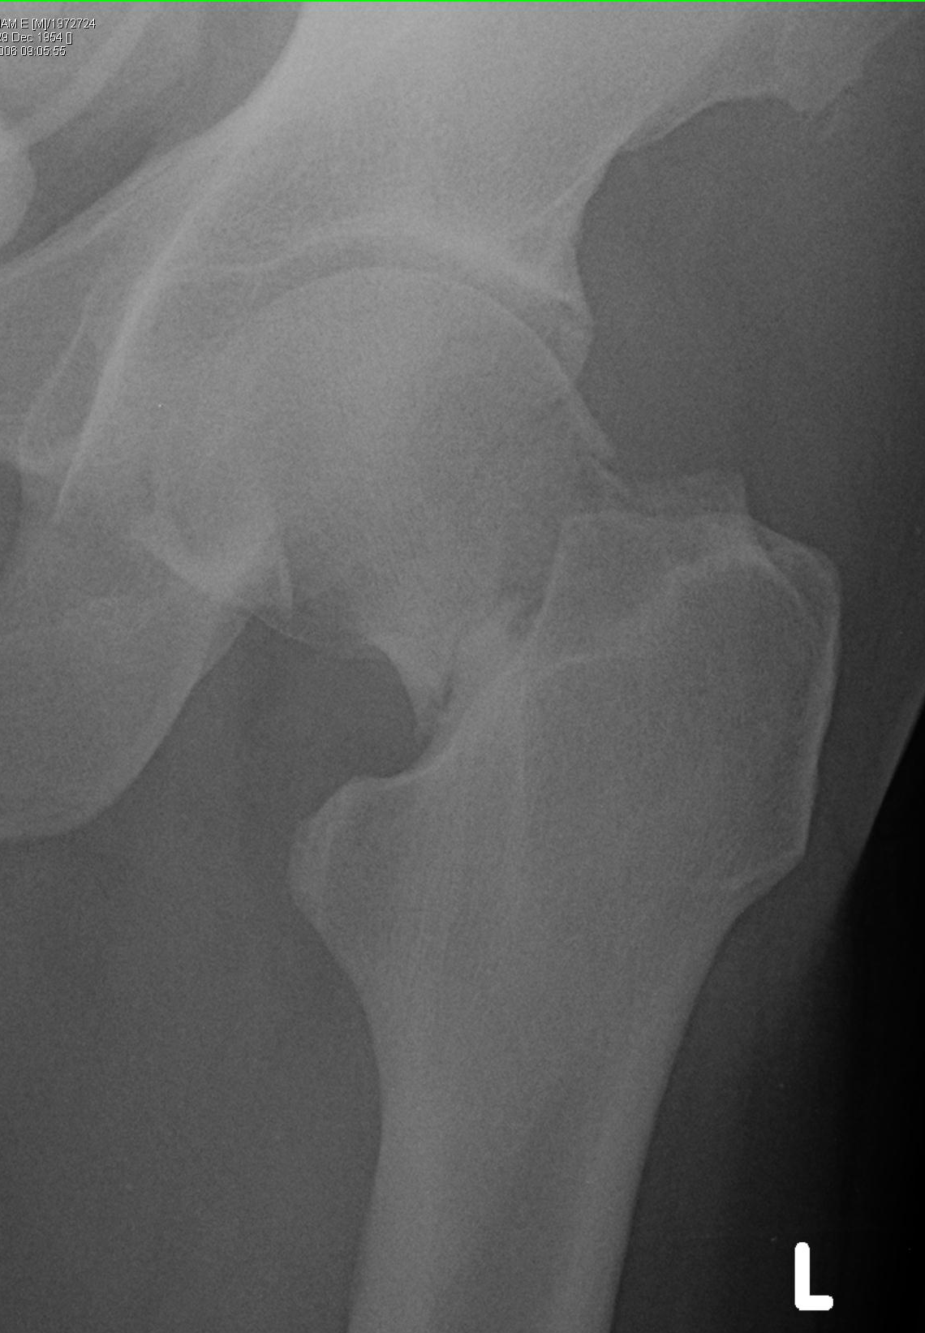
Appropriate treatment??

Slide 38
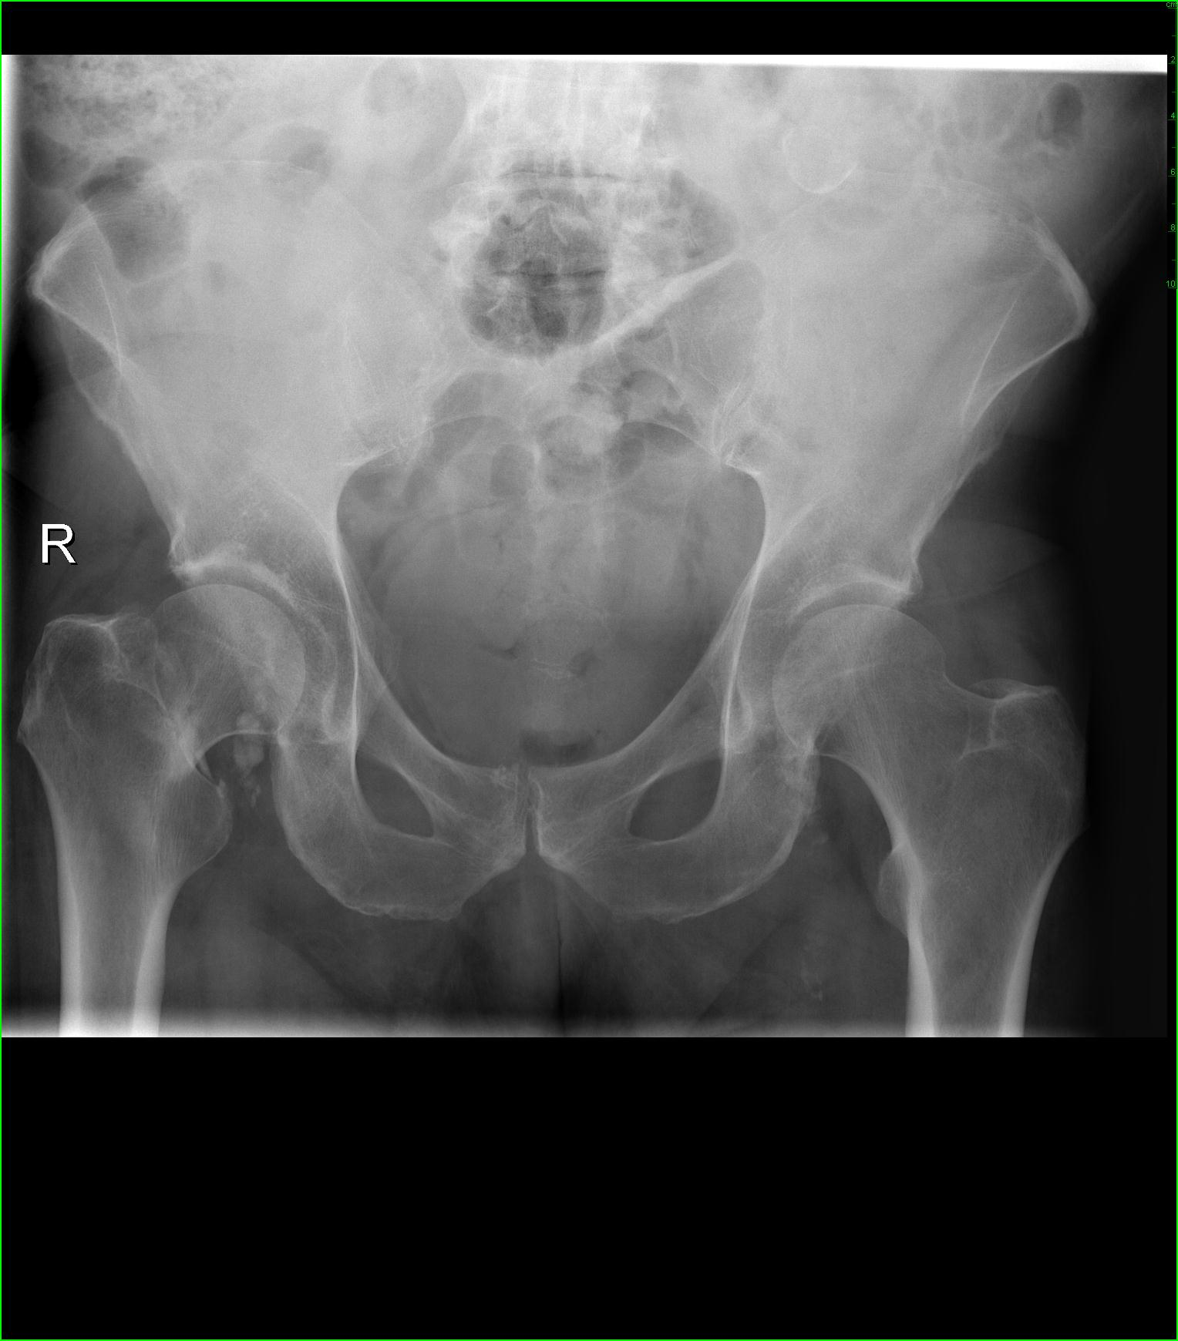
VASCULARITY IS DESTINY
How will this patient be treated? Replace the proximal femur, or give it a chance to heal??

Slide 39
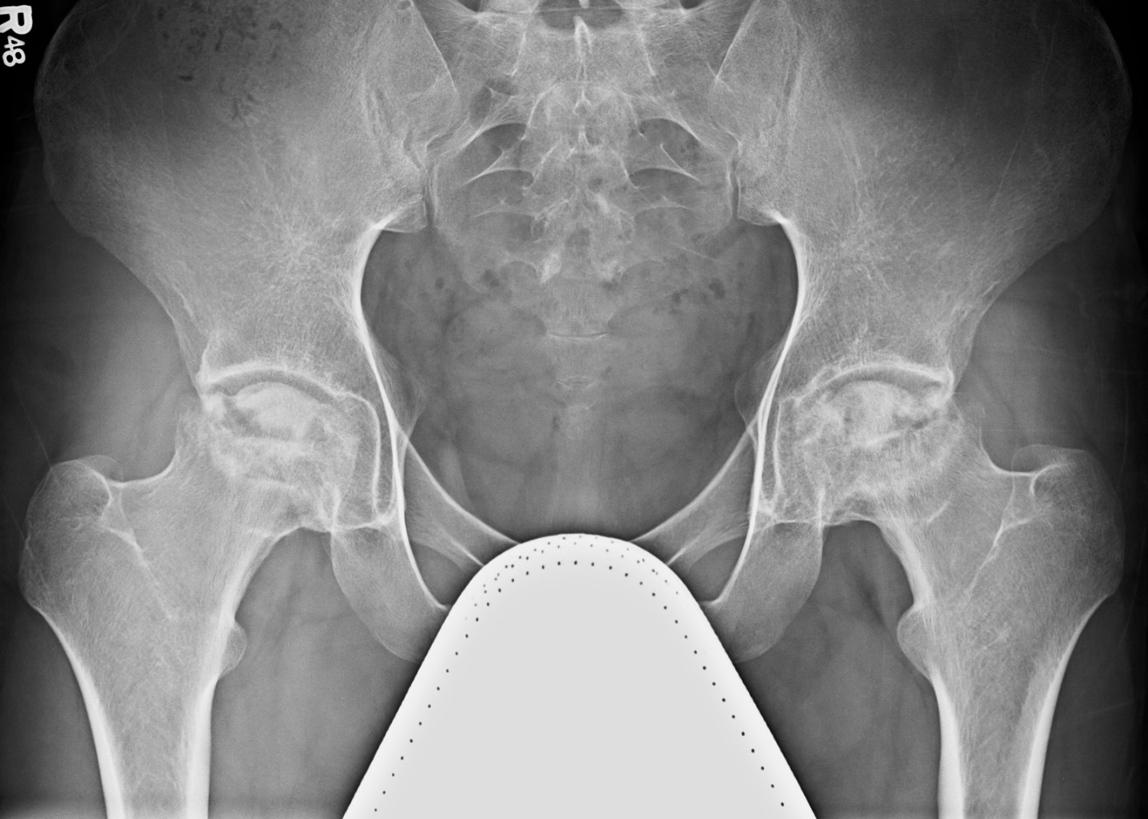
1) Describe the bony abnormality.
2) What is the white triangle over the symphysis?

Slide 40
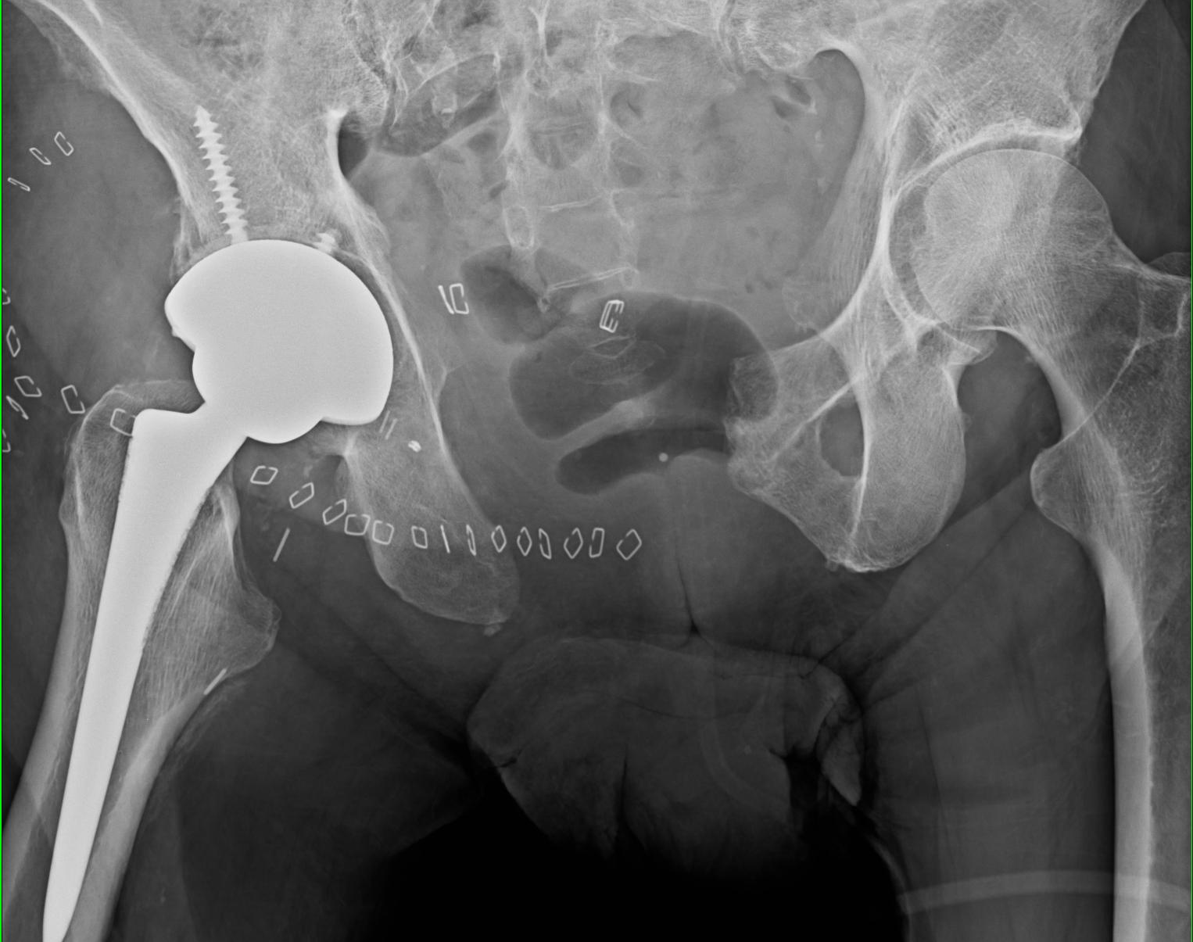
What is missing? Why might it be missing?

Slide 41
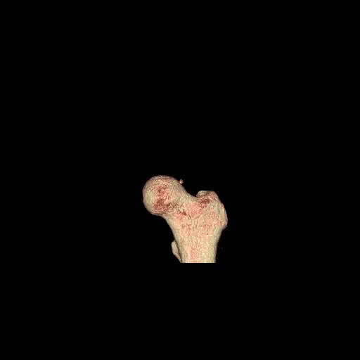

Slide 42
FX. HEALING: NON-WEIGHT-BEARING → PARTIAL WBg → (GRADUAL) FULL USE
IMMOBILIZED PT(STROKE,POLYTRAUMA): PHYSICAL THERAPY SIMULATES NORMAL USE: ‘REMIND’ MUSCLE, BONE OF END-GOAL; GUIDE NEW BONE FORMATION, HEALING, REMODELLING
DISUSE, NON WBg LEAD TO BONE LOSS (REVERSES W’S LAW)

Slide 43
UNKNOWNS
What is being illustrated in each image?
Something missing? Deformed?
If 2 images, what are the similarities/differences?
Are these “Worry” or “Don’t Worry” scenarios?

Slide 45
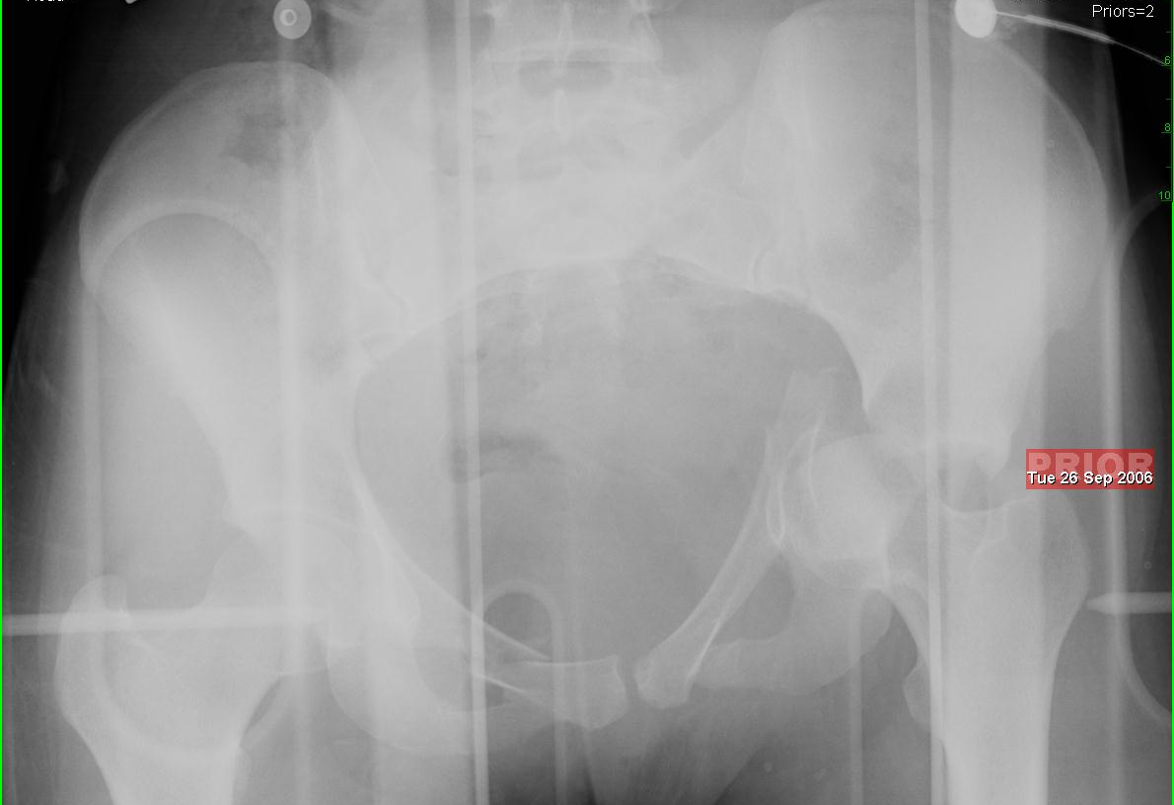
What happened here? What is the foreign matter??

Slide 46
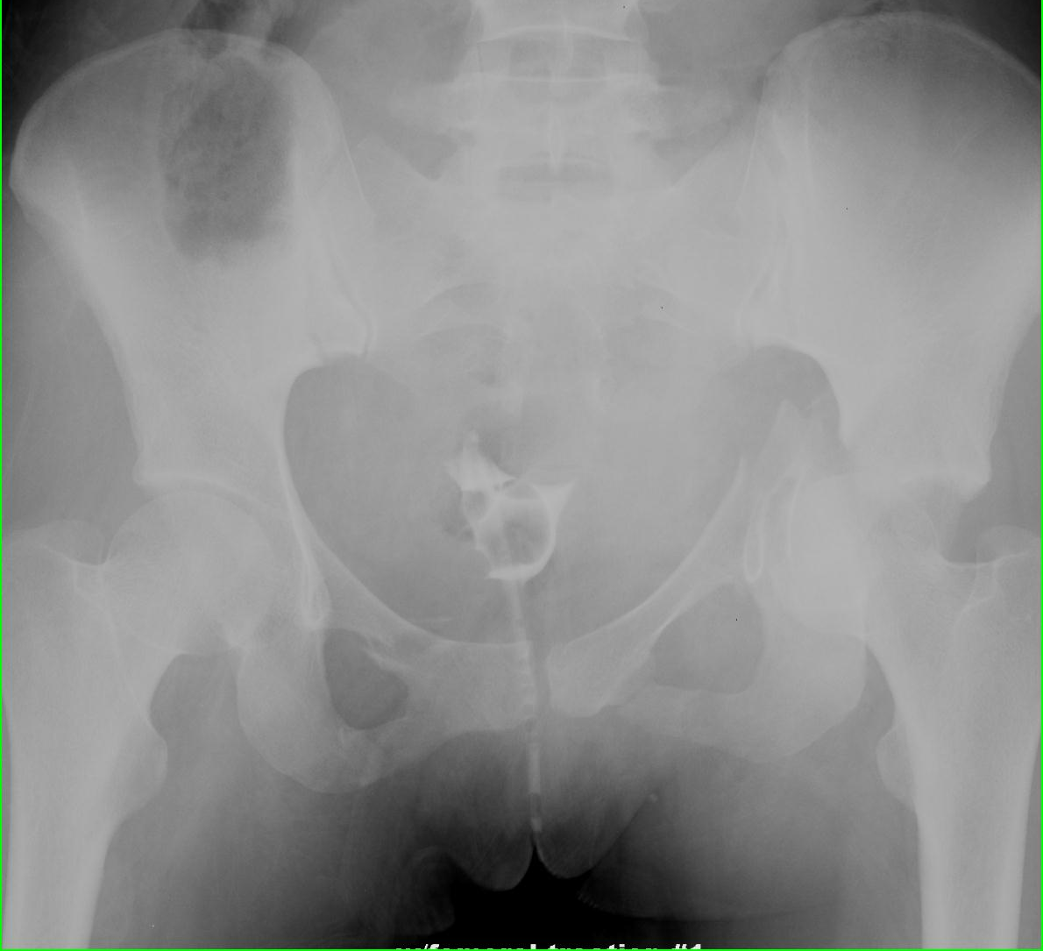
20 minutes later– what has changed?
What has been added??

Slide 47
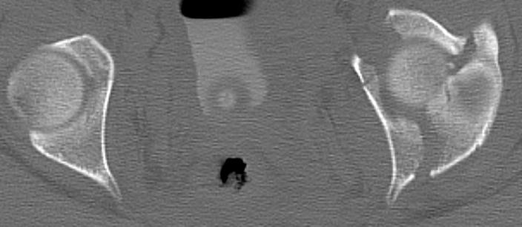
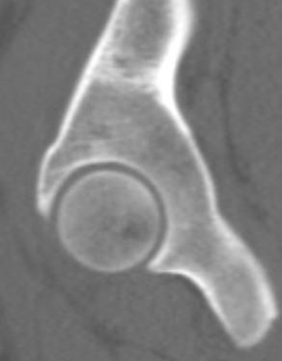



Slide 48



Slide 49


WHICH MAY HEAL FASTER?

Slide 50


Slide 51


Slide 52


Slide 53

www.TeamRads.com ; #TheRealTeamRads Instagram;
JH TeamRads on Facebook… keep comments coming!!

Slide 54



THANK YOU!
COMING SOON TO AN ANATOMY CLASS NEAR YOU Lower Extremity (LE) 9/8
Spine 9/15
dmagid@jhmi.edu

